Slide 1
How to Talk to a Conspiracy Theorist
Lecture 01: Introduction
The History of Conspiracy Theories
---
DR CHRISTOPHER DICARLO

Slide 2
Consider all of the relevant causal influences that have contributed to their particular states of mind.
Better enabled in understanding both the physical and cultural constraints which bias their particular points of view.

Slide 3
The History of Conspiracy Theories
From the earliest recorded conspiracy theories all the way to QAnon
Trends behind the surges of conspiracy theories through recorded history
// How to Talk to a Conspiracy Theorist

Slide 4
Everyone knows a conspiracy theorist.
It may even be you.
// How to Talk to a Conspiracy Theorist

Slide 5
Distinction
Folklore
Superstitions
Conspiracy Theories
Folklore
Often expressed in narratives, customs, rituals, foodways, proverbs, and rhymes.
Can include
Behaviors
Expressions
Beliefs involving magic
Popular belief
Omens
Folk religion
Planting signs
Hoodoo
Conjuration
Portents
Charms
Root work
Taboos
Old wives' tales
The supernatural and folk medicine

Slide 6
Distinction
Folklore
Superstitions
Conspiracy Theories
Folklore
Often expressed in narratives, customs, rituals, foodways, proverbs, and rhymes.
Can include
Behaviors
Expressions
Beliefs involving magic
Popular belief
Omens
Folk religion
Planting signs
Hoodoo
Conjuration
Portents
Charms
Root work
Taboos
Old wives' tales
The supernatural and folk medicine

Slide 7
Distinction
Folklore
Superstitions
Conspiracy Theories
Superstitions
A belief or practice resulting from ignorance, fear of the unknown, trust in magic or chance, or a false conception of causation
An irrational abject attitude of mind toward the supernatural, nature, or a notion maintained despite evidence to the contrary

Slide 8
Distinction
Folklore
Superstitions
Conspiracy Theories
Conspiracy Theories
Explanatory beliefs about a number of actors who join together in secret agreement, and try to achieve a hidden goal which is perceived as unlawful or malevolent.

Slide 9
Distinction
Folklore
Superstitions
Conspiracy Theories
Conspiracy beliefs are monological in nature
One conspiracy theory reinforces other conspiratorial ideas, making individuals who believe in one conspiracy theory more likely to also believe in other conspiracy theories.

Slide 10
Most likely
It is impossible to pinpoint exactly when conspiracy theories began.
Prior to recorded history
Xenophobia: Inherent fear of foreignness

Slide 11
One of the oldest recorded conspiracy theories occurred over two thousand years ago
Rome (331 BCE)
Alliance of upper-class women secretly preparing poisons
Prove their innocence
They claimed their concoctions were medicinal
2 suspects obliged
Mass arrests
170 women were found to be involved
Rome elected a dedicated official to perform a ritual banishment of evil

Slide 12
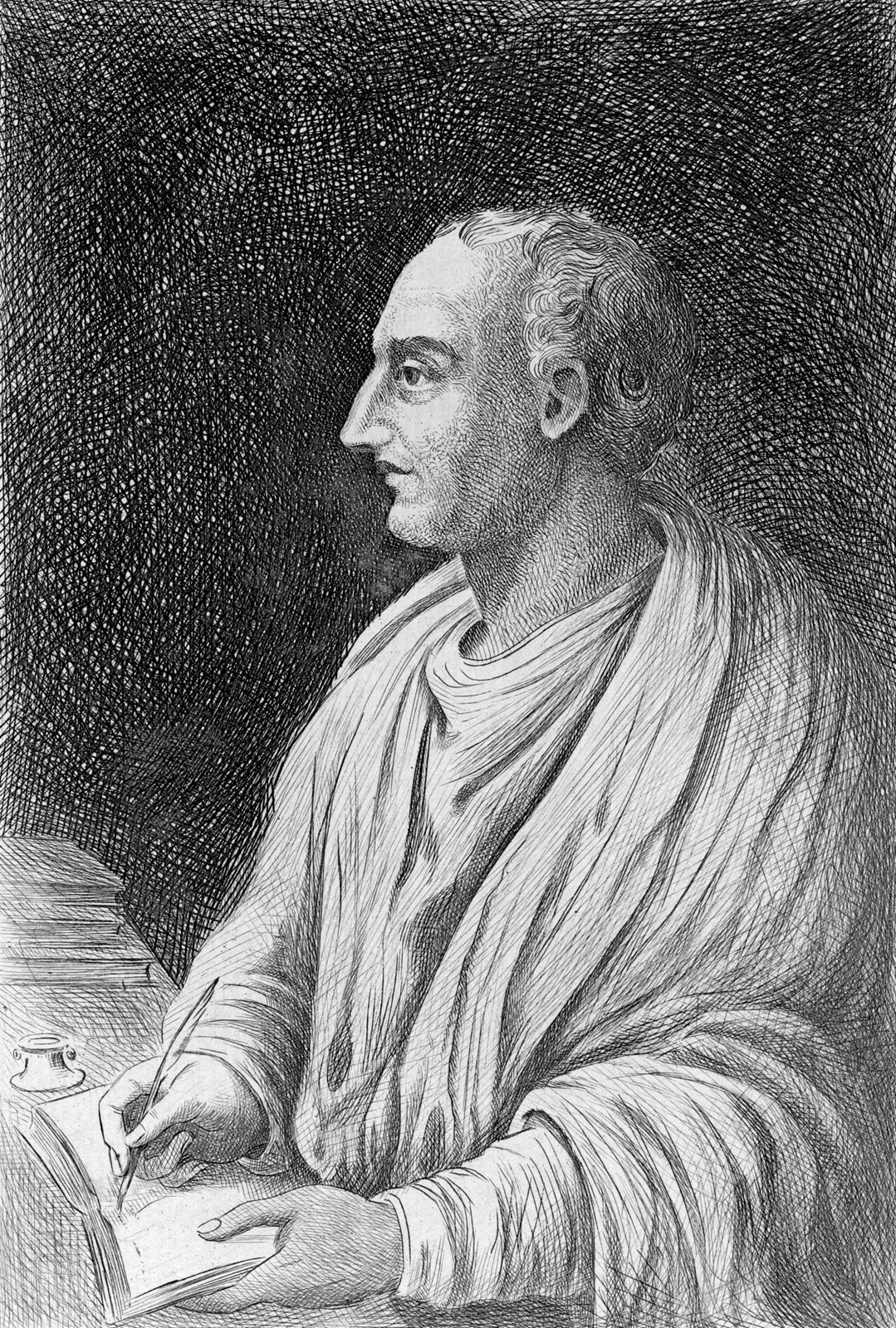
Hundreds of years later
Respected historian: Livy
Contemporary scholars
Epidemic
Possibly a virulent form of influenza
‘The fever of Perinthus’: Hippocrates
Group of women with high social rank
Curative potions: hemlock and aconite
History //

Slide 13
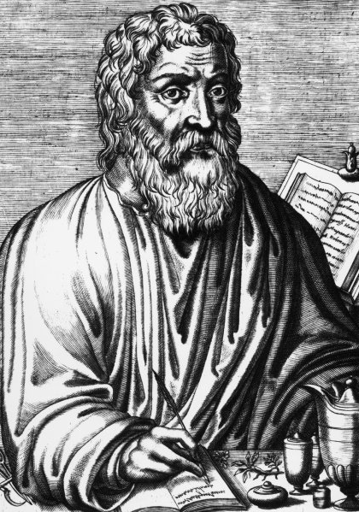
‘Fear of that which is foreign to us’ i.e Xenophobia
Black Death
European bubonic plague (1347-1351 CE)
Killed 200 million people
Jews were blamed for poisoning the wells
Fear and ignorance are often at the heart of such theories because survival is so important to us as a species
The truth: Yersinia pestis

Slide 14
Once the ‘Fear of that which is foreign to us’ has been reduced, the fear diminishes.
When levels of uncertainty and fear return
Epistemic state
Potentially dangerous
Societal Characteristics that Influence Conspiracy Theories
Covid-19 pandemic
Fertile ground for conspiracy theories
Powerlessness, anxiety, and uncertainty
Predictors of conspiracy beliefs
Uncertainty: What’s actually happening?
When will it end?
When will we have a vaccine?
How are things going to work when we re-open?

Slide 15
But when, exactly, did such theories start to become popular?
Written History: 5,000 years
Sumerian cuneiform script (2600 BCE)
Clay tablets, hieroglyphs carved in stone, wax tablets, papyrus scrolls, parchment, etc

Slide 16
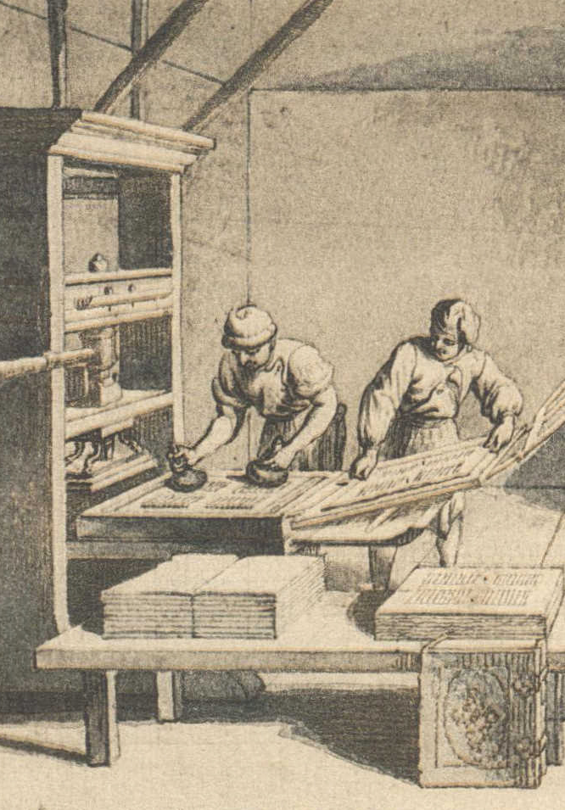
Books (840 CE)
Libraries of cloistered monasteries throughout Europe
Dynasties in China
Printing press (1000 CE)

Slide 17
Developed by Bi Sheng from Yingshan, Hubei, China (970 - 1051 CE)
Southern Song Dynasty (1127 - 1279 CE)
Books becoming so common in Chinese society
Created a scholarly class of citizens

Slide 18
Large printed book collections became a status symbol for the wealthy class
Wang Chen used wood blocks as type (1297 CE)
Nung Shu (1297 CE)
World’s first mass-produced book
Revealed that many Chinese inventions were often wrongly attributed to Europeans

Slide 19
Printing Press (1440 CE)
Johannes Gutenberg
Replica casting
Developed his own ink which would adhere to metal rather than wood
Perfected a method for flattening printing paper by using a winepress
Wide production of printing presses
Greater literacy
Greater distribution of ideas

Slide 20
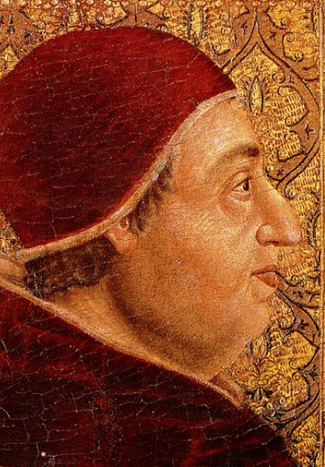
Pope Alexander VI (1501)
Promised excommunication for anyone who printed manuscripts without the church’s approval
20 years later books from John Calvin and Martin Luther spread
Copernicus: On the Revolutions of Heavenly Spheres
Relation (1605)
The first official newspaper, was printed and distributed in Strasbourg
The growth of literacy, education, and the far-reaching availability of uniform information for ordinary people

Slide 21
Wide availability of information

Slide 22
The wide distribution of information in this printed form also generated a proliferation of false information as well.
A newly “literate public where anonymously written statements can be circulated”.
Conspiracy theories are not particular to any one, specific, geographic location.

Slide 23
Conspiracy theories are simply a part of human nature.
Major calamities

Slide 24
Salem Witch Trials (1692)
Largely the result of fear, ignorance, and hysteria
Michael Butter says between the 17th century and the 1950s, such fantastic stories were a universally accepted way of understanding the world
Old school: subversives trying to undermine established power
Today: the all-powerful state and its mastermind cronies want to control the humble citizen
Greater availability of information + calamities = conspiracy theories

Slide 25
Age of Enlightenment
Introduced mechanical view of the universe
During the 18th and 19th centuries, approximately 90% of the population likely subscribed to some kind of conspiracy
Today: approximately 50% of US citizens and more than a quarter of the German population believe in conspiracy theories
Is someone you know is a conspiracist?
How about you?
A good skeptic

Slide 26
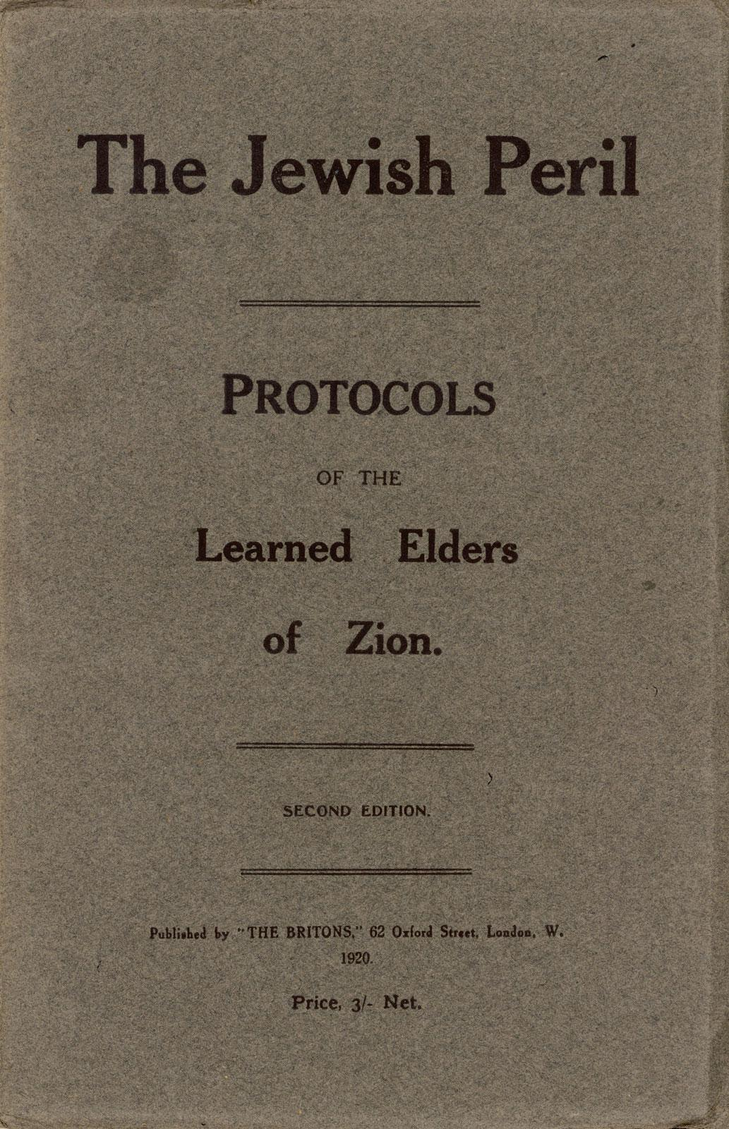
Anti-semitism in Europe (19th - 20th centuries)
Jewish Bankers in Europe (19th century)
The Protocols of the Elders of Zion (1903)
Jews supposedly ran the world of money, finance and media, and would stop at nothing to increase this power
Henry Ford
500,000 copies

Slide 27
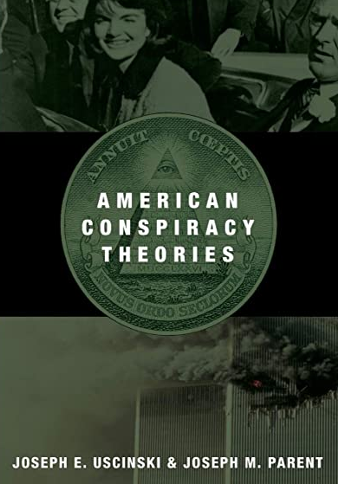
Over the last 100 years...
Joseph Uscinski and Joseph Parent
104,803 published letters
1890 - 2010
Prevalence of conspiracy theories
The first spike occurred shortly before the year 1900
Height of the second industrial revolution
The second spike occurred during the late 1940s and the early 1950s
Cold War
McCarthyism
Context

Slide 28
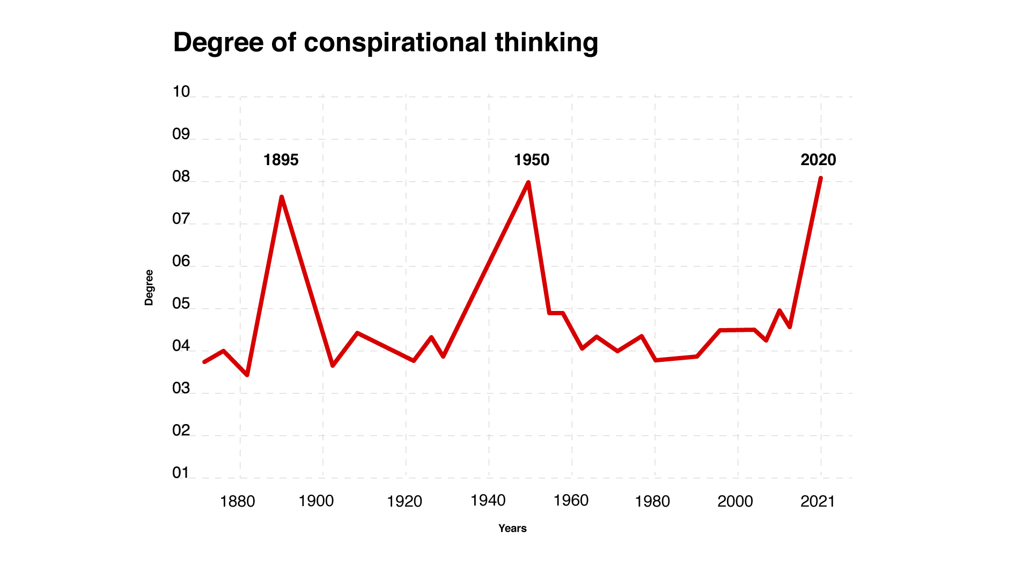

Slide 29
Most conspiracy theories fall into fairly discrete categories:
100 Years of Conspiracy Theories
Aviation
Business and industry
Deaths and disappearance
Economics and society
Espionage
Ethnicity/race and religion

Slide 30
Most conspiracy theories fall into fairly discrete categories:
100 Years of Conspiracy Theories
Extraterrestrials and UFOs
Government politics and conflict
Medicine
Science and technology
Space agencies
Sports

Slide 31
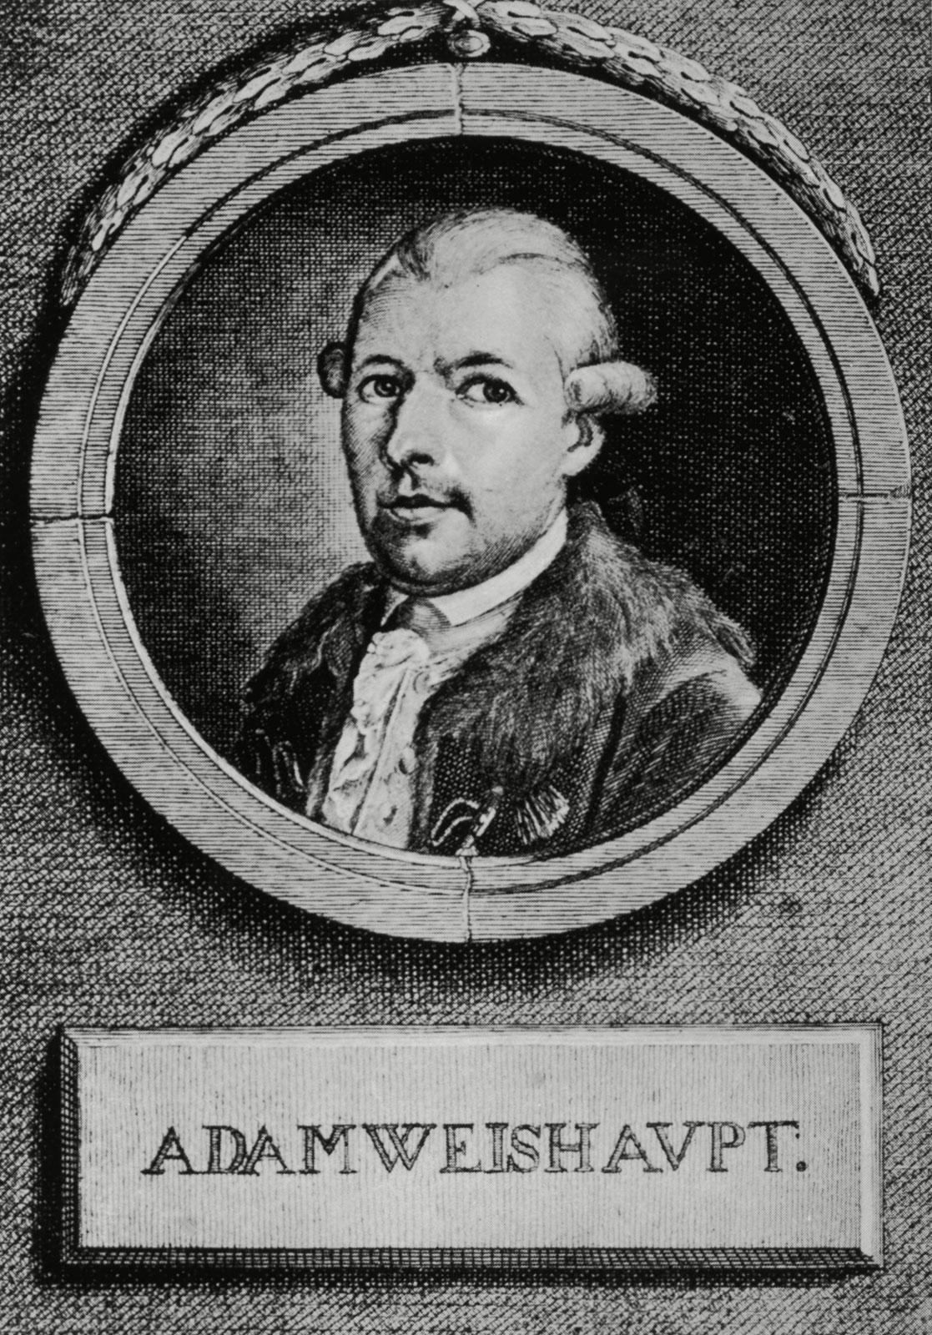
The Illuminati
The Illuminati was a real and arguably noble group at one time
Born of the The Enlightenment, the Bavarian Illuminati consisted of intellectuals, politicians, writers, philosophers, and poets
Founded by Professor Adam Weishaupt in Bavaria on May 1, 1776
Cast aside organized religion in favour of a new form of “illumination” through reason
Jesuits (he was a former member), the Mysteries of the Seven Sages of Memphis, the Kabbalah and freemasons

Slide 32
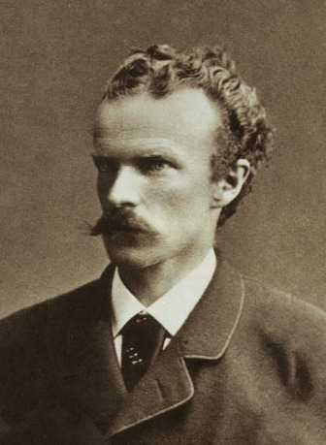
Bavarian Illuminati, referred to as “Perfectibilists”
All communication was in cipher and members were given classical nicknames
What happened to the Illuminati?
The organization prospered for 11 years before being disbanded by Karl Theodor of Bavaria
French Revolution -> Assassination of JFK
Dan Brown’s Angels & Demons and Umberto Eco’s Foucault’s Pendulum

Slide 33
Their pursuits seemed quite noble as they set out...
To oppose superstition, obscurantism, religious influence over public life, and abuses of state power
Put an end to the machinations of the purveyors of injustice, to control them without dominating them
Today belief in ‘The Illuminati’ means something quite different
New World Order (NWO)

Slide 34
A secretive power elite with a globalist agenda
Rule the world through an authoritarian world government
Replace sovereign nation-states
Culmination of history's progress
A cabal
An ongoing plot to achieve world domination

Slide 35
What is a cabal?
A group of individuals
Share common viewpoints
Gather, often in secret
Commonly-held views or interests which form an ideology
Supportive community
Political ties, control, secrecy, and conspiracy theories

Slide 36
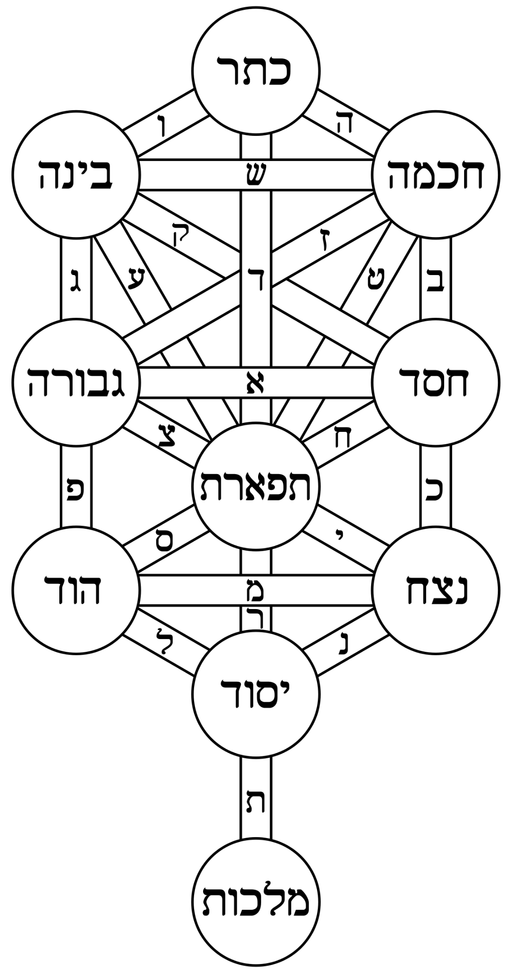
Etymology
Jewish // Kabbalah (קַבָּלָה) "reception" or "acceptance"
European Christian culture // occult doctrines and secrecy
French // cabale
Medieval Latin // cabbala
Small political cliques
Folk // Sir Thomas Clifford, Lord Arlington, the Duke of Buckingham, Lord Ashley, and Lord Lauderdale CABAL
Folk etymology

Slide 37
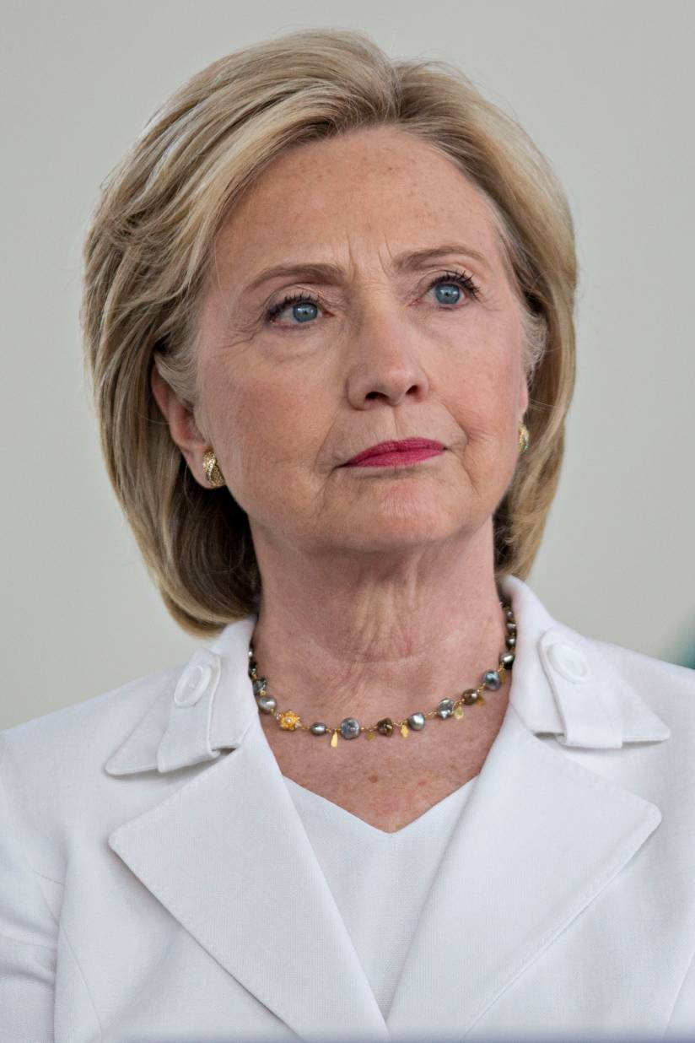
Qanoners believe in a secretive deep state Satanic cabal
Hillary Clinton, Nancy Pelosi, Barack Obama, and Chuck Schumer
Operate a child prostitution ring
Drink the blood of aborted fetuses to consume adrenochrome in an effort to maintain perpetual youth
Denver Airport
Underground buildings

Slide 38
The Illuminati (NWO) and The Hippy Movement
LSD and interest in Eastern philosophy
Principia Discordia
Discordianism
Worship Eris (goddess of chaos)
To cause civil disobedience, practical jokes and hoaxes
Such miscreant activities could bring about social change and force individuals to question the parameters of reality
Robert Anton Wilson

Slide 39
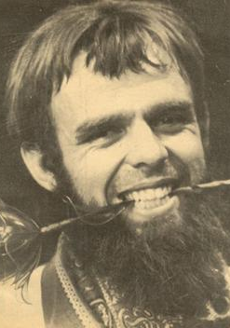
Kerry Thornley
Spread disinformation
Invented a secret society
Started writing letters to the men's magazine Playboy
Then wrote contrary letters
To confuse, bewilder, and spread misinformation
Backfired: instead of jarring readers into a realm of philosophical and political doubt, it convinced them that such a society was real

Slide 40
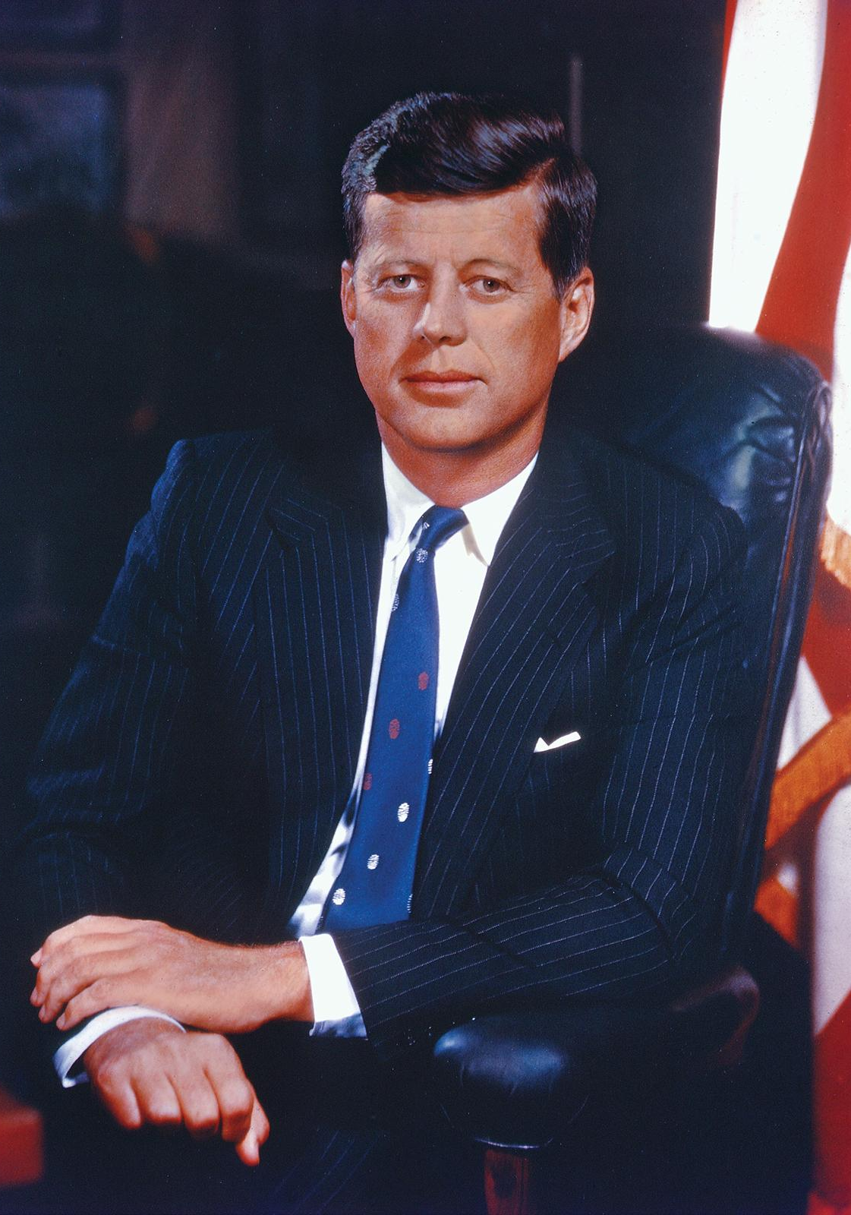
The Illuminatus! Trilogy
Jay-Z and Beyoncé
The Illuminati triangle
John F. Kennedy Assassination (Nov 22, 1963)
Struck by two bullets — one in the head, one in the neck — while riding in an open-topped limo through Dealey Plaza in Dallas.
Lee Harvey Oswald was charged with killing him, and a presidential commission headed by Chief Justice Earl Warren found that Oswald acted alone

Slide 41
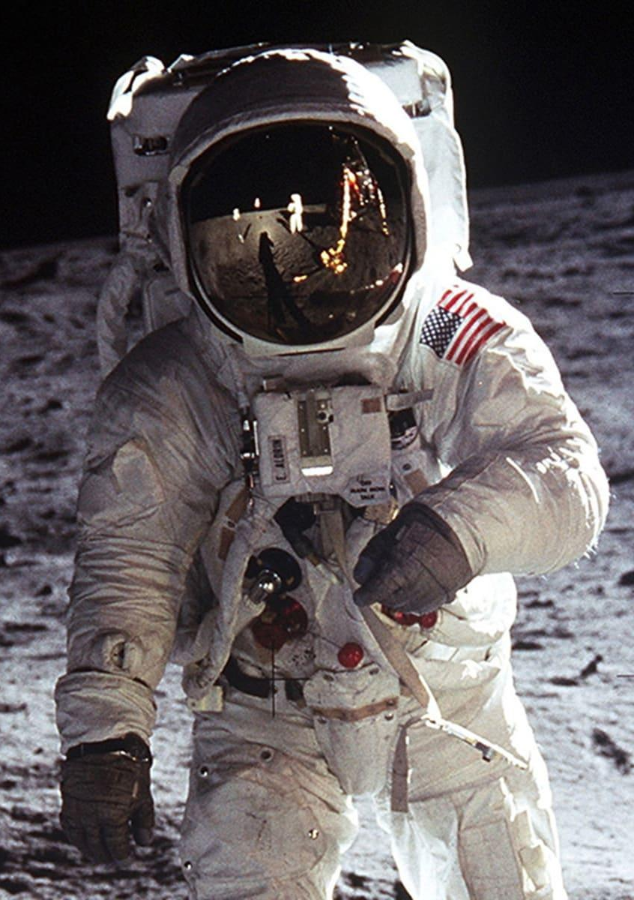
Faked moon landing
Apollo 11 launched from Cape Kennedy on July 16, 1969, carrying Commander Neil Armstrong, Command Module Pilot Michael Collins and Lunar Module Pilot Edwin "Buzz" Aldrin into an initial Earth-orbit of 114 by 116 miles
An estimated 650 million people watched Armstrong's televised image and heard his voice describe the event as he took "one small step for a man, one giant leap for mankind" on July 20, 1969

Slide 42
Chemtrails
SLAP Secret Large-scale Atmospheric Program
This theory alleges that water condensation trails ("contrails") from aircraft consist of chemical or biological agents
Supposedly contain toxic mix of aluminum, strontium, and barium
Secret Government policies
17% world population believe this to be true

Slide 43
UFOs / Area 51
Extraterrestrial alien life
Government cover-ups
9/11
An inside job
Controlled demolitions
Sandy Hook
A 2012 fatal mass shooting at Sandy Hook Elementary School in Newtown, Connecticut
A manufactured event with the aim of promoting gun control
David Duke
Alex Jones
Rush Limbaugh

Slide 44
Jeffrey Epstein’s death
Connections to Donald Trump, Bill Clinton
Anti-vaxxers
Vaccines cause autism
‘Mr.’ Andrew Wakefield
Rob Schneider, Jenny McCarthy, and ex-U.S. President Donald Trump

Slide 45
QAnon
Far-right conspiracy theory
A cabal of Satan-worshiping pedophiles running a global child sex-trafficking ring
Plotting against President Donald Trump
Trump planning day of reckoning aka “The Storm”
No part of the theory is based on fact
‘Q’ = Q clearance
QAnon believers commonly tag their social media posts with the hashtag #WWG1WGA, signifying the motto "Where We Go One, We Go All"

Slide 46
Flat Earthers
American software consultant Mark Sargent
YouTube videos
The earth is not a sphere
But a disc
Anti-NASA
GPS devices are rigged
Moon landing, pics from outer space = Fake
Violation of Occam’s Razor

Slide 47
From India The Love Jihad
Good-looking Muslim males are infiltrating Indian regions to woo young Hindu women away from their families, culture, and religion
Hindu women must denounce their religion, join the Islamic faith, and start producing babies
Believed by an overwhelming number of Indian citizens
Written into law
‘Love Jihad’ is a term used by fringe right-wing radical Hindu groups

Slide 48
Events happening worldwide are nurturing underlying emotions.
Feelings of anxiety make people think more conspiratorially.
Conspiracy theories can provide comfort by identifying a convenient scapegoat.

Slide 49
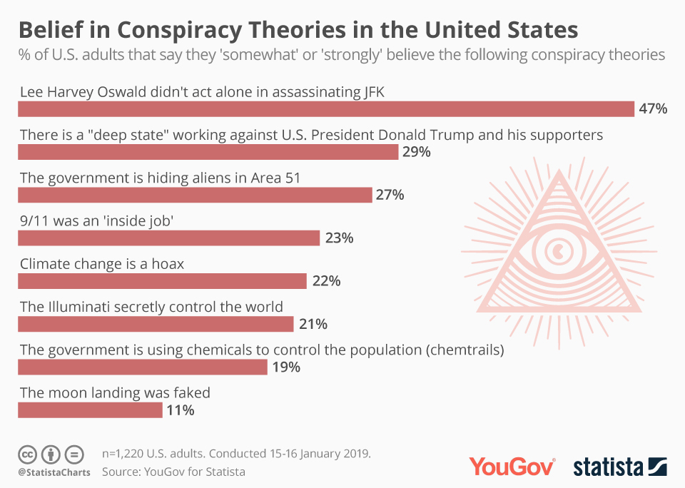

Slide 50
Q&A session

Slide 51
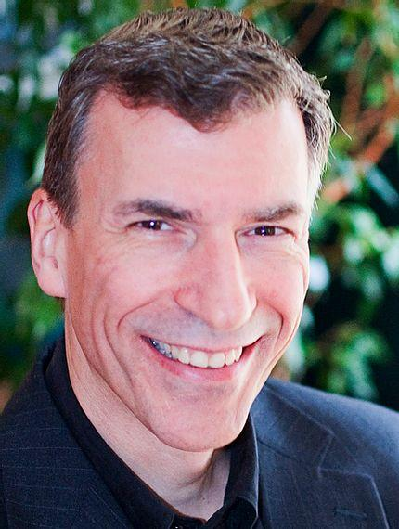
Thank you

