Slide 1
The ABC’s
of Critical Thinking
in Six Steps
Dr. Christopher DiCarlo
www.criticalthinkingsolutions.ca

Slide 2
The ABC’s of Critical Thinking
What is Critical Thinking?
Careful reflection on how and why you believe what you do?
How is Critical Thinking done?
By analyzing information according to a specific skill set
Why is Critical Thinking important?
Because what you think often influences how you behave which affects others whose beliefs and actions affect you.

Slide 3
The ABC’s of Critical Thinking
The ABCs (DEFs) of Critical Thinking
A is for Argument
B is for Bias
C is for Context
D is for Diagramming
E is for Evidence
F is for Fallacies

Slide 4
The ABC’s of Critical Thinking
A is for Argument
What comes to mind when you think of the word ‘argument’?
Anger, yelling, screaming…?
Monty Python: “Is this the right room for an argument?”
In Critical Thinking, an argument is a good thing
But what is it?
An argument is the way you put together or structure your ideas, opinions, or beliefs so that people will better understand what it is you’re trying to say.

Slide 5
The ABC’s of Critical Thinking
The structure of an argument: A main point and reasons that support it
Premise(s) + Conclusion = Argument
The Moon Landing was a hoax
9-11: A government conspiracy
Vaccines cause autism
“I believe x because…a, b, c…etc.”
Whatever your opinions, beliefs, ideas, or understandings, you need to realize that unless you can formulate them into arguments, you have nothing more than unjustified opinions (Jerry Springer, The View, etc.)

Slide 6
The ABC’s of Critical Thinking
When it comes to arguments, you need to think of a house
Your conclusion is your roof
Your walls (premises) support your roof
And your foundation is universal criteria
Consistency
Simplicity
Reliability
Relevance
Sufficiency

Slide 7
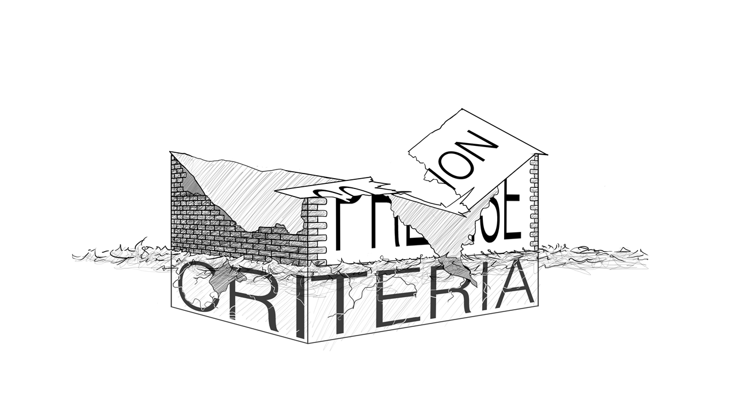
The ABC’s of Critical Thinking
If your premises fail to satisfy the foundational universal criteria…

Slide 8
The ABC’s of Critical Thinking
Types of Reasoning: Deductive, Inductive, Deductive
Deductive: CSI, Law and Order, House, The Good Doctor, etc.
Board games: Clue, Guess Who?
Father Bridgeman and Senator Donna Grainger
In deductive reasoning, the conclusion is guaranteed by the premises; it cannot be otherwise

Slide 9
The ABC’s of Critical Thinking
Inductive Reasoning
Conclusions are not logically valid but warranted or reasonable or probable
Hallmark of scientific reasoning
Uses statistical generalizations
Example: Likelihood of a dropped keys falling downwards in class?
Abductive Reasoning: Ignaz Semmelweis
A is for Argument

Slide 10
The ABC’s of Critical Thinking
B is for Biases
A bias is a way in which a person is influenced in order to understand and act on particular types of information
Consider many of the relevant factors that influence the ways in which we and others see and understand the world

Slide 11
The ABC’s of Critical Thinking
Is Donald Trump a good U.S. President?
How you answer this and many of life’s important questions are the result of your biases
Biological Biases: Genetics, neuropsychology, emotions, sex, age, health, etc.
Cultural Biases: Ethnicity, family, religion, friends, media, education, etc.

Slide 12
The ABC’s of Critical Thinking
Biological Biases: Genetics, neuropsychology, emotions, gender, age, health, etc.
Cultural Biases: Ethnicity, family, religion, friends, media, education, etc.
Emotions

Slide 13
The ABC’s of Critical Thinking
Biological Influences
Genetics
ADHD Timmy: 1950’s midwest USA
Choice vs. biological development
Genes do not work in isolation
Epigenetics

Slide 14
The ABC’s of Critical Thinking
Neuropsychology
Mental health issues, neuroses, psychoses, OCD, suicide, infanticide, addictions, etc.
Emotions
Affective states that can motivate human behavior
Basic human emotional states: fear, anger, sorrow, joy, disgust, anticipation, surprise, and acceptance
More subtle variations: terror or phobia, rage, sadness, grief, depression, happiness, gladness, gratitude, etc.
These are cross-culturally universal

Slide 15
The ABC’s of Critical Thinking
Human emotions are a product of millions of years of evolution during which our ancestors were placed in situations requiring them to behave and react in specific ways
The interactions between our thinking or rational selves and our emotional selves generate conflicting beliefs, attitudes, and behaviour
We need to be attentive to the fact that we are a highly emotional species
Discussing issues that we find emotionally charged creates an environment in which controlling our biases becomes extremely difficult e.g. abortion, euthanasia, healthcare, capital punishment, stem cell research, the Leafs….

Slide 16
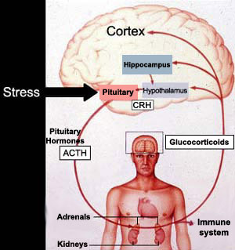
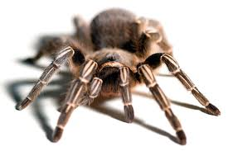
The ABC’s of Critical Thinking
My son’s pet
tarantula: Harry
Fight or Flight

Slide 17
The ABC’s of Critical Thinking
Sexual differences
Males and females composed of differing quantities of hormones
Dimorphism
Studies into the physiological, hormonal, and neural differences between males and females provide important information in the treatment of sex specific diseases, the function of medications, different procedures for surgeries, etc.

Slide 18
The ABC’s of Critical Thinking
Cultural Influences
Memes: any cultural artifact imaginable including one’s beliefs, habits, and customs
Over the last forty thousand years, the quantity of our memes has increased exponentially

Slide 19

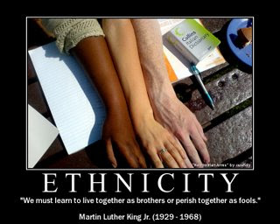
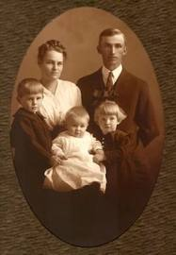
The ABC’s of Critical Thinking
Social Biases
Ethnicity
Family Upbringing
Religion

Slide 20
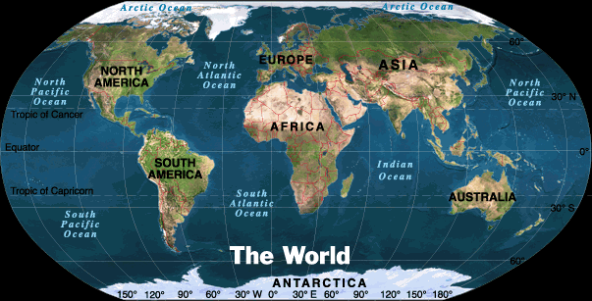

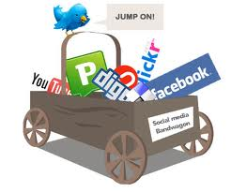

The ABC’s of Critical Thinking
Geographic Location
Education
Friends
Media

Slide 21
The ABC’s of Critical Thinking
Biases act like filters through which we attempt to make sense of the world

Slide 22
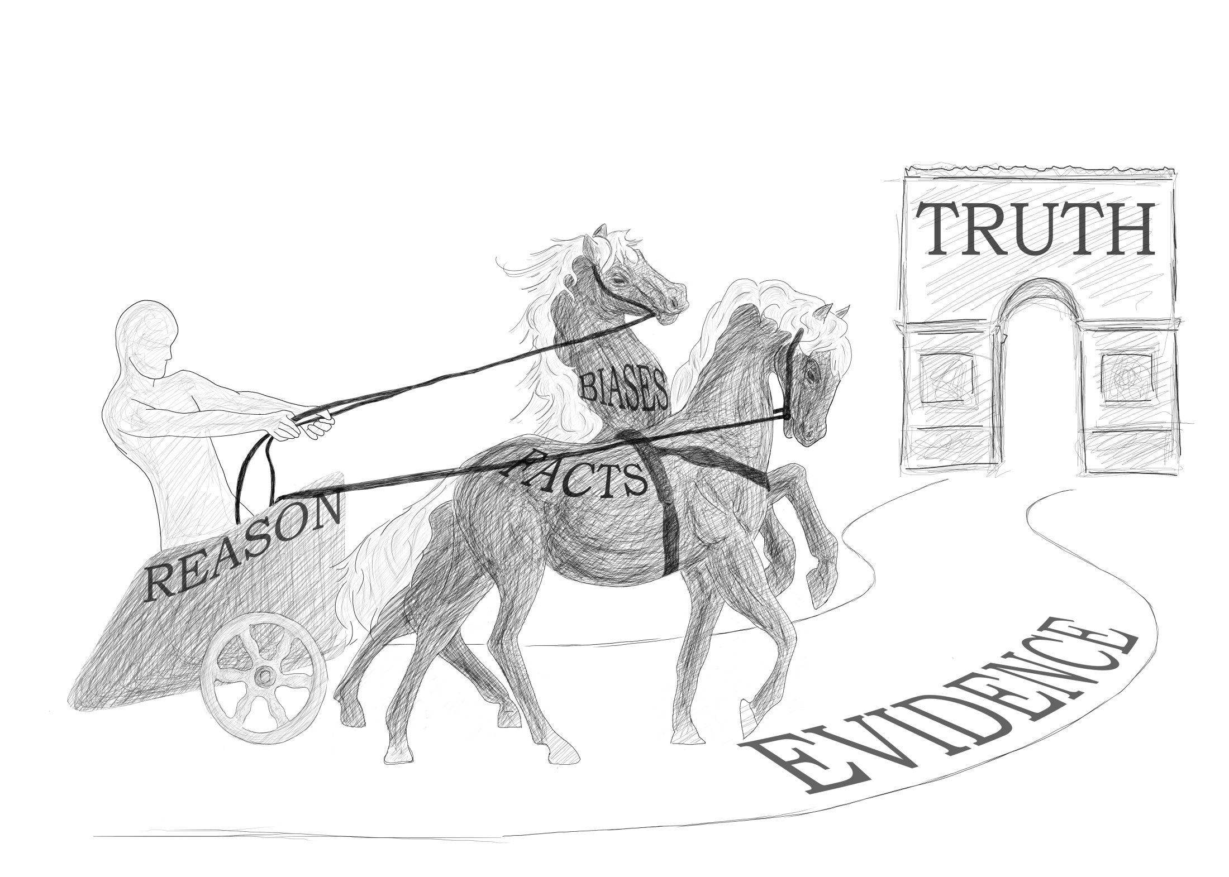
Six Steps to Better Thinking

Slide 23
The ABC’s of Critical Thinking
The most difficult part of becoming a good critical thinker is to acknowledge any biases in yourself that may distort your reasoning
The better we understand our biases, the more reflective we will be when discussing important issues
B is for Biases

Slide 24
The ABC’s of Critical Thinking
C is for Context
Context = Time, Place, and Circumstance

Slide 25
The ABC’s of Critical Thinking
These factors, along with other factual forms of background information, will allow you to more fairly assess information
“The Roof Is on Fire” (Bloodhound Gang)
Important to identify context related to arguments or information
Otherwise, we may judge and react unfairly and too quickly
Strawman Argument

Slide 26
The ABC’s of Critical Thinking
All of language is embroiled within a context in which we try to convey not only what it is we’re thinking but also how we’re feeling and what the setting is in which these interactions are taking place
Context allows us to better understand the reasons why someone might think and act in a particular way

Slide 27
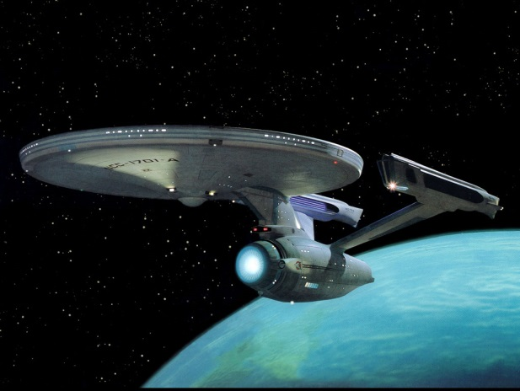
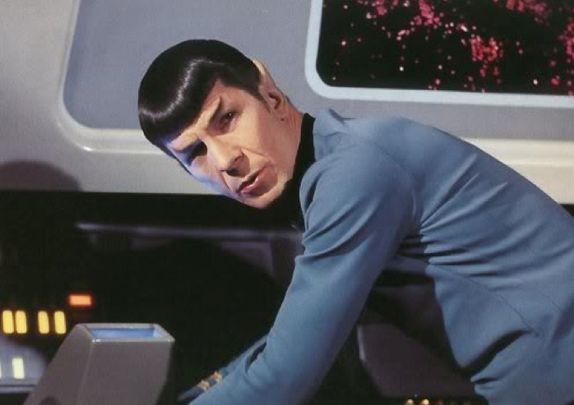
The ABC’s of Critical Thinking
Spock just not himself lately
Spock diverts the ship to his home
planet against the orders of Captain
Kirk
Why would such a logical being defy orders
from Kirk?
Context: Spock must return to his home
planet (Vulcan) within
eight days to take part in
Pon farr: a mating ritual,
or he will die

Slide 28
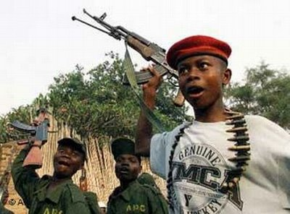
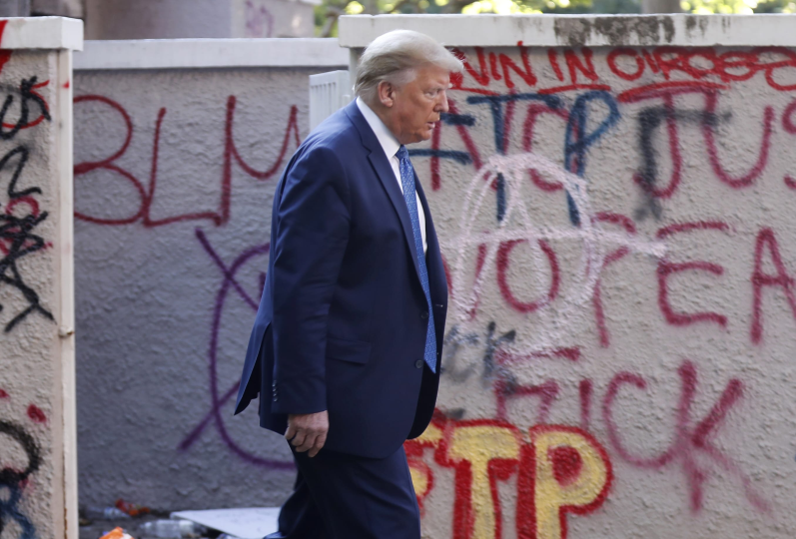
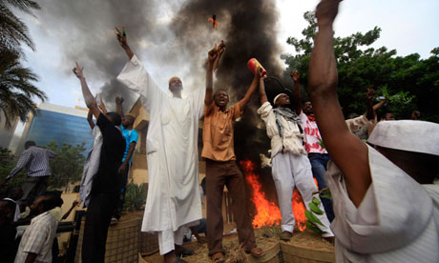
The ABC’s of Critical Thinking
How then, do we try to understand the actions of others elsewhere?
For example: the Middle East, the Congo, the United States….

Slide 29
The ABC’s of Critical Thinking
My privileged view of trying to understand what is happening in other parts of the world has limited contextual background
Since I am removed from their world, and I experience it through the filtered and biased views of television news editors (as well through the filters of my own biases), I may not be getting the complete story and may find myself divorced from some of the contextual nature of the activities that are taking place

Slide 30
The ABC’s of Critical Thinking
We need to be careful when interpreting information to make sure we have established enough background information to be able to acknowledge the context in which the information is being presented
In this way, when context is sufficient, we can more fairly interpret what is being presented and why the information is being presented in the way it is

Slide 31
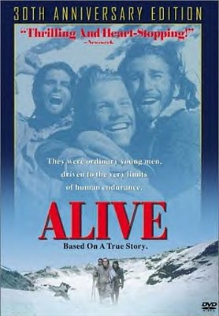
The ABC’s of Critical Thinking
Thought Experiment: Would you consume human remains?
Alive
On Oct. 13, 1972, a Uruguayan
rugby team crosses the Andes to
play a game in Chile
The plane crashes
45 people were onboard when it
crashed and 33 survived
When they were rescued on Dec. 23
72 days after the crash, only 16 were alive

Slide 32
The ABC’s of Critical Thinking
How many times have you said or heard the phrase: “That was taken out of context.”
Refers to an unfair interpretation of an issue due either to a lack of factual information or a misunderstanding of the surroundings or circumstances in which the information was situated

Slide 33
The ABC’s of Critical Thinking
Context Example:
Chicago Cubs Baseball Game: Terrible Grown Man Steals Foul Ball From Little Kid at Cubs Game
https://www.youtube.com/watch?v=t35eyHNTxYY
At first glance, it would seem that the man was acting senselessly. However, context reveals that he already gave the kid a ball earlier as well as one to another kid:
https://deadspin.com/sounds-like-everyone-should-lay-off-that-cubs-fan-who-1827798042

Slide 34
The ABC’s of Critical Thinking
Context Example: Fox News stated that the Philadelphia Eagles were protesting the American National anthem by kneeling instead of standing. However, the pictures taken were of the players who were praying prior to the game. Oops.

Slide 35
The ABC’s of Critical Thinking
Scenario: Evan, his mother (Mary), the cat, and the broken cookie jar
Mary is more justified in believing Evan is responsible for the broken cookie jar unless and until new evidence is presented or discovered
Sitcoms: “You mean that was your sister and not some other woman you’ve been seeing?! Oh, honey, can you ever forgive me?”
Determining the facts, the context in which those facts take place and unfold, and recognizing our biases,will go a long way in making us more responsible critical thinkers
This will lead to greater fairness when acting on the information
Believe it or not, fairness is a principle best shared equally among all—including rivals

Slide 36
The ABC’s of Critical Thinking
Context and enough relevant information is dependent upon the conditional that one believes to be in possession of enough relevant information and the context in which that information is found
The conditional can be stated in various forms, as shown in the list that follows, but they all mean the same thing:
  1. “Based on the information I have before me and the context in which it is placed, . . .”
  2. “All things considered, . . .”
  3. “Given what I now know, . . .”

Slide 37
The ABC’s of Critical Thinking
Understanding Context allows us to more fairly assess the information which we are considering
So fairness is directly tied into the amount of information determined and the context in which it is found in light of the way it is understood according to specific biases
Fairness is the Cornerstone of Critical Thinking

Slide 38
The ABC’s of Critical Thinking
So why should we “play fair”?
The rest of the world doesn’t. Wouldn’t doing so make us suckers or chumps?
No, not really
Because playing fair and cooperating is the only way we can truly keep order and respect in a world where there are so many cheaters
When everyone plays fairly, the majority gets more of what it wants

Slide 39
The ABC’s of Critical Thinking
THE RULES OF FAIR PLAY FOR CRITICALTHINKING
1. Acknowledge your existing biases and determine how they filter the way in which you see and act in the world.
2. Make every effort to attain enough facts before formulating a position on a particular issue.
3. Make every effort to acknowledge the context in which the facts occur before formulating a position on a particular issue. Use a conditional: “All things considered, this is what I now believe.”
4. Acknowledge that, due to the way in which so many people are biased differently, there are going to be disagreements on many issues.
5. Be open to the possibility of revising your position.

Slide 40
The ABC’s of Critical Thinking
C is for Context
By understanding how our biases affect our judgments—and considering the amount of information we have attained along with the context in which it is presented—we can go a long way toward increasing the likelihood of a fair account, which will ultimately lead to more effective communication for all parties

Slide 41
The ABC’s of Critical Thinking
D is for Diagramming
Diagramming = Drawing the Structure of Arguments
Allows us to represent and visually identify the structure of an argument from the overall conclusion (roof ) to the supporting premises (walls) to the underlying assumptions (foundation)
To literally see yours or another’s argument

Slide 42
The ABC’s of Critical Thinking
Diagramming allows us to identify a number of key components of an argument:
  1. The conclusion (roof): The overall main point
  2. The premises (walls): The reasons that support the main point
  3. The foundation: The underlying criteria that anchor the premises
  4. Noise: Factors that may or may not provide context

Slide 43
The ABC’s of Critical Thinking
When you are presented with an argument, you first need to determine the conclusion
Ask yourself what the overall point is that an argument’s presenter wants you to believe
What remains are the other components

Slide 44
The ABC’s of Critical Thinking
When you are presented with an argument, you first need to determine the conclusion
Ask yourself what the overall point is that an argument’s presenter wants you to believe
What remains are the other components

Slide 45
The ABC’s of Critical Thinking
Big oil companies need to stop drilling wells thousands of feet below the ocean floor. In the Gulf of Mexico, this practice has led to catastrophic devastation of plant life and wildlife. It is unsafe to the workers who operate these wells. And it has cost my family shrimp business thousands of dollars in lost revenue. (Bob Smith, Louisiana)

Slide 46
The ABC’s of Critical Thinking
Mr. Smith’s overall conclusion is that oil companies should stop using deepwater drilling
Why he believes this can be seen in his three premises: it devastates plants and wildlife; it is unsafe to its workers; and it cost his business a lot of money
No noise
Underlying assumption: it is unfair and wrong for people to harm humans, animals, and plant life through specific actions—in this case, it was business, in other words, for the purpose of making money
There may be nothing wrong with making money, but you can’t harm others/other species in doing so

Slide 47
The ABC’s of Critical Thinking
Diagramming Abbreviations:
All premises are abbreviated as P
The conclusion is abbreviated as C
It is a beautiful day today. The birds are chirping, the sun is shining, and there isn’t a cloud in the sky.
C
P1 P2 P3
Universal Criteria

Slide 48
The ABC’s of Critical Thinking
I like lemons, limes, and oranges. These are all citrus fruits that provide me with the essential vitamin C that my body needs every day in order to remain healthy. (Marge Henderson, Cedar Rapids, Michigan)
C
MP1
P1 P2 P3
Universal Criteria

Slide 49
The ABC’s of Critical Thinking
So Marge’s argument resembles a house with her roof (C) as her desire to remain healthy, and her main support being food containing vitamin C (MP1), and the individual supports being lemons (P1), limes (P2), and oranges (P3)

Slide 50
The ABC’s of Critical Thinking
For all arguments, we need to determine and separate the conclusion from the premises
Clues…?
Indicator words

Slide 51
The ABC’s of Critical Thinking
Premise Indicators: since, the reason(s) is (are), as indicated by. for, if, as, because, given that, etc.
Conclusion Indicators: therefore, we may infer that, hence, I conclude that, thus, which shows/reveals that, so, which means that, ergo, establishes, then, implies, consequently, proves, as a result, justifies, follows, supports, etc.

Slide 52
The ABC’s of Critical Thinking
How to Diagram an Argument
If you are reading an argument, begin by circling words that show where the conclusion is and where the premises are
Once you have located the conclusion, underline it
What remains will be the supporting premises and noise

Slide 53
The ABC’s of Critical Thinking
Place brackets around what you believe to be individual premises
Then determine if they are basic premises (P) or a main premise (MP), and number them accordingly: P1, P2, MP1, and so forth
Marge’s Argument: P1[I like lemons], P2[limes], and P3[oranges]. MP1[These are all citrus fruits that provide me with the essential vitamin C that my body needs every day] in order to remain healthy.

Slide 54
The ABC’s of Critical Thinking
Next, make a legend:
P1 = I like lemons
P2 = I like limes
P3 = I like oranges
MP1 = These are all citrus fruits that provide me with the essential vitamin C that my body needs every day
C = In order to remain healthy

Slide 55
The ABC’s of Critical Thinking
I like lemons, limes, and oranges. These are all citrus fruits that provide me with the essential vitamin C that my body needs every day in order to remain healthy. (Marge Henderson, Cedar Rapids, Michigan)
C
MP1
P1 P2 P3
Assumption(s)

Slide 56
The ABC’s of Critical Thinking
The Checklist:
1. Determine the conclusion or overall point that the person is trying to make. If it is a written argument, underline the conclusion. If the overall point is not clearly stated, it is probably hidden.
2. Consider whether or not the person is using indicator words. If any are present, circle them.
3. Put brackets around and number the various basic or main premises.
4. Create a legend, and adjust the wording of the premises, if necessary.
5. Build a house with the conclusion on top, premises beneath, and assumptions on the bottom.
6. Consider the underlying assumption(s).

Slide 57
The ABC’s of Critical Thinking
Keep in mind that the examples we have considered so far involve what are called simple arguments
Most arguments presented in real life are much longer and far more complex e.g. Fred Truscott example in text

Slide 58
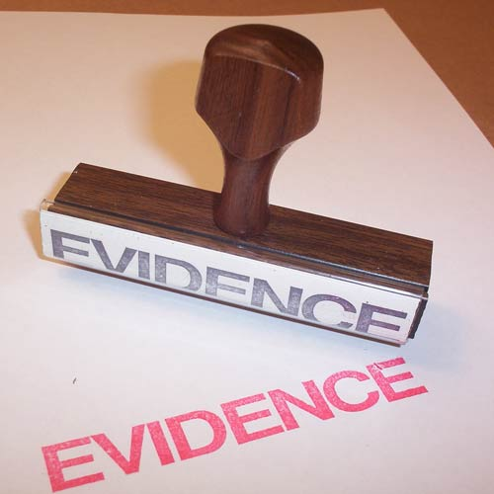
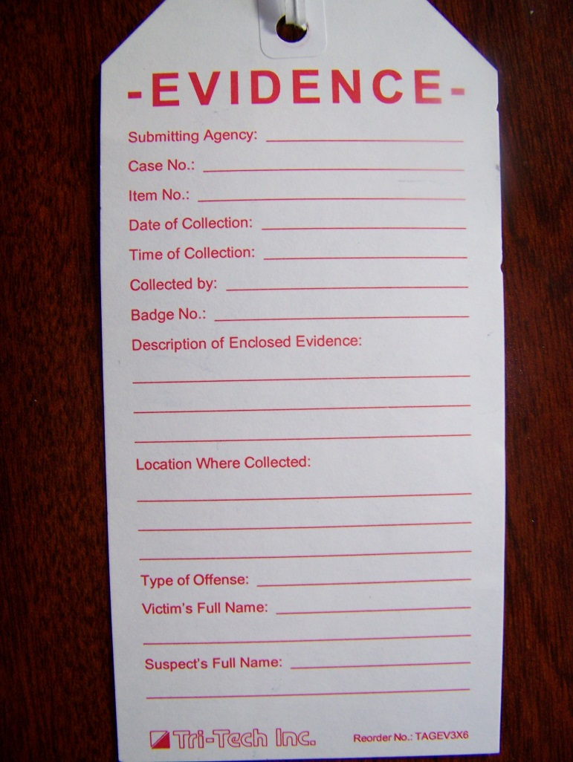
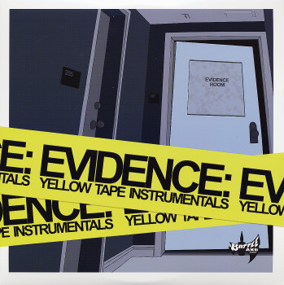
The ABC’s of Critical Thinking
Step 5: E is for Evidence

Slide 59
The ABC’s of Critical Thinking
There are many different types of claims that we and others make every day
Some of these claims require very little evidence to convince someone of our views
Other claims, however, require considerably more evidence
Remember Carl Sagan’s statement: “Extraordinary claims require extraordinary evidence.”
We might refer to this as the Sagan principle

Slide 60
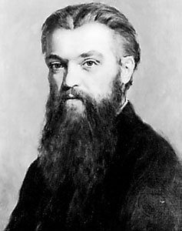
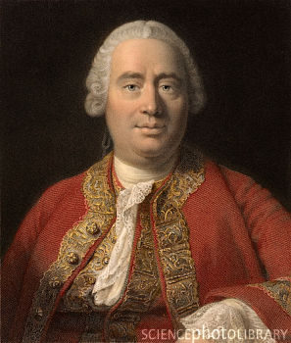
The ABC’s of Critical Thinking
A nineteenth-century British
mathematician named William
Kingdon Clifford: “It is wrong
always, everywhere, and for
any one, to believe anything
upon insufficient evidence.”
David Hume, wise people
proportion themselves to the
evidence

Slide 61
The ABC’s of Critical Thinking
Whenever we make a claim or state an argument, our premises act as supports to our conclusion
It is often the case that premises require various forms of evidence
If you make any claim, then the burden of proof lies with you to support that claim
You must provide evidence to try to convince somebody why it is you believe something to be true
The stronger the claim, the greater the burden of proof, the more convincing the evidence is going to have to be
Varying types of evidence can be supplied, and criteria are used to measure the effectiveness of those types of evidence

Slide 62
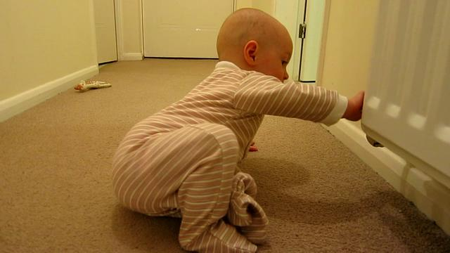
The ABC’s of Critical Thinking
Anecdotal Evidence: Personal Experience
Improper generalizations
“I saw Bigfoot”
“Vaccinations give your kids Autism”
“I’ll never eat a Joe’s Diner again!”
Proper generalization: Once
bitten, twice shy e.g. child
learning not to touch hot items

Slide 63
The ABC’s of Critical Thinking
Anecdotal evidence usually involves individual personal experience, which often involves cause-and-effect relationships
It can lead to stronger forms of evidence (e.g., scientific evidence), because it often begins as a correlation between two events which can be further investigated to determine if causality is present

Slide 64
The ABC’s of Critical Thinking
Legal Evidence
In legal testimonials, witnesses in a court of law swear under oath that the information they are providing is true
Sometimes eyewitness accounts are given
At other times, so-called expert witnesses are brought in to support either the prosecution or the defense
In most cases, lawyers try to demonstrate why testimonials for their side should be considered as valuable evidence, while testimonials from the other side should not
Keep in mind that the basis of legal testimony rests on the assumption that a person providing information or evidence has agreed to swear an oath that the information he or she is providing is “the truth, the whole truth, and nothing but the truth.”

Slide 65
The ABC’s of Critical Thinking
Intuition
“I didn’t walk down that dark alley because I felt as though it might be dangerous”
“I didn’t purchase the car from that salesman even though it seemed like a great buy because there was something suspicious about him.”
These intuitive approaches to evidence come from personal feelings about specific situations that are triggered by cues or behavioral patterns that elicit emotional responses in us
They are sometimes referred to as hunches

Slide 66
The ABC’s of Critical Thinking
Problems with Intuition
They are sometimes right but often wrong
There is no way to personally regulate these feelings
What you intuitively “feel” might be the opposite of what I’m intuitively feeling
Who’s right?
How could we possibly measure this type of evidence?
It should come as little surprise then that intuitive evidence is the least justifiable because of its very nature; we cannot measure hunches

Slide 67
The ABC’s of Critical Thinking
Scientific Evidence
Includes claims involving our understanding of the natural world that require that we present physical, empirical evidence to show we are on the right track in terms of understanding natural properties and mechanisms
As we saw in chapter 1, Induction, as a form of reasoning, is the hallmark of scientific investigation
We look at some behavior in the world, observe that it repeatedly occurs the same way under the same circumstances, and then conclude it is likely to behave the same way in the future

Slide 68
The ABC’s of Critical Thinking
THE SCIENTIFIC METHOD IN SIX EASY STEPS
The scientific method for acquiring evidence generally follows this type of pattern:
1. We often first make an observation of something that has happened.
2. We then consider what caused this thing to happen by posing educated guesses (or hypotheses).
3. We can then make predictions about what we should expect to see if our hypotheses are correct.
4. If necessary, experimentation and data collection may be conducted.

Slide 69
The ABC’s of Critical Thinking
5. Further observation is necessary, which will lead to three possible outcomes:
  a. If we observe that our data positively support our prediction, then we have hypothesis confirmation (at least for now, or tentatively).
  b. If we observe that our data do not support our prediction, then we have hypothesis falsification, and we may be forced to either give up or modify our hypothesis.
  c. If there are simply not enough data to decide either way, then we suspend judgment.
6. Finally, we need to consider whether there are any other competing hypotheses that provide an equally plausible or likely explanation of our observation. If there are, then we need to ask ourselves which seems more reasonable. If there are no others, then we may decide to tentatively accept the hypothesis based on the currently available information

Slide 70
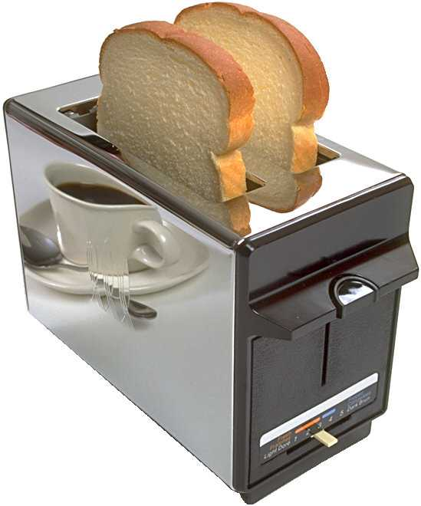
The ABC’s of Critical Thinking
Bread in the Toaster Example
Scientific reasoning has
become our most powerful tool
In understanding cause-and-effect
relationships in the natural world,
and the evidence it provides gives the
greatest strength to our premises
in support of our explanations

Slide 71
The ABC’s of Critical Thinking
SCIENTIFIC STUDIES: ASKINGTHE RIGHT QUESTIONS
“There are three types of lies: lies, damn lies, and statistics.” (Mark Twain)
67.52% of all statistics are made up on the spot ;-)

Slide 72
The ABC’s of Critical Thinking
Important Questions for Studies:
1. Who conducted the study?
2. What was the motivation for the study—in other words, why was it conducted in the first place?
3. Who funded the study?
4. What was the methodology of the study, or how was the study carried out? (Remember to consider sample size and representation.)
5. Is the study repeatable? That is, would any other scientists, under similar conditions, arrive at the same findings?

Slide 73
The ABC’s of Critical Thinking
Asking these questions will empower you with the ability to cut through any references to studies as evidence for premises in any given argument
Whenever anyone tries to support their conclusion with the statement: “Studies show that….”
Remember the five questions

Slide 74
The ABC’s of Critical Thinking
E is for Evidence
The criteria behind the consistency of evidence have become benchmarks for determining what counts as acceptable and as unacceptable in reasoning and argumentation
Criteria such as simplicity, reliability, relevance, sufficiency, and the avoidance of common logical fallacies are the main benchmarks that guide anyone who puts forward arguments
These criteria are generally universally accepted as indicators for sound reasoning and strong arguments
Violation of such criteria often results in what are called fallacies

Slide 75
The ABC’s of Critical Thinking
Step 6: F is for Fallacies
A fallacy is an error in reasoning
They can occur in formal or informal reasoning (deductive or inductive)
Inconsistencies and Contradictions
Jedi Knight advice: “Listen to and trust your feelings.”
“Don’t let your feelings cloud your judgment.”

Slide 76
The ABC’s of Critical Thinking
Inconsistency and Hypocrisy
“I did not have sexual relations with that woman – Ms. Lewisnki.” (Bill Clinton)
“Do as I say, not as I do”.
The ex-partier: George W. Bush
We are all hypocrites: we just vary by degree (and admission)
24 Fallacies in book

Slide 77
The ABC’s of Critical Thinking
Ad Hoc Rescue
The term ad hoc is Latin and literally means “for this purpose.” It involves the addition of more premises in the attempt to save a particular belief or position
BETTY: If you take this herbal medicine for fourteen days, it will cure your migraine headaches.
JOE: I took your advice, Betty, but I still had several migraines in the past two weeks.
BETTY: Did you take it exactly as prescribed?
JOE: Yes, I did.
BETTY: Well, then, it must have been expired.
JOE: No, it says on the box that it doesn’t expire for another two years.
BETTY: Okay. Then, I suppose you picked the wrong brand name.
JOE: But this is the brand you told me to buy.
BETTY: Ah, then perhaps the company produced a low-dosage batch by mistake; that must be it.

Slide 78
The ABC’s of Critical Thinking
Ad Hominem
Also be known as the “sticks and stones fallacy.”
The term ad hominem means “against the man.” An abusive ad hominem occurs when we lose focus in our analysis and, instead of directing our attack against a person’s argument, focus on irrelevant qualities or characteristics of a person
For example: Why on earth should we read anything written by Plato since it is clear that he was a homosexual?
Jean Chretien example: 1993 Canadian Federal Election

Slide 79
The ABC’s of Critical Thinking
Argumentum ad Ignoratiam
Also referred to as the “argument to ignorance” but could also be called the “burden of proof fallacy” or the “for all you know fallacy”
When this fallacy is committed it is because someone has taken the position that “I’m not absolutely sure it’s false, so it must be true” or “I’m not absolutely sure it’s true, so it must be false.”
If we assume that ghosts or UFOs or psychic abilities exist because it has not been completely proven that they do not exist, we are fallaciously appealing to this kind of reasoning

Slide 80
The ABC’s of Critical Thinking
Appeal to Emotions or Force
Sometimes people use pity in an irrelevant context to justify their beliefs and actions
On some occasions pity is warranted
The same is true for force
You don’t win an argument by taking someone outside and beating them up
But there are times when all measures have been explored and the only one left is force

Slide 81
The ABC’s of Critical Thinking
Begging the Question
This fallacy is a form of circular reasoning
Begging the question is a fallacy that occurs whenever anyone assumes as a premise what they hope to support as a conclusion
The word of the Bible is true. For it says right in the Bible that it is the word of God, and God would never allow the Bible to contain false information.
Loaded questions, leading the witness, etc.

Slide 82
The ABC’s of Critical Thinking
Confirmation Bias
Also could be called the “hammer fallacy” or the “fallacy of selective attention”
In other words, when the only tool you have is a hammer, everything looks like a nail
Very difficult to escape this type of bias
Once we start to see certain aspects of the world in a particular way, it is difficult for us to ignore opposing evidence
This happens in cases where we unjustly make judgments about people because of preconceived ideas
Psychics: pp. 145 – 149

Slide 83
The ABC’s of Critical Thinking
False Dichotomy
Also could be called the “black or white fallacy” or the “only two ways about it fallacy.”
This fallacy occurs when someone attempts to state an argument in a way that leads us to believe there are only two alternatives
Either you are with us, or you are against us.
The choice for American university students is clear: they can choose not to smoke marijuana and live a healthy, happy life, or they can choose to become addicted to the deadly weed, which will inevitably lead them to harder drugs and a life of crime.
DAVID: Boy, I hate this weather [walking in a snowstorm].
ROY: Look at it this way: Either we get the snow or we get freezing rain. Which would you prefer?

Slide 84
The ABC’s of Critical Thinking
Language Problems: Euphemisms, Vagueness, and Ambiguity
Euphemisms: Substituting mild or indirect terms for those more harsh
For example, “passed away” is often used instead of “died.” Animals are “put to sleep” or “put down” rather than “killed.” And companies “downsize” rather than “massively fire” employees.
Can also distort information, for example, using the term “police action” for “war,” or referring to a “clean bomb,” which kills people but leaves buildings standing

Slide 85
The ABC’s of Critical Thinking
A vague term is one that is lacking precise definition or meaning and an ambiguous term is one that has two or more distinct meanings
Vague terms:
Ted is a liberal thinker.
Heather is a good student.

Slide 86

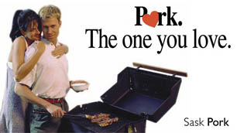
The ABC’s of Critical Thinking
Ambiguous terms:
Pork. The one you love.
Chi-chi’s. When you feel a little Mexican.

Slide 87
The ABC’s of Critical Thinking
Post Hoc Fallacy
The complete name of the fallacy is actually post hoc ergo propter hoc, which means, “after this, therefore, because of this”
Because A precedes B, A must cause B
Not always the case
Every Monday evening I put out the garbage on our curbside. And every Tuesday morning, a garbage truck picks it up. Therefore, my putting garbage out on the curb causes the garbage truck to come.

Slide 88
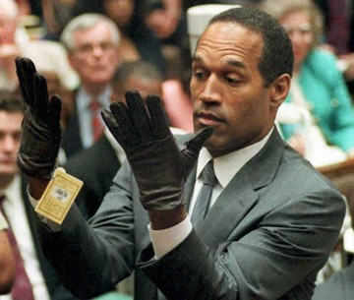
The ABC’s of Critical Thinking
Red Herring
Could also be called the “something smells fishy fallacy” or the “beside the point fallacy,” or even the “smoke screen fallacy”
A red herring occurs whenever one uses a premise that is irrelevant to the conclusion, which distracts one away from the topic at hand—that is, when one shifts the topic in such a way that focus is no longer on the originally stated issue.
Sitcom Example: When a husband is caught leaving to play golf with his buddies rather than stay home and finish the yard work, and his wife confronts him, he might blurt out any number of distracting red herring remarks, such as, “Have I told you how attractive you look today?” or “I think we should go out for dinner tonight,” or “Have I told you how much I love you lately?”
OJ Simpson Trial

Slide 89
The ABC’s of Critical Thinking
Slippery Slope Fallacy
Once one cause starts, it will create an effect that will be the cause of another effect, and so on, until the final effect is something really terrible
Fallacious if you can demonstrate that one cause will not necessarily lead to others or the final effect

Slide 90
The ABC’s of Critical Thinking
Strawman Argument
Also can be referred to as the “mannequin fallacy” or “dummy fallacy”
We must take special care when interpreting someone’s argument regardless of whether we agree or disagree with it
If we misrepresent an argument, not only are we being unfair to the speaker, but we also may be referring to aspects of an issue that the speaker never intended

Slide 91
The ABC’s of Critical Thinking
The Critical Thinking Skill Set that involves the Six Steps is taught at all age/grade levels – from High School, to Community College, to University.
www.sixstepstobetterthinking.com

Slide 92
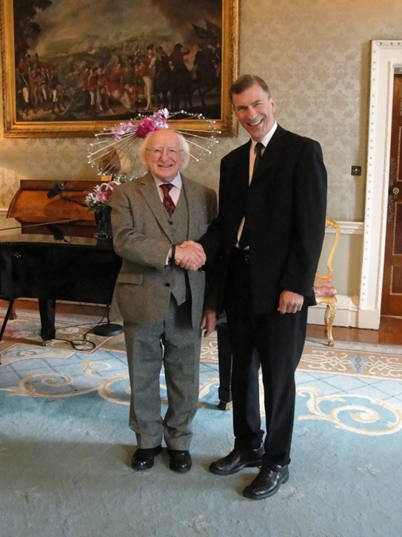
Thank you.

Slide 93
The ABC’s of Critical Thinking
Evaluation Metrics
In Class:
  Write a brief position paper/have students analyze after skills have been taught
  Spot the Argument:
    Advertisements, commercials, etc.
  One-page journal of biases
    Biological and Cultural
  Internet example(s) of importance of context
  Diagram practice
    Basic arguments
  Minor and Major Claims:
    What type of evidence is required?
  Spot the fallacies
    2 or 3 fallacies

