Slide 1
How to Talk to a Conspiracy Theorist
Lecture 02:
The Psychology of Conspiracy Theories
---
DR. CHRISTOPHER DICARLO

Slide 2
Biases influence or constrain
Internal and external biases
Fall under two categories
Biological
Cultural
Biological biases
Did my genes make me do it?
Notes:
Genes: Did my genes make me do it?
Image: [[File:Nick Brett bowling.jpg|Nick_Brett_bowling]]

Slide 3
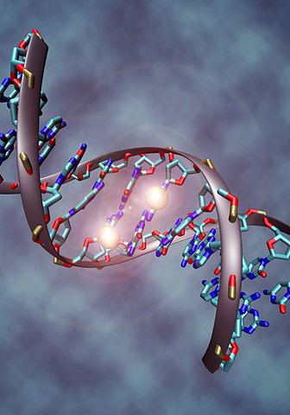
DNA (deoxyribonucleic acid)
Janice is a 28-year old woman from Chicago, IL
Bob is a 57-year old man from Lincoln, NB
Not all narcissists are conspiracists. But a large percentage of conspiracists are narcissists
// How to Talk to a Conspiracy Theorist
Notes:
Every living species on this planet, from amoeba to zebra, possess genetic instructions called DNA (deoxyribonucleic acid) that informs how their cells will function as well as how those species will behave under certain conditions.
The behaviour of all species on this planet – including humans – is biased in many ways by the history and evolution of its DNA. This however, does not mean that humans cannot act otherwise. We are not dancing bees. We are conscious beings. And as such, we seemingly possess the capacity to control or alter our behaviour. But how much control do we really have? Consider two examples:
Example 1: Janice is a 28-year old woman from Chicago, IL who has watched several people in her family suffer and die from Huntington’s disease. Based on her genetic lineage, she faces a 50-50 chance of possessing the Huntington’s disease gene. There’s an equal chance she will either develop symptoms of the disease, or she will not.
Example 2: Bob is a 57-year old man from Lincoln, NB who has inherited genes largely responsible for NPD or Narcissistic Personality Disorder. Such a disorder “is a mental condition in which people have an inflated sense of their own importance, a deep need for excessive attention and admiration, troubled relationships, and a lack of empathy for others. But behind this mask of extreme confidence lies a fragile self-esteem that's vulnerable to the slightest criticism.”[1] Recent evidence indicates that such a disorder is often found in people who tend to believe in conspiracy theories.
In the first example, the expression or non-expression of genes is either going to cause Janice to develop Huntington’s disease or it’s not; the odds are exactly 50-50%. In the second example, gene expression may cause Bob to believe in conspiracy theories or it may not. For not all narcissists are conspiracists. But a large percentage of conspiracists are narcissists.
Image: Wikicommons: [[File:DNA methylation.jpg|DNA_methylation]]

Slide 4
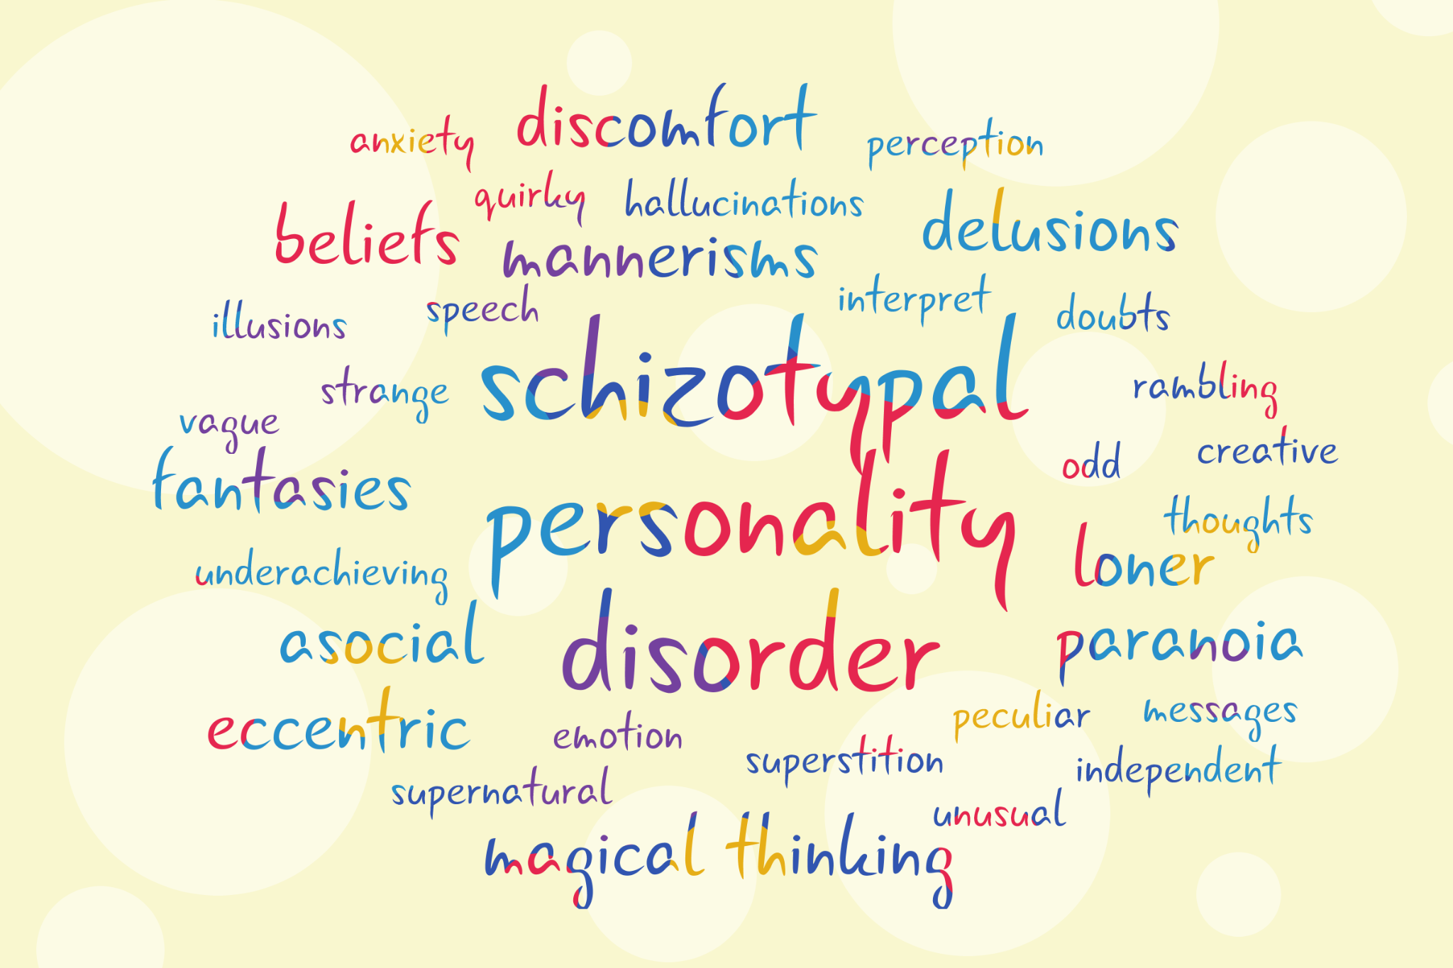
Did my brain make me do it?
Psychological profile of a conspiracy theorist:
Aside from narcissism, there are other various genetic factors which can contribute to neurotic or paranoid tendencies such as Schizotypal Personality Disorder:
Loner
Notes:
Brains: Did my brain make me do it?
Our brains are responsible for how we understand the world. If you, or someone you know has suffered with mental illness, you will understand the ways in which they are biased to see the world differently, simply because there may be a chemical imbalance within their brains. And so it follows that those who are afflicted with specific forms of mental illnesses are biased in ways that cause them to understand information differently.
Our research has found the following mental commonalities amongst conspiracy theorists:
Psychological Profile of a Conspiracy Theorist:
Aside from narcissism, there are other various genetic factors which can contribute to neurotic or paranoid tendencies such as Schizotypal Personality Disorder
Schizotypal personality disorder typically includes five or more of these signs and symptoms:
· Being a loner and lacking close friends outside of the immediate family
Image: By permission Wikicommons: Image: By MissLunaRose12 - Own work, CC BY-SA 4.0, https://commons.wikimedia.org/w/index.php?curid=81496821
If you can make the image fit in the side panel of the slide, that would be great. I believe we can put the credits in this Notes section.

Slide 5
Flat emotions or limited or inappropriate emotional responses
Persistent and excessive social anxiety
Incorrect interpretation of events, such as a feeling that something that is actually harmless or inoffensive has a direct personal meaning
Peculiar, eccentric or unusual thinking, beliefs or mannerisms
Notes:
Flat emotions or limited or inappropriate emotional responses
Persistent and excessive social anxiety
Incorrect interpretation of events, such as a feeling that something that is actually harmless or inoffensive has a direct personal meaning
Peculiar, eccentric or unusual thinking, beliefs or mannerisms
Image: Fit to side panel.

Slide 6
Suspicious or paranoid thoughts and constant doubts about the loyalty of others
Belief in special powers, such as mental telepathy or superstitions
Unusual perceptions, such as sensing an absent person's presence or having illusions
Notes:
Suspicious or paranoid thoughts and constant doubts about the loyalty of others
Belief in special powers, such as mental telepathy or superstitions
Unusual perceptions, such as sensing an absent person's presence or having illusions
Image: Fit to side panel.

Slide 7
Dressing in peculiar ways, such as appearing unkempt or wearing oddly matched clothes
Peculiar style of speech, such as vague or unusual patterns of speaking, or rambling oddly during conversations
Notes:
Dressing in peculiar ways, such as appearing unkempt or wearing oddly matched clothes
Peculiar style of speech, such as vague or unusual patterns of speaking, or rambling oddly during conversations
Image: Fit to side panel.

Slide 8
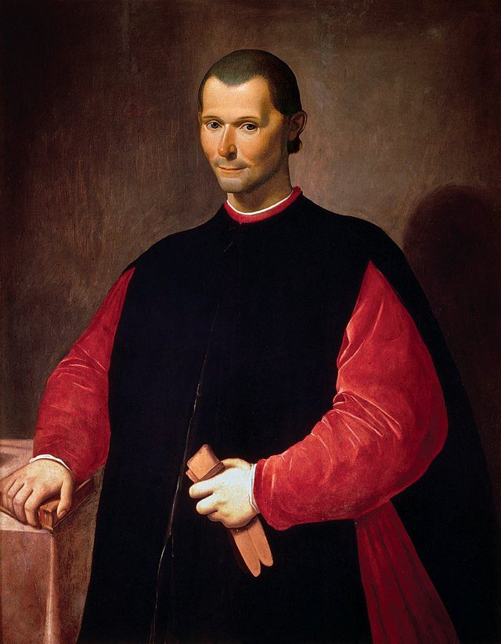
‘Predictors of belief’
Odd beliefs/magical thinking [as a] subtype of schizotypy, machiavellianism, grandiose narcissism, vulnerable narcissism, primary psychopathy, and secondary psychopathy in predicting belief in conspiracy theories
Strategic, manipulative, dominant, and callous
Notes:
Social psychologists attempt to identify specific ‘predictors of belief’ that give rise to conspiracy theories in an attempt to understand and potentially manage such beliefs. Some of these predictors of belief include, but are not limited to: “…odd beliefs/magical thinking [as a] subtype of schizotypy, Machiavellianism, grandiose narcissism, vulnerable narcissism, primary psychopathy, and secondary psychopathy in predicting belief in conspiracy theories.”
On the most harmful end of the spectrum are those who are strategic, manipulative, dominant, and callous.
Image: By permission (Wikicommons): [File:Portrait of Niccolò Machiavelli.jpg|Portrait_of_Niccolò_Machiavelli]

Slide 9
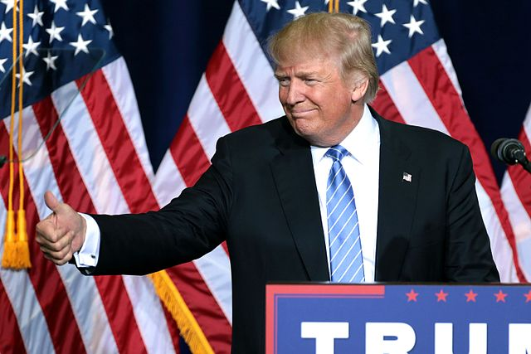
Anyone come to mind?
Notes:
Anyone come to mind?
Image: Wikicommons: File:Donald Trump (29273056092).jpg|Donald_Trump_(29273056092)

Slide 10
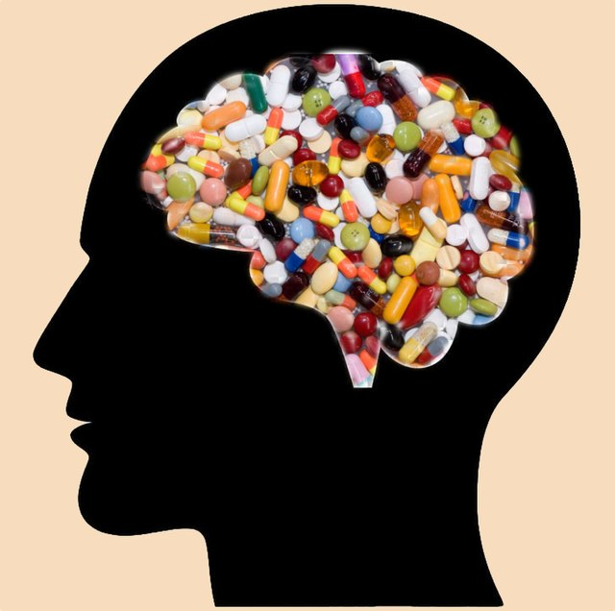
We are all on drugs: sex, survival, and status
Certain types of activities get us high
“…on drugs.”
Biological Equilibrium = Homeostasis
Biology holds culture on a short leash
Notes:
We are all on Drugs: Sex, Survival, and Status
We must always keep in mind that we have been emotional beings a lot longer than we have been so called rational beings. Our brains have evolved over millions of years in ways that influence our behaviour to achieve specific goals. In biology, the two largest and most central goals of all living things are, in no specific order, survival and sex. Attaining both of these goals does not simply have a practical benefit but is incentivized with a great neurological payload in the form of specific neural transmissions. In other words, doing certain types of activities get us high. In this way, all humans (and for that matter, all mammals) are constantly “on drugs”.
If you can remember from your childhood days, enjoying the thrill of an amusement ride, the joy of swimming in the ocean, being cradled in your mother’s arms, or even being pushed on the playground swing, that joyful, warm, or exuberant thrill you were experiencing was the direct result of specific neurotransmitters like dopamine, serotonin, oxytocin, vasopressin, etc., that were coursing through your brain and making you high.
Our brains have evolved to get us to behave in specific ways that increases our likelihood for survival and reproduction. This is why eating good food tastes so great and why sexual activity feels so incredible. Evolution has modelled our brains with great neural payloads so we will behave in particular ways. Taking substances like alcohol, cannabis, hallucinogens, etc., are evolutionary shortcuts. In other words, such substances produce neural payloads without us actually having to do anything. But in all biological ecosystems, every species – including humans – seeks to attain and maintain a relative comfort level known as biological equilibrium. Sometimes referred to as homeostasis, all forms of life are driven to regulate their internal environment in relation to a changing external environment and thereby process energy, and ultimately, survive.
We need to act in ways that are going to increase the likelihood that we survive until the next day. So we need to find food, shelter, tools, security, and so on. But we are also driven to reproduce. And so much of our time is preoccupied in the determination of finding a mate; or, at least, having sex. Whatever cultures have evolved throughout history, they are the direct result of our genetically hardwired programs to survive and reproduce. In this way, biology always holds culture on a very short leash. As such, we seek out information and activities which increase our likelihood to attain these two central biological goals. History has well demonstrated that those who can attain the greatest status, resources, and influence within a specific group, will increase their likelihood to attain these two goals.
Image: Wikicommons: File:Psychotropic drugs.jpg|Psychotropic_drugs]

Slide 11
Conspiracists fall into two main categories:
1. Those who are quite fearful of the information they believe is true
2. Those who have a heightened understand of a particular issue
Conspiracists see themselves as possessing privileged information which in turn increases their status which, at the same time, gets them high
Memetic Equilibrium
Memes = Cultural artefacts
Notes:
It should come as no surprise, then, that emotionally, conspiracists see themselves as possessing privileged information which in turn increases their status which, at the same time, gets them high. This is what I refer to as: memetic equilibrium. In other words, any cultural artefacts – from your hair style and clothes, to your preference for music, to your ideas of politics, religion, and sex – are memes.
Image: Wikicommons: File:Top secret.jpg|Top_secret]

Slide 12
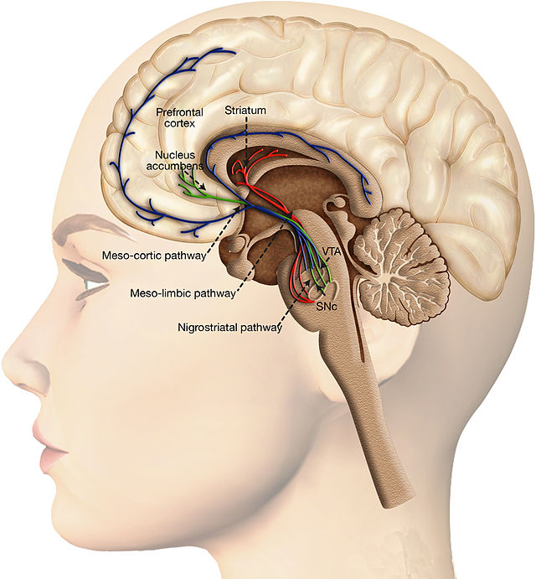
Everyone likes to be right―or at least the feeling of being right.
A neurochemical reward
Control, empowerment, security, and epistemic status
People = like to be perceived as knowledgeable, smart, insightful
Notes:
Everyone likes to be right―or at least the feeling of being right. This feeling of being right provides us with a neurochemical reward, accompanied by a sense of control, empowerment, security, and epistemic status. People like to be perceived as knowledgeable, smart, insightful, etc.
Image: File:Dopaminergic system and reward processing.jpg|Dopaminergic_syste

Slide 13
There is a certain amount of cache or status that comes with being a so-called ‘expert’ in a particular field.
Epistemic status
Significant neurochemical reward in our brains
No greater high than the feeling of being right
Notes:
There is a certain amount of cache or status that comes with being a so-called ‘expert’ in a particular field. As we grow and mature, so too do our beliefs become entrenched through various biological and cultural biases. When we believe that our memes and knowledge gives us a special epistemic status, this produces a significant neurochemical reward in our brains. There is no greater high than the feeling of being right. And so, attempting to get someone to give up that ‘high’ is not going to be easy.
Image: Wikicommons: File:Jeopardy Germany 2016 logo.jpg|Jeopardy_Germany_2016_logo

Slide 14
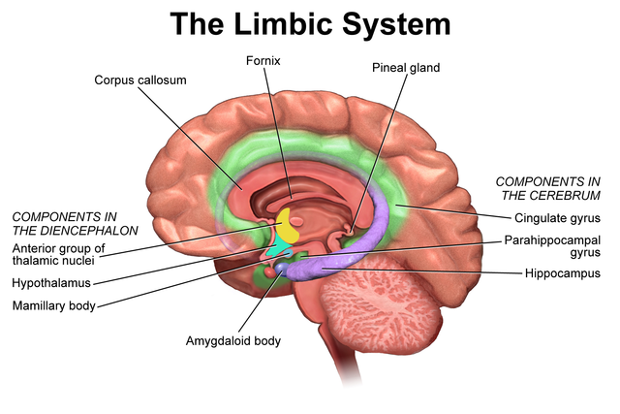
You are the buzz-kill
Limbic system (emotions) vs. Prefrontal cortex (rational)
“The thrilla adjacent to the amygdala”
Notes:
Conspiracists, much like deeply religious individuals, often find themselves quite comfortable with their view of the world at a given time. Their beliefs represent to them the most important information possibly attainable. No other information is as important; and no other information gets them as high as what they believe is true. It is extremely important to remember that, when talking to a conspiracist, it is not unlike talking to either a deeply religious individual, or an alcoholic, or a drug addict. If you try to introduce information that contradicts their current worldview and cherished beliefs, it is like trying to falsify the existence of God to a person of deep faith, or it’s like taking the bottle from the hands of the alcoholic, or the needle from the hands of the opioid addict. They will see you as the problem; as that which stands between them and their joyful highs. You are the buzz-kill. And hence, you are a problem.
The neurological and biological drives of the human condition, combined with the complexities of ideas generated within cultures around the world, creates the desire for many individuals to seek out information and resources that will increase status, and maintain biological and memetic equilibria. But there is an interesting battle going on within each one of our brains between our emotional centre or limbic system, and our rational centre or prefrontal cortex – what The Big Bang Theory’s character Amy Farrah Fowler once referred to as: “The thrilla adjacent to the amygdala.” (Aside: In order to get this joke requires knowledge of both brain neurology and the history of boxing).
Image: Wikicommons: File:Blausen 0614 LimbicSystem.png|Blausen_0614_LimbicSystem

Slide 15
Cultural biases
Family upbringing
Deflection, projection, narcissism, victim mentality
Notes:
We have a strong emotional need to be liked, listened to, respected, and cared for. These emotions have been with our species for millions of years. And they are very strong predictors of belief – whether we’re conspiracists or not. And emotions often get in the way and overrule our critical thinking capacities. So we must know what we’re in for when talking to a conspiracy theorist. For much of their current identity is intimately and emotionally tied to their current less-conventional beliefs. If we can understand how such biases might influence a conspiracist, then we will be in a far better position in which to talk to them.
Considering how our biases influence our thoughts and our actions is one of the clearest ways to help us better understand why we have disagreements so that we might engage the conspiracist in healthy and helpful dialogue.
Cultural Biases:
Family Upbringing

Slide 16
Ethnicity
Arabs/Jews
Turks/Greeks
Indians/Pakistanis
The enemy or ‘the other’ is de-humanized
Indoctrination
Notes:
Ethnicity
To what extent is racism or xenophobia indoctrinated within ethnic circles? Why do Arabs and Jews, Turks and Greeks, Indians and Pakistanis, and many other ethnic groups continue to dislike one another to the point of terrorism, war, or genocide?
War and conflict creates a social-psychological phenomenon in which we objectivity and vilify the enemy as sub-human. The enemy or ‘the other’ is de-humanized and often compared to various forms of vermin and pestilence e.g. equating Jews with rats in WWII that move into and take over areas while spreading contagion; Mexicans as cockroaches who invade the US and spread disease, etc. When you de-humanize others, it makes it easier and more justifiable to hate and to harm them because they are “not like us – they are sub-human, like animals”. Since we commonly kill so-called ‘vermin’ with little regard, so too, are we justified in killing our enemies who are literally, no different. Ethnicities which have been at war for generations often remember and foster hatred for their enemies for centuries. It should come as little surprise, then, that such indoctrination could influence and bias the minds of its community with stories, half-truths, and conspiracy theories about ‘the other’.
Image: Wikicommons: File:Multiculturalism.jpg|Multiculturalism]
Religion
We do not need to delve too far into history to witness the atrocities brought about by specific world religions fueled by conspiratorial thinking. To be sure, many world religions have accomplished great things – from great works of art, to the compassion for the sick, the downtrodden and the dying. If religious beliefs are not harming other humans or other species, it’s none of my, nor anyone else’s business. However, when any ideology – religious or secular – generates harm, we have the right (some might say, duty) to speak and act out. Just one example to demonstrate this point: The Jewish Blood Libel. Towards the end of the Dark Ages in Western Europe, an idea began circulating that on an annual basis, Jewish cabals would choose a child from a village to be sacrificed around the time of Easter/Passover in order to mock the Passion of the Christ. Their blood would be harvested for use in secret rituals. In 1173, the monk, Thomas of Monmouth, stated:
“…it was written that the Jews, without the shedding of human blood, could neither obtain their freedom, nor could they ever return to their fatherland…Hence it was laid down by them in ancient times that every year they must sacrifice a Christian in some part of the world to the Most High God in scorn and contempt of Christ, that so they might avenge their sufferings on Him.”[1]
As fear of such atrocities circulated, so too did anti-Semitism evolve and morph throughout Western Europe. Fast-forward some 900 years, and we again, witness massive beliefs in a Satanic cabal feasting on the blood of innocent children. This is the basis of the latest blood libel known as Qanon.
Image: Wikicommons: File:Religion distribution.png|Religion_distribution
[1] https://newrepublic.com/article/159529/qanon-blood-libel-satanic-panic

Slide 17
Religion
The Jewish Blood Libel
Thomas of Monmouth
Anti-Semitism
QAnon
Notes:
Religion
We do not need to delve too far into history to witness the atrocities brought about by specific world religions fueled by conspiratorial thinking. To be sure, many world religions have accomplished great things – from great works of art, to the compassion for the sick, the downtrodden and the dying. If religious beliefs are not harming other humans or other species, it’s none of my, nor anyone else’s business. However, when any ideology – religious or secular – generates harm, we have the right (some might say, duty) to speak and act out. Just one example to demonstrate this point: The Jewish Blood Libel. Towards the end of the Dark Ages in Western Europe, an idea began circulating that on an annual basis, Jewish cabals would choose a child from a village to be sacrificed around the time of Easter/Passover in order to mock the Passion of the Christ. Their blood would be harvested for use in secret rituals. In 1173, the monk, Thomas of Monmouth, stated:
“…it was written that the Jews, without the shedding of human blood, could neither obtain their freedom, nor could they ever return to their fatherland…Hence it was laid down by them in ancient times that every year they must sacrifice a Christian in some part of the world to the Most High God in scorn and contempt of Christ, that so they might avenge their sufferings on Him.”[1]
As fear of such atrocities circulated, so too did anti-Semitism evolve and morph throughout Western Europe. Fast-forward some 900 years, and we again, witness massive beliefs in a Satanic cabal feasting on the blood of innocent children. This is the basis of the latest blood libel known as Qanon.
Image: Wikicommons: File:Religion distribution.png|Religion_distribution
[1] https://newrepublic.com/article/159529/qanon-blood-libel-satanic-panic

Slide 18
Geographic location
Identities and differences
Rivalries
Notes:
Geographic Location
The very fact that you live in a particular part of the world will have a profound influence on how you interpret and act on information. How someone in the U.K. will understand the Syrian conflict will be different from those who live within Middle-Eastern countries. But geographic location can be even more specific than this. For example, consider the identities and differences between provinces in Canada, states in the U.S., regions of England, India, Mexico, etc. Rivalries often develop between neighboring cities, like the fictional rivalry between Springfield and Shelbyville in The Simpsons.
Image: Wikicommons:
[[File:1851 Global tropical cyclone summary map.png|1851_Global_tropical_cyclone_summary_map]]

Slide 19
Education
Analytic thinking reduces belief in conspiracy theories
Why education predicts decreased belief in conspiracy theories
Changing conspiracy beliefs through rationality and ridiculing
Teach the conspiracies for what they are
Notes:
Education:
Levels of education factor fairly heavily in susceptibility to conspiracy theories. Some prominent research papers speak to the inverse relationship between increased education and decreased belief in such conspiracies.
Analytic thinking reduces belief in conspiracy theories
Why Education Predicts Decreased Belief in Conspiracy Theories
Changing Conspiracy Beliefs through Rationality and Ridiculing
Teach the Conspiracies for what they are
We have to be careful, here, because there are plenty of highly-educated people who maintain belief in at least some aspects of conspiracy theories e.g. anti-vaxxers, 9/11 deniers, etc. When we talk about ‘education’ perhaps we should be more specifically referring to Critical Thinking.
Image: Wikicommons:
[[File:Graduation hat1.svg|Graduation_hat1]]

Slide 20
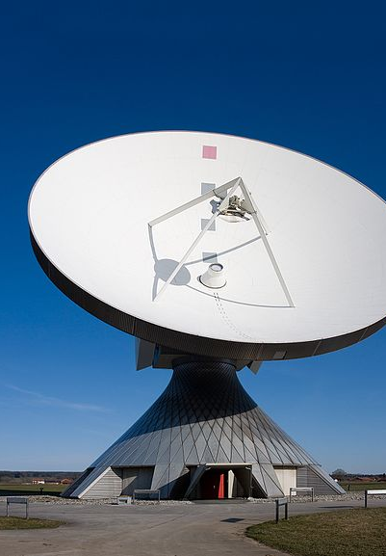
Media
“Fake news”
Be on our guard against such fake accounts of information
Media literate
Critical thinking skills
Where do you get your information?
No such thing as bias-neutral information
Notes:
Media
We are constantly inundated with information coming from various forms of media, such as the Internet, television, movies, music, newspapers, magazines, art, etc. Over the last two decades, there has been an increasing rise in what is known as “fake news” (especially online). This involves information that can appear on Twitter or Facebook or other such sites, in which people have deliberately created fake or false information to appear as though it is reliable. So we must be on our guard against such fake accounts of information. We must learn to become media literate. We have to empower ourselves with the critical-thinking skills that will allow us to recognize when information is not factual. So we cannot simply believe everything we see or read just because it’s on the Internet, or in a magazine, or on television.
You must ask yourself where you get your information. Do you get it mostly from online sources? Television? Newspapers? Magazines? The schoolyard? Your neighbor? Be aware that all information―no matter which type―comes to you already biased (including this very lecture). There is no such thing as bias-neutral information.
Image: Wikicommons: Erdfunkstelle Raisting 2.jpg

Slide 21
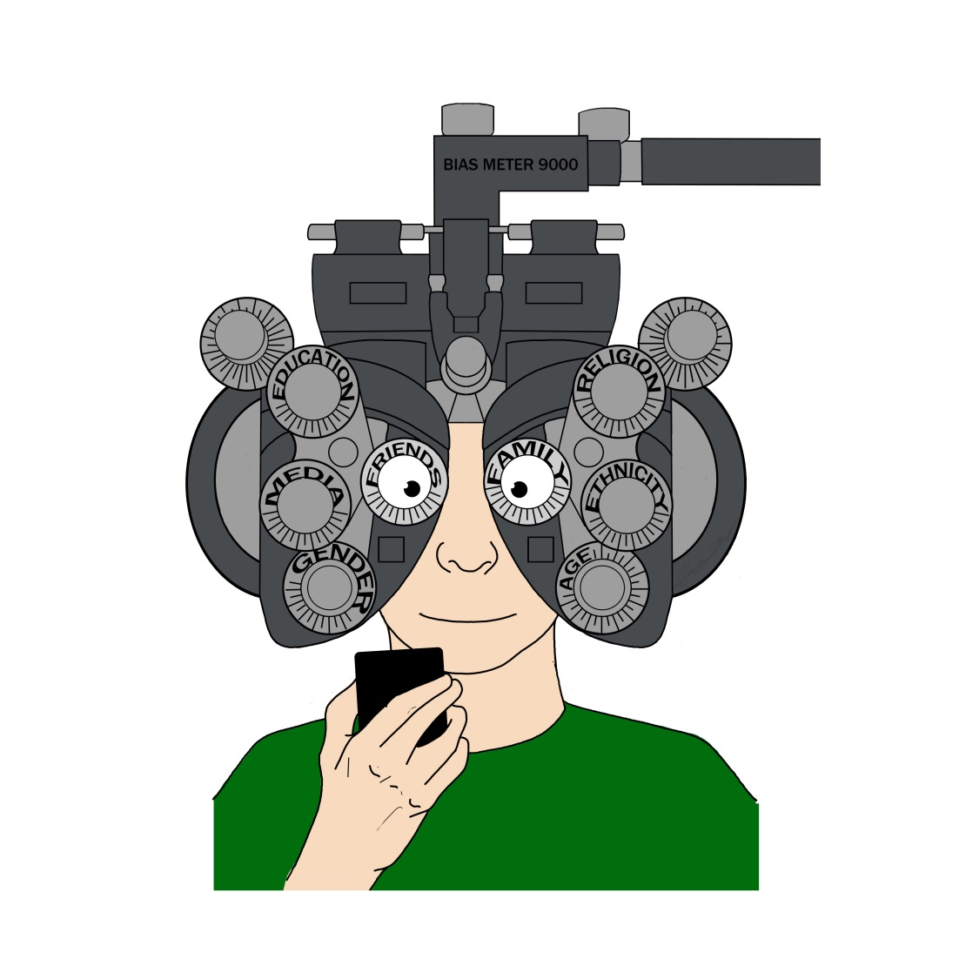
Bias check
Biases are filters of information
Confirmation bias
We favour information that confirms our own biases
Normal
Critical thinking -> Develop the ability to acknowledge our biases
Notes:
Bias Check: Biases are Filters of Information
If you haven’t already, you now need to understand that everything you think and everything you do is the result of your biological and cultural biases. You now need to do a Bias Check and become aware that any new information presented to you must pass through a series of biased filters before you can accept it, reject it, or remain neutral to it.
Image: Wikicommons:
Confirmation Bias:
We often favour information that confirms our own biases. This is normal. And this is what it means in many respects to be human. However, in critical thinking, we develop the ability to acknowledge what our biases are in an effort to more fairly understand why it is we believe what we do and why it is that we act according to those particular beliefs.
Image: Wikicommons:

Slide 22
More humble in our assertions
Fairer in our treatment of others
Recognize social biases -> Both in others and in ourselves
Notes:
In this way, we become more critically reflective of our beliefs and ideas and opinions. And in this way, we can become more humble in our assertions and fairer in our treatment of others whose opinions, ideas, and beliefs may differ from our own. As with news services, it is often difficult to diminish our own biases and vested interests in order to objectively consider and act upon the facts. So we must learn to recognize social biases, both in others and in ourselves,
Image: Wikicommons: [[File:HumilityErnie.jpg|HumilityErnie]]

Slide 23
Distorts sound reasoning -> Unwarranted conclusions
Critical thinking takes time, effort, and repetition
The most difficult part of becoming a good critical thinker is to acknowledge any biases in yourself that may distort your reasoning
Notes:
because these often distort sound reasoning, which leads to unwarranted conclusions. It is extremely difficult to acknowledge our own biases, especially when we are emotionally connected to a particular issue. But in order to argue clearly and present our ideas in a precise, consistent, and fair manner, we must learn to recognize and compensate for our biases. And this is not easy. That is why critical thinking takes time, and effort, and repetition. And it is why the most difficult part of becoming a good critical thinker is to acknowledge any biases in yourself that may distort your reasoning.
Image: Wikicommons:
[[File:Ambigram Real world Prank Fake rainbow animated (1).gif|Ambigram_Real_world_Prank_Fake_rainbow_animated_(1)]]

Slide 24
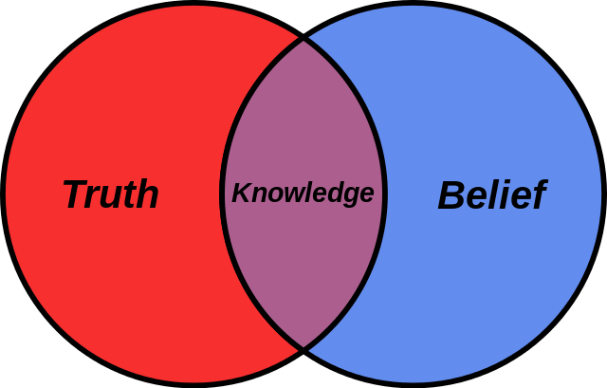
Take a moment
Why do you believe what you now do
Argument
Biases
Context
Evidence
Notes:
It is perfectly normal then that we are all victims of confirmation bias. Take a moment to consider your current beliefs regarding, say, gun control. Why do you believe what you now do in relation to this topic? What is your argument for or against gun control? What are you particular biases? In what context did you develop your views? What evidence do you rely upon to support your views? Whether you believe all guns should be destroyed or everyone should be able to carry loaded weapons anywhere they travel, your entrenched views developed over time, and whether you are aware of this or not, we tend to look more favorably toward information and evidence that supports our views and ignore that which disconfirms or fails to support our views. This type of positive-feedback looping of support feeds and confirms our already-established biases about issues.
Image: Wikicommons: [[File:Belief Venn diagram.svg|Belief_Venn_diagram]]

Slide 25
A person hears what they want to hear and disregards the rest
Acknowledge biases
Don’t let them cloud our abilities to think critically about important issues
Notes:
Perhaps a definition of confirmation bias is best summed up in a paraphrase of Paul Simon’s lyrics from the song ‘The Boxer’: A person hears what they want to hear and disregards the rest. We can never escape our biases. But at least we can acknowledge them and do our best to make sure that they have not clouded our abilities to think critically about important issues.
Image: Wikicommons: [[File:Paul Simon at the 9-30 Club (b).jpg|Paul_Simon_at_the_9-30_Club_(b)]]

Slide 26
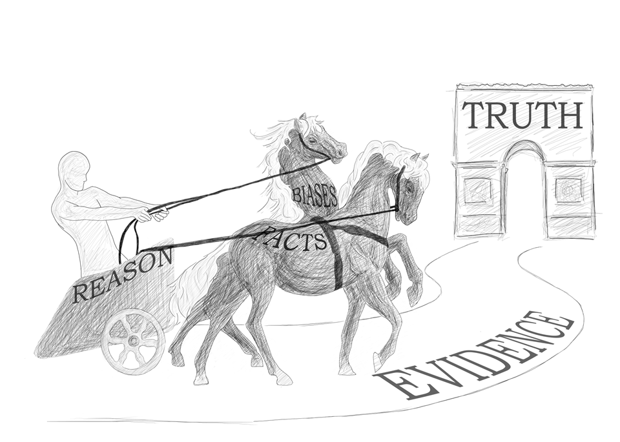
Notes:
The ancient Egyptians and Greeks had a wonderful model for humankind’s struggle with such influences. They used the analogy of a chariot rider. I wish to borrow and modify this allegory to visually demonstrate the difficulty we face when practicing critical thinking. If we can imagine the charioteer being represented as our reason, then the horses can be represented as both the facts and our biases. On the one hand, the facts lead us on a fairly straight path of evidence. However, our biases influence the manner in which we perceive and frame the facts according to our current habits of thinking. As critical thinkers, we must try to control our biases so that we can steer them to better follow where the facts will lead us down a path of evidence towards the truth.

Slide 27
Q&A session

Slide 28
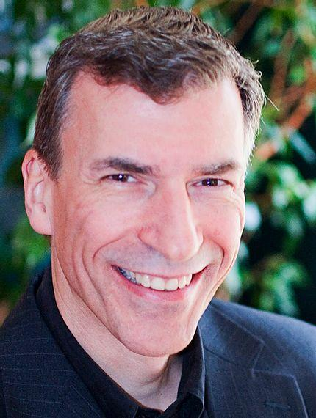
Thank you

