Slide 1
The ABC’s
of Critical Thinking
in Six Steps
Dr. Christopher DiCarlo
www.criticalthinkingsolutions.ca

Slide 2
The ABC’s of Critical Thinking
What is Critical Thinking?
Careful reflection on how and why you believe what you do?
How is Critical Thinking done?
By analyzing information according to a specific skill set
Why is Critical Thinking important?
Because what you think often influences how you behave which affects others whose beliefs and actions affect you.

Slide 3
The ABC’s of Critical Thinking
The ABCs (DEFs) of Critical Thinking
A is for Argument
B is for Bias
C is for Context
D is for Diagramming
E is for Evidence
F is for Fallacies

Slide 4
The ABC’s of Critical Thinking
A is for Argument
What comes to mind when you think of the word ‘argument’?
Anger, yelling, screaming…?
Monty Python: “Is this the right room for an argument?”
In Critical Thinking, an argument is a good thing
But what is it?
An argument is the way you put together or structure your ideas, opinions, or beliefs so that people will better understand what it is you’re trying to say.

Slide 5
The ABC’s of Critical Thinking
The structure of an argument: A main point and reasons that support it
Premise(s) + Conclusion = Argument
The Moon Landing was a hoax
9-11: A government conspiracy
Vaccines cause autism
“I believe x because…a, b, c…etc.”
Whatever your opinions, beliefs, ideas, or understandings, you need to realize that unless you can formulate them into arguments, you have nothing more than unjustified opinions (Jerry Springer, The View, etc.)

Slide 6
The ABC’s of Critical Thinking
When it comes to arguments, you need to think of a house
Your conclusion is your roof
Your walls (premises) support your roof
And your foundation is universal criteria
Consistency
Simplicity
Reliability
Relevance
Sufficiency

Slide 7
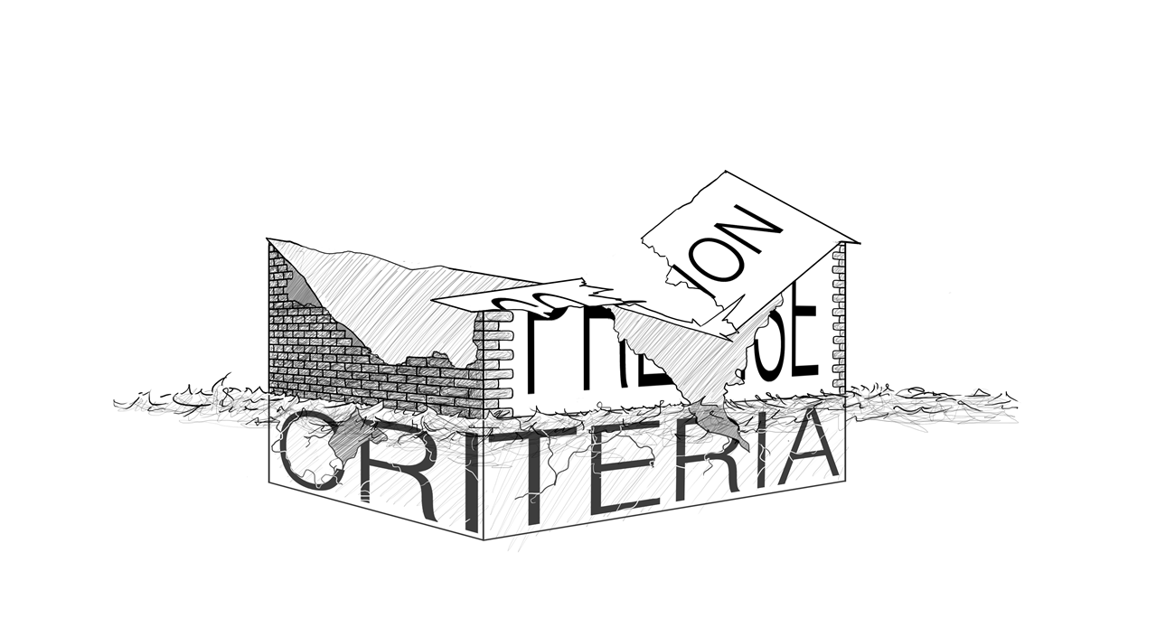
The ABC’s of Critical Thinking
If your premises fail to satisfy the foundational universal criteria…

Slide 8
The ABC’s of Critical Thinking
Types of Reasoning: Deductive, Inductive, Deductive
Deductive: CSI, Law and Order, House, The Good Doctor, etc.
Board games: Clue, Guess Who?
Father Bridgeman and Senator Donna Grainger
In deductive reasoning, the conclusion is guaranteed by the premises; it cannot be otherwise

Slide 9
The ABC’s of Critical Thinking
Inductive Reasoning
Conclusions are not logically valid but warranted or reasonable or probable
Hallmark of scientific reasoning
Uses statistical generalizations
Example: Likelihood of a dropped keys falling downwards in class?
Abductive Reasoning: Ignaz Semmelweis
A is for Argument

Slide 10
The ABC’s of Critical Thinking
B is for Biases
A bias is a way in which a person is influenced in order to understand and act on particular types of information
Consider many of the relevant factors that influence the ways in which we and others see and understand the world

Slide 11
The ABC’s of Critical Thinking
Is Donald Trump a good U.S. President?
How you answer this and many of life’s important questions are the result of your biases
Biological Biases: Genetics, neuropsychology, emotions, sex, age, health, etc.
Cultural Biases: Ethnicity, family, religion, friends, media, education, etc.

Slide 12
The ABC’s of Critical Thinking
Biological Biases: Genetics, neuropsychology, emotions, gender, age, health, etc.
Cultural Biases: Ethnicity, family, religion, friends, media, education, etc.
Emotions

Slide 13
The ABC’s of Critical Thinking
Biological Influences
Genetics
ADHD Timmy: 1950’s midwest USA
Choice vs. biological development
Genes do not work in isolation
Epigenetics

Slide 14
The ABC’s of Critical Thinking
Neuropsychology
Mental health issues, neuroses, psychoses, OCD, suicide, infanticide, addictions, etc.
Emotions
Affective states that can motivate human behavior
Basic human emotional states: fear, anger, sorrow, joy, disgust, anticipation, surprise, and acceptance
More subtle variations: terror or phobia, rage, sadness, grief, depression, happiness, gladness, gratitude, etc.
These are cross-culturally universal

Slide 15
The ABC’s of Critical Thinking
Human emotions are a product of millions of years of evolution during which our ancestors were placed in situations requiring them to behave and react in specific ways
The interactions between our thinking or rational selves and our emotional selves generate conflicting beliefs, attitudes, and behaviour
We need to be attentive to the fact that we are a highly emotional species
Discussing issues that we find emotionally charged creates an environment in which controlling our biases becomes extremely difficult e.g. abortion, euthanasia, healthcare, capital punishment, stem cell research, the Leafs….

Slide 16
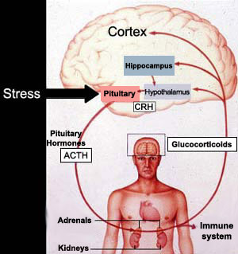
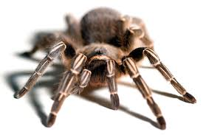
The ABC’s of Critical Thinking
My son’s pet
tarantula: Harry
Fight or Flight

Slide 17
The ABC’s of Critical Thinking
Sexual differences
Males and females composed of differing quantities of hormones
Dimorphism
Studies into the physiological, hormonal, and neural differences between males and females provide important information in the treatment of sex specific diseases, the function of medications, different procedures for surgeries, etc.

Slide 18
The ABC’s of Critical Thinking
Cultural Influences
Memes: any cultural artifact imaginable including one’s beliefs, habits, and customs
Over the last forty thousand years, the quantity of our memes has increased exponentially

Slide 19

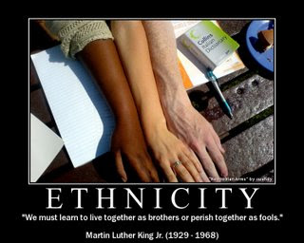
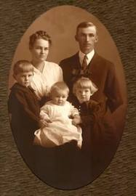
The ABC’s of Critical Thinking
Social Biases
Ethnicity
Family Upbringing
Religion

Slide 20
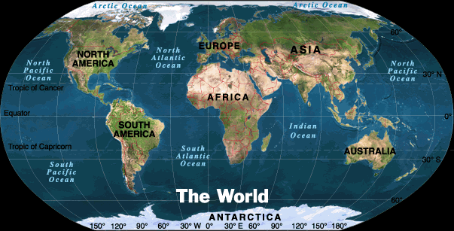



The ABC’s of Critical Thinking
Geographic Location
Education
Friends
Media

Slide 21
The ABC’s of Critical Thinking
Biases act like filters through which we attempt to make sense of the world

Slide 22
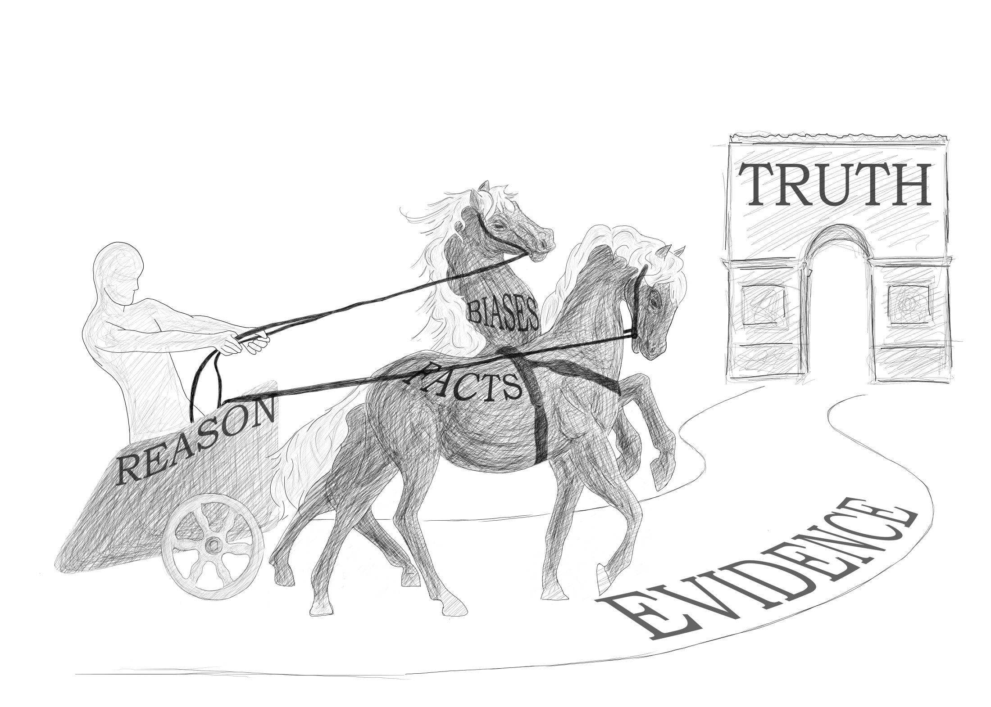
Six Steps to Better Thinking

Slide 23
The ABC’s of Critical Thinking
The most difficult part of becoming a good critical thinker is to acknowledge any biases in yourself that may distort your reasoning
The better we understand our biases, the more reflective we will be when discussing important issues
B is for Biases

Slide 24
The ABC’s of Critical Thinking
C is for Context
Context = Time, Place, and Circumstance

Slide 25
The ABC’s of Critical Thinking
These factors, along with other factual forms of background information, will allow you to more fairly assess information
“The Roof Is on Fire” (Bloodhound Gang)
Important to identify context related to arguments or information
Otherwise, we may judge and react unfairly and too quickly
Strawman Argument

Slide 26
The ABC’s of Critical Thinking
All of language is embroiled within a context in which we try to convey not only what it is we’re thinking but also how we’re feeling and what the setting is in which these interactions are taking place
Context allows us to better understand the reasons why someone might think and act in a particular way

Slide 27
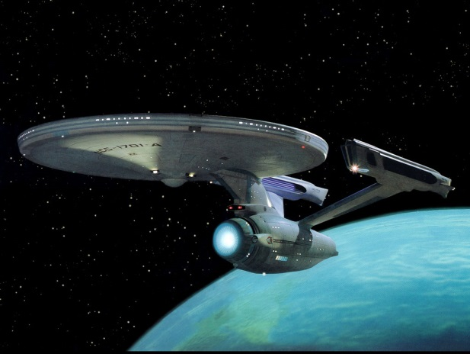
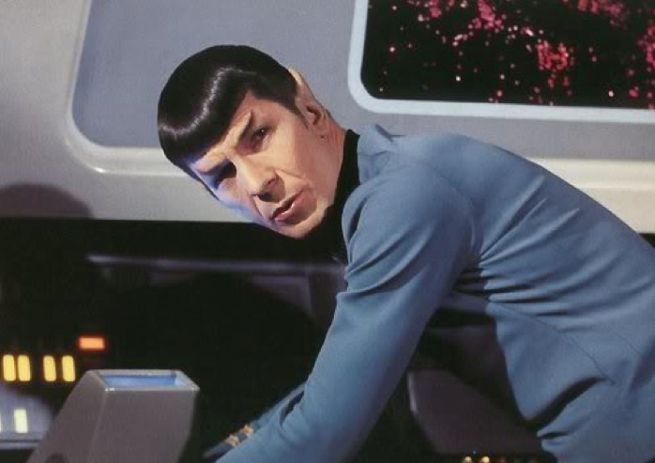
The ABC’s of Critical Thinking
Spock just not himself lately
Spock diverts the ship to his home
planet against the orders of Captain
Kirk
Why would such a logical being defy orders
from Kirk?
Context: Spock must return to his home
planet (Vulcan) within
eight days to take part in
Pon farr: a mating ritual,
or he will die

Slide 28
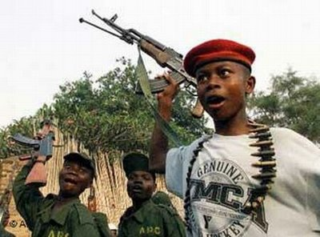
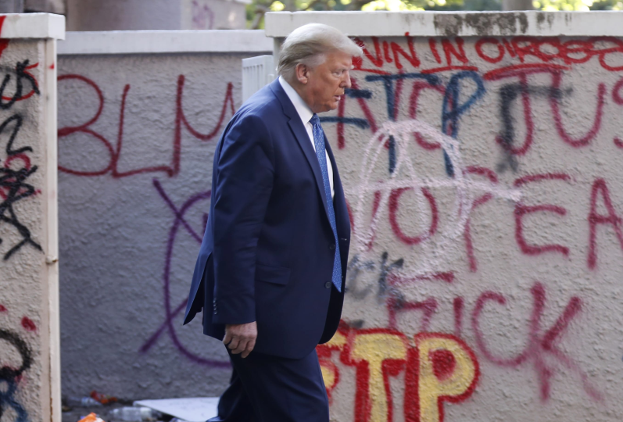
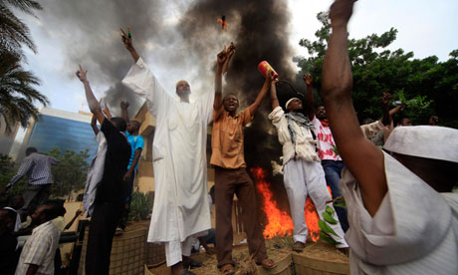
The ABC’s of Critical Thinking
How then, do we try to understand the actions of others elsewhere?
For example: the Middle East, the Congo, the United States….

Slide 29
The ABC’s of Critical Thinking
My privileged view of trying to understand what is happening in other parts of the world has limited contextual background
Since I am removed from their world, and I experience it through the filtered and biased views of television news editors (as well through the filters of my own biases), I may not be getting the complete story and may find myself divorced from some of the contextual nature of the activities that are taking place

Slide 30
The ABC’s of Critical Thinking
We need to be careful when interpreting information to make sure we have established enough background information to be able to acknowledge the context in which the information is being presented
In this way, when context is sufficient, we can more fairly interpret what is being presented and why the information is being presented in the way it is

Slide 31
The ABC’s of Critical Thinking
Context and enough relevant information is dependent upon the conditional that one believes to be in possession of enough relevant information and the context in which that information is found
The conditional can be stated in various forms, as shown in the list that follows, but they all mean the same thing:
  1. “Based on the information I have before me and the context in which it is placed, . . .”
  2. “All things considered, . . .”
  3. “Given what I now know, . . .”

Slide 32
The ABC’s of Critical Thinking
Understanding Context allows us to more fairly assess the information which we are considering
So fairness is directly tied into the amount of information determined and the context in which it is found in light of the way it is understood according to specific biases
Fairness is the Cornerstone of Critical Thinking

Slide 33
The ABC’s of Critical Thinking
So why should we “play fair”?
The rest of the world doesn’t. Wouldn’t doing so make us suckers or chumps?
No, not really
Because playing fair and cooperating is the only way we can truly keep order and respect in a world where there are so many cheaters
When everyone plays fairly, the majority gets more of what it wants

Slide 34
The ABC’s of Critical Thinking
THE RULES OF FAIR PLAY FOR CRITICALTHINKING
1. Acknowledge your existing biases and determine how they filter the way in which you see and act in the world.
2. Make every effort to attain enough facts before formulating a position on a particular issue.
3. Make every effort to acknowledge the context in which the facts occur before formulating a position on a particular issue. Use a conditional: “All things considered, this is what I now believe.”
4. Acknowledge that, due to the way in which so many people are biased differently, there are going to be disagreements on many issues.
5. Be open to the possibility of revising your position.

Slide 35
The ABC’s of Critical Thinking
C is for Context
By understanding how our biases affect our judgments—and considering the amount of information we have attained along with the context in which it is presented—we can go a long way toward increasing the likelihood of a fair account, which will ultimately lead to more effective communication for all parties

Slide 36
The ABC’s of Critical Thinking
THE SCIENTIFIC METHOD IN SIX EASY STEPS
The scientific method for acquiring evidence generally follows this type of pattern:
1. We often first make an observation of something that has happened.
2. We then consider what caused this thing to happen by posing educated guesses (or hypotheses).
3. We can then make predictions about what we should expect to see if our hypotheses are correct.
4. If necessary, experimentation and data collection may be conducted.

Slide 37
The ABC’s of Critical Thinking
5. Further observation is necessary, which will lead to three possible outcomes:
  a. If we observe that our data positively support our prediction, then we have hypothesis confirmation (at least for now, or tentatively).
  b. If we observe that our data do not support our prediction, then we have hypothesis falsification, and we may be forced to either give up or modify our hypothesis.
  c. If there are simply not enough data to decide either way, then we suspend judgment.
6. Finally, we need to consider whether there are any other competing hypotheses that provide an equally plausible or likely explanation of our observation. If there are, then we need to ask ourselves which seems more reasonable. If there are no others, then we may decide to tentatively accept the hypothesis based on the currently available information

Slide 38
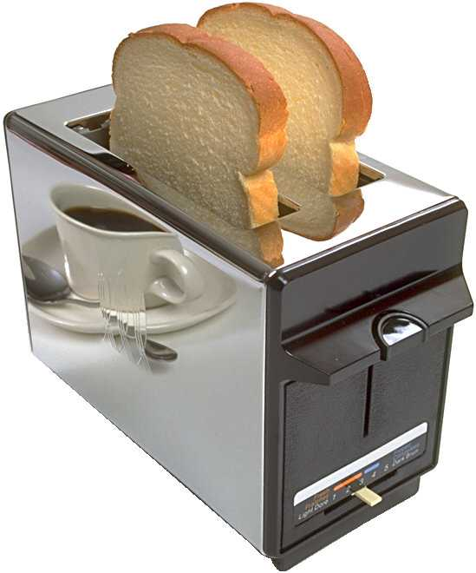
The ABC’s of Critical Thinking
Bread in the Toaster Example
Scientific reasoning has
become our most powerful tool
In understanding cause-and-effect
relationships in the natural world,
and the evidence it provides gives the
greatest strength to our premises
in support of our explanations

Slide 39
The ABC’s of Critical Thinking
SCIENTIFIC STUDIES: ASKINGTHE RIGHT QUESTIONS
“There are three types of lies: lies, damn lies, and statistics.” (Mark Twain)
67.52% of all statistics are made up on the spot ;-)

Slide 40
The ABC’s of Critical Thinking
Important Questions for Studies:
1. Who conducted the study?
2. What was the motivation for the study—in other words, why was it conducted in the first place?
3. Who funded the study?
4. What was the methodology of the study, or how was the study carried out? (Remember to consider sample size and representation.)
5. Is the study repeatable? That is, would any other scientists, under similar conditions, arrive at the same findings?

Slide 41
The ABC’s of Critical Thinking
Asking these questions will empower you with the ability to cut through any references to studies as evidence for premises in any given argument
Whenever anyone tries to support their conclusion with the statement: “Studies show that….”
Remember the five questions

Slide 42
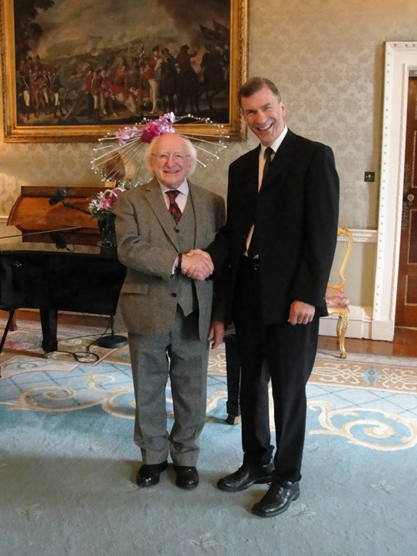
Thank you.

