Slide 1
How to Talk to a Conspiracy Theorist
Lecture 03:
The Demise of Journalism and the Rise of Social Media
---
DR CHRISTOPHER DICARLO

Slide 2
Psychological underpinnings
Processes
Last 20 years
Two central historical events
Diametrically opposing processes
The demise of journalism since the 1990s
Increase of social media presence on the World Wide Web
A perfect recipe
Notes:
Introduction:
Now that we have a better understanding of the type of psychological underpinnings that predominantly characterize a conspiracy theorist, it becomes important to familiarize ourselves with the processes through which conspiracy theories have exploded over the last 20 years or so. Generally speaking, we will consider two central historical events that generated diametrically opposing processes which created a perfect environment for conspiracy theorists to spread information and join like-minded communities. The two processes involved the demise of journalism since the 1990s and the simultaneous increase of social media presence on the World Wide Web. As we shall see, these two processes fed off of one another and, in so doing, reduced the rigour of journalistic integrity while simultaneously allowing popular forms for anyone with an opinion to be able to reach millions of people. This was a perfect recipe for the proliferation of conspiracy theories in the 21st century.

Slide 3
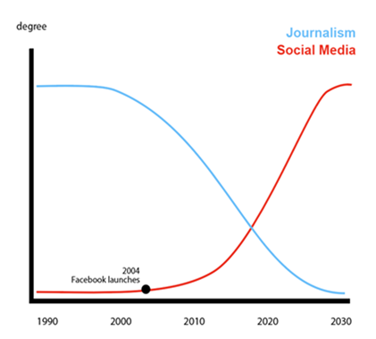

Slide 4
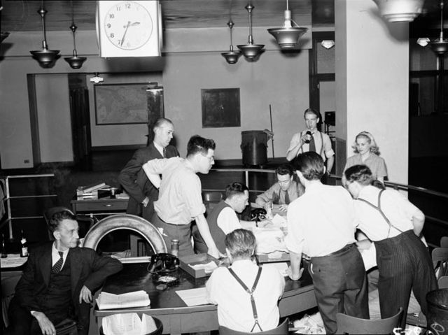
From the Golden Days of Journalism to its Eventual Decline.
No such thing as bias-free journalism
World War II
Field of journalism was revered and well-respected
Notes:
From the Golden Days of Journalism to its Eventual Decline
Keep in mind, that as long as there has been news reporting, there have been biases and vested interests. There is simply no such thing as bias-free journalism. However, there was a time, not too long ago, soon after World War II, when the field of journalism was revered and well-respected...
Image:
[[File:Globe and Mail staff wait for news.jpg|Globe_and_Mail_staff_wait_for_news]]

Slide 5
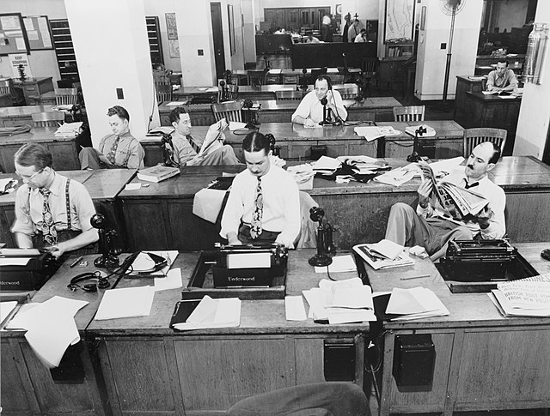
From the Golden Days of Journalism to its Eventual Decline.
Journalists were driven by duty and integrity to report information honestly and truthfully
Keeping their personal biases in check
Mid-20th century
Reliability and trustworthiness
Notes:
...precisely because journalists were driven by duty and integrity to report information honestly and truthfully while keeping their personal biases in check. By the mid-20th century, journalists, writers, and reporters, were given an elevated status in society because they endeavored to present news and information in the most relevant and honest manner. The concepts of reliability and trustworthiness were embedded in the creed of all journalists who considered it not just an injustice, but a betrayal of their integrity to report false or overly biased information.
Image:
[[File:Globe and Mail staff wait for news.jpg|Globe_and_Mail_staff_wait_for_news]]

Slide 6
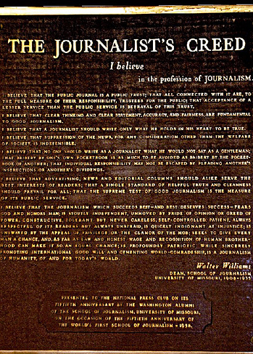
The Journalist's Creed
American journalist, Walter Williams
I believe in the profession of journalism
I believe that the public journal is a public trust; that all connected with it are, to the full measure of their responsibility, trustees for the public; that acceptance of a lesser service than the public service is betrayal of this trust
Notes:
In 1914, the American journalist, Walter Williams, wrote a code of journalistic ethics called The Journalist's Creed which states the following:
I believe in the profession of journalism.
I believe that the public journal is a public trust; that all connected with it are, to the full measure of their responsibility, trustees for the public; that acceptance of a lesser service than the public service is betrayal of this trust.
Image: https://longversion.wordpress.com/2012/09/23/the-journalists-creed/

Slide 7
I believe that clear thinking and clear statement, accuracy and fairness are fundamental to good journalism
I believe that a journalist should write only what he holds in his heart to be true
I believe that suppression of the news, for any consideration other than the welfare of society, is indefensible
Notes:
I believe that clear thinking and clear statement, accuracy and fairness are fundamental to good journalism.
I believe that a journalist should write only what he holds in his heart to be true.
I believe that suppression of the news, for any consideration other than the welfare of society, is indefensible.
Image: https://longversion.wordpress.com/2012/09/23/the-journalists-creed/

Slide 8
I believe that no one should write as a journalist what he would not say as a gentleman; that bribery by one’s own pocketbook is as much to be avoided as bribery by the pocketbook of another; that individual responsibility may not be escaped by pleading another’s instructions or another’s dividends
Notes:
I believe that no one should write as a journalist what he would not say as a gentleman; that bribery by one’s own pocketbook is as much to be avoided as bribery by the pocketbook of another; that individual responsibility may not be escaped by pleading another’s instructions or another’s dividends.
Image: https://longversion.wordpress.com/2012/09/23/the-journalists-creed/

Slide 9
I believe that advertising, news and editorial columns should alike serve the best interests of readers; that a single standard of helpful truth and cleanness should prevail for all; that the supreme test of good journalism is the measure of its public service
Notes:
I believe that advertising, news and editorial columns should alike serve the best interests of readers; that a single standard of helpful truth and cleanness should prevail for all; that the supreme test of good journalism is the measure of its public service.
Image: https://longversion.wordpress.com/2012/09/23/the-journalists-creed/

Slide 10
I believe that the journalism which succeeds best — and best deserves success — fears God and honors Man; is stoutly independent, unmoved by pride of opinion or greed of power, constructive, tolerant but never careless, self-controlled, patient, always respectful of its readers but always unafraid, is quickly indignant at injustice; is unswayed by the appeal of privilege or the clamor of the mob; seeks to give every man a chance and, as far as law and honest wage and recognition of human brotherhood can make it so, an equal chance; is profoundly patriotic while sincerely promoting international good will and cementing world-comradeship; is a journalism of humanity, of and for today’s world
Notes:
I believe that the journalism which succeeds best — and best deserves success — fears God and honors Man; is stoutly independent, unmoved by pride of opinion or greed of power, constructive, tolerant but never careless, self-controlled, patient, always respectful of its readers but always unafraid, is quickly indignant at injustice; is unswayed by the appeal of privilege or the clamor of the mob; seeks to give every man a chance and, as far as law and honest wage and recognition of human brotherhood can make it so, an equal chance; is profoundly patriotic while sincerely promoting international good will and cementing world-comradeship; is a journalism of humanity, of and for today’s world.
Image: https://longversion.wordpress.com/2012/09/23/the-journalists-creed/

Slide 11
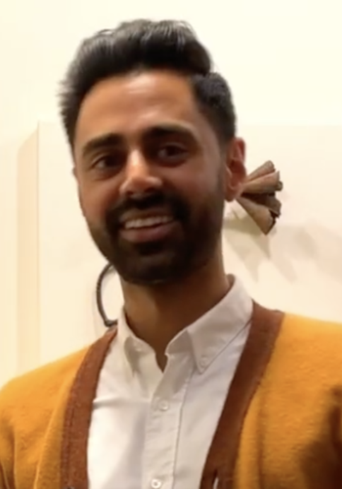
Reporting the facts in as least-biased a manner as possible
A sacred trust between journalists and the general public
‘The golden days of journalism’
‘The Golden Age of Nonsense’
- Hasan Minhaj
Notes:
Published in more than 100 languages, a bronze plaque of The Journalist's Creed hangs at the National Press Club in Washington, D.C. Walter Williams became the founding dean of the Missouri School of Journalism.
Members of the Fourth Estate, as it were, were held in such high regard because of their integrity and commitment to limit their biases when reporting information in as honest and truthful manner as possible. Reporting the facts in as least-biased a manner as possible, was often considered to be a sacred trust between journalists and the general public. It was not the job of the journalist to inject their own social commentary into reporting the facts. Getting the story right - in other words, presenting information in as truthful and contextually accurate manner as possible, was the overarching and central goal of all journalism at one time. We might call that time ‘the golden days of journalism’. Today, those days are gone; sad remnants of a time that was. Today, we’re living in what Hasan Minhaj calls ‘The Golden Age of Nonsense’.
Image: [[File:HasanMinhaj2020.png|HasanMinhaj2020]]

Slide 12
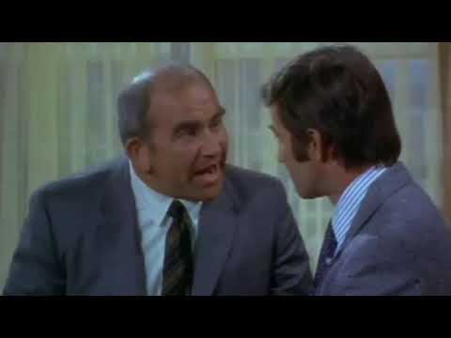
The Mary Tyler Moore Show
The Gradual Decline of Journalistic Integrity
“News is truth, Jack! And I'm not going to make it into something fake!”
Notes:
The Gradual Decline of Journalistic Integrity
It is difficult to pinpoint exactly when journalism began to lose its integrity. On a personal note, my earliest recollection came from a television sitcom I remember watching in the early 1970s called: The Mary Tyler Moore Show. The basic premise of the show involved the setting of a television news show - WJM-TV - in Minneapolis Minnesota. Mary Tyler Moore played a character named Mary Richards who was an associate news producer. Her boss, Lou Grant, played by Ed Asner, played the executive producer. And the anchorman, Ted Baxter, was played by Ted Knight. In one episode, the television station was being run by a new station manager who wanted to make the news more appealing to the general public in order to increase ratings. During this episode there is a scene in which the characters Lou Grant, Mary Richards, and Ted Knight, visit the new station manager to discuss his radical new idea to spruce up the news and make it “more entertaining”. It is during this particular prescient scene that we see the roots of the decline of journalistic integrity:
Lou Grant: We’re talking about news, here. News! Our job isn't to make people laugh. It's to let them know what's happening. I can live with ratings. When I was an editor, I used to live with circulation numbers. But when the circulation went down, we didn’t put the comics on the front page. News is truth, Jack! And I'm not going to make it into something fake.
Jack Stonem: Why not?
Lou Grant: Why not?
Jack Stonem: Well after all Lou, there's fake, and then there's fake.
Image: [[File:Mary Tyler Moore Show cast last show 1977.JPG|Mary_Tyler_Moore_Show_cast_last_show_1977]]

Slide 13
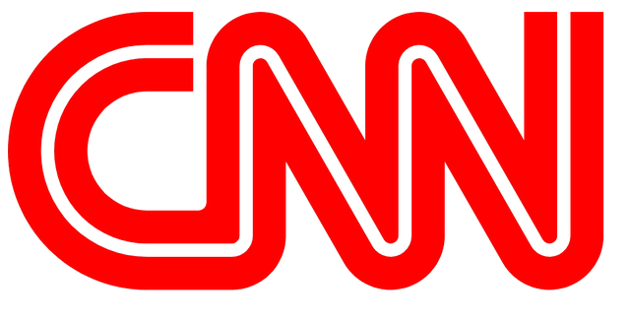
Dual Anchors
1980’s
MTV
Big Hair
CNN
Notes:
This appears to be the earliest reference to so-called ‘fake news’ on American television. And that was in 1972. Since then, more and more newscasts throughout the 1970s went from singular anchors reporting the news, two dual anchors who provide witty banter and commentary about the stories they're covering. This shift in reporting the news to commenting on the news was a crucial development in journalistic history. And it was coming largely from the United States. This fostered continuous competition amongst new services on television to 'spruce up' or make the reporting of news more entertaining to the general public. Form became more important than substance. And eventually, the entertainment aspect of appealing to viewers to increase ratings began to overshadow the journalistic integrity of those doing the reporting. By the 1980s, this new model of television news reporting had taken hold. But something else was happening as well. The 80s ushered in MTV, VHS videos, big hair, Pay-TV, and 24-hour news. In Atlanta, Ted Turner had started CNN and around the clock news-casting had begun. In the decades to follow, major news outlets would be established or purchased by wealthy billionaires with very clear political leanings.
Image: [[File:MTV Logo.png|MTV_Logo]]
Image: [[File:CNN.png|CNN]]

Slide 14
15 billionaires and six corporations
Notes:
About 15 billionaires and six corporations own most of the U.S. media outlets. The biggest media conglomerates in America are AT&T, Comcast, The Walt Disney Company, National Amusements (which includes Viacom Inc. and CBS), News Corp and Fox Corporation (which are both owned in part by the Murdochs), Sony, and Hearst Communications.
It should come as little surprise to witness the way such biases influence both the manner in which the news is presented, and the viewers of such services.
Image: <a href="https://www.titlemax.com/discovery-center/lifestyle/who-owns-your-news-the-top-100-digital-news-outlets-and-their-ownership"><img src="https://storage.googleapis.com/titlemax-media/9da18bf2-who-owns-your-news-11_60per_compressed.png" alt=" Who Owns Your News? The Top 100 Digital News Outlets and Their Ownership – TitleMax.com – Infographic" title=" Who Owns Your News? The Top 100 Digital News Outlets and Their Ownership – TitleMax.com – Infographic"></a><br><a href="https://www.titlemax.com" alt="TitleMax.com" title="TitleMax.com">Created by TitleMax.com</a>

Slide 15
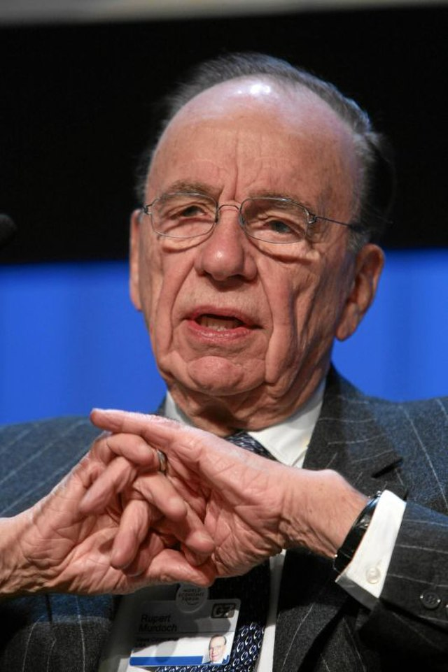
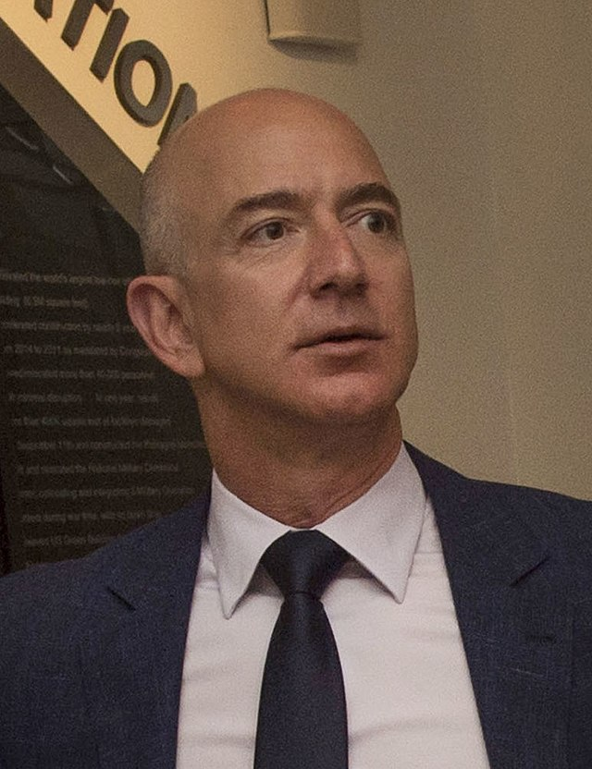
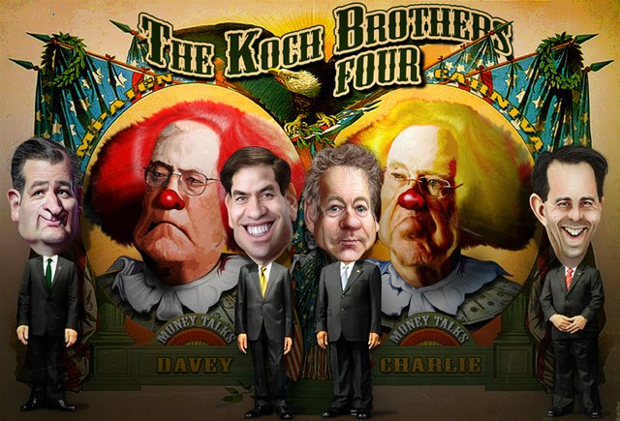
Fox and CNN
The Murdoch family owns Fox News
Amazon's Jeff Bezos owns the Washington Post
The Koch brothers own Time
Notes:
It is pretty obvious in which political directions the viewers, listeners, or readers lean. Fox and CNN seem to be the most obvious for right and left leanings. But others, like MSNBC and say, Brietbart are also clearly polarized.
Left or Right Leanings for News Sources in America:
It is important to understand that there are some very wealthy and influential people who own these major news outlets. For example, the Murdoch family owns Fox News, while Amazon's Jeff Bezos owns the Washington Post. The Koch brothers own Time and other billionaires and conglomerates control the rest.
Images:
[[File:Rupert Murdoch - WEF Davos 2007.jpg|Rupert_Murdoch_-_WEF_Davos_2007]]
[[File:Jeff Bezos 2016 (cropped).jpg|Jeff_Bezos_2016_(cropped)]]
[[File:Koch Brothers Four (16334841461).jpg|Koch_Brothers_Four_(16334841461)]]

Slide 16
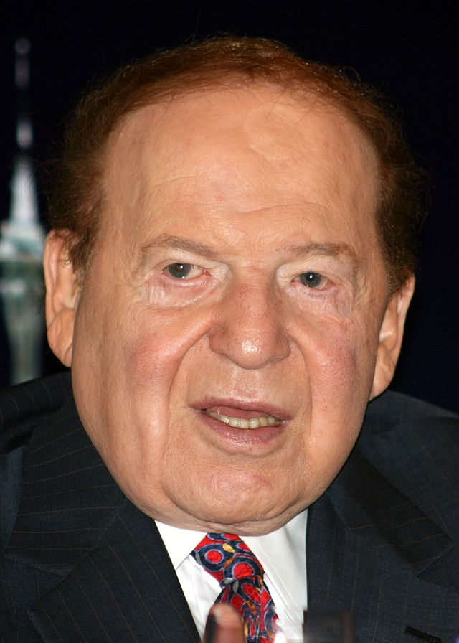
Many media owners are hands-off in terms of content
Some are quite invasive
The Las Vegas Review-Journal
Sheldon Adelson
Adelson doesn’t practice the ‘hands-off’ approach to journalism
Notes:
While it’s important to consider who controls the media, it’s also important to remember that many media owners are hands-off in terms of content, but some are quite invasive. Will news companies run a story that paints their umbrella corporation in a negative light? It depends on the publication, the parent company, and the ethics of their journalists.
The important point to remember, here, is that if you have enough money, you can control not just how the news is delivered, but what the content will be and how it will be spun. As John Oliver points out, this is exactly what happened to the Las Vegas Review-Journal. This particular paper was purchased by billionaire Republican mega-donor, Sheldon Adelson. Due to his vast wealth and influence, many of the stories in the Review-Journal are about businesses he personally owns. But Adelson doesn’t practice the ‘hands-off’ approach to journalism; he actively controls the content and the way in which the content is presented:
Image: [[File:Sheldon Adelson crop.jpg|Sheldon_Adelson_crop]]

Slide 17
Print Media
Print media
Local newspapers
73% of US citizens trust their local newspapers as opposed to 55% who trust national news services
2004: approximately 2,000 newspapers have shut down
A drop of 57% of all newspapers in the US
In all major cities throughout the world
Notes:
In this review process, things are changed, added, removed. There's no explanation for why and there's no appeal. Reporters have asked if they could have their name taken off the story and have been told that's not allowed. There are things that are done because it's known that this is the way Adelson wants it to read. And it can be something minor or something very big.
While billionaires have been buying up media outlets, something rather peculiar was happening to print media. By the turn of the millennium, print media was starting to go the way of the dinosaur due to the rise of digital media. And that is unfortunate because local newspapers provide the best sources for reliable news and even though they have been cut back to producing only around 25% of news media available, they produce almost half of all original reporting which shows up on Facebook, or Twitter, or podcasts, or cable news shows. Even though polls indicate that 73% of US citizens trust their local newspapers as opposed to 55% who trust national news services, since 2004, approximately 2,000 newspapers have shut down. That’s a drop of 57% of all newspapers in the US and similar patterns have occurred in all major cities throughout the world.
Image: [[File:Newspapers.png|Newspapers]]

Slide 18
Google, Facebook, and Twitter
A drastic decay in the level of news reporting world-wide
‘High-fructose bullshit’
- Hasan Minhaj
‘Commentary on other peoples’ commentary is not news; it’s gossip’
Notes:
Even major newspapers were laying off staff and selling assets because large social media platforms like Google, Facebook, and Twitter, could practically give the news away for free. This led to a drastic decay in the level of news reporting world-wide. The internet was capitalizing on producing what Hasan Minhaj calls “high-fructose bullshit” saying: “Commentary on other peoples’ commentary is not news; it’s gossip.” The newspaper and magazine industries were hit very hard during these times. In case you’re wondering, newspapers - especially local newspapers - are extremely important in the gathering and reporting of information.
Image: [[File:Automotive Social Media.jpg|Automotive_Social_Media]]

Slide 19
Newspapers and magazines make their money on print advertising.
So who’s getting the money for online news?
Facebook and Google
The unregulated world of private industry.
Notes:
As John Oliver says:
Papers have been closing for years, and that affects all of us, even if you only get your news from Facebook, Google, Twitter, "Arianna Huffington's Junction and Book Excerpt Clearinghouse." Those places are often repackaging the work of newspapers...It's obvious: without newspapers around to cite, TV news would just be Wolf Blitzer endlessly batting a ball of yarn around.
Newspapers and magazines make their money on print advertising. But online, there isn’t nearly the means to earn as much revenue:
And the problem is, print ads are less popular with advertisers than they used to be. And online ads produce much less revenue. Between 2004 and 2014, newspapers gained two billion dollars in online ad revenue. Unfortunately, in that same period, they lost $30 billion in print revenue.
So who’s getting the money for online news?
Facebook and Google capture much of the online gatekeeping ad dollars. Online subscriptions are the only way to make money for news services. That may work for the NY Times, Washington Post, WSJ, etc., but the smaller papers have been hit hard by unregulated world of private equity.
Wait, what? What the hell is the unregulated world of private industry?
Image: [[File:More than 70% of all internet traffic goes through sites owned or operated by Google or Facebook.png|More_than_70%_of_all_internet_traffic_goes_through_sites_owned_or_operated_by_Google_or_Facebook]]

Slide 20
Vulnerable to private equity firms and hedge funds
‘Leveraged buyout’ (LBO)
A huge bank loan (that’s the leverage)
Dump the bank loan debt back on the newspaper
Squeeze as much money out of the newspaper by laying off workers, selling assets like real estate, and [then] charge enormous management fees
Notes:
Image: [[File:Leveraged Buyout Diagram.png|Leveraged_Buyout_Diagram]]

Slide 21
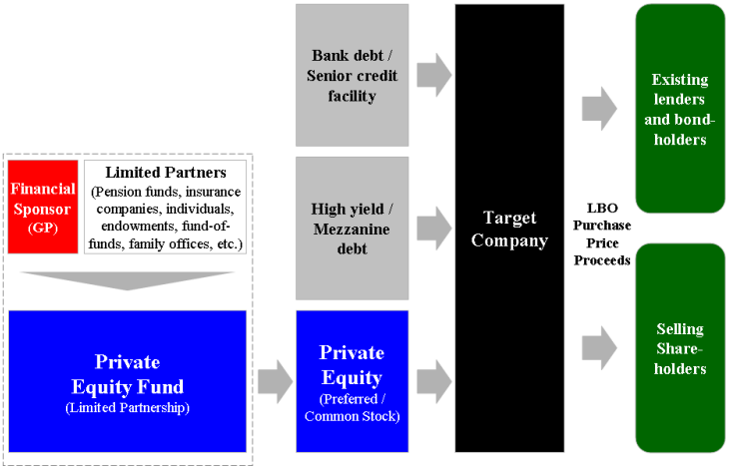

Slide 22
‘Off the hook’
Ten times more likely to claim bankruptcy
‘Vulture funds’
30% of all newspapers in the US are controlled by two such vulture funds: Fortress Investment Group and Alden Global Capital
A ‘rape and pillage’ strategy
Notes:
If the newspaper goes bankrupt, the hedge fund company is ‘off the hook’. Large companies who conduct LBO’s are ten times more likely to claim bankruptcy.
For the record, the name given to such private equity companies who go after failing newspapers is ‘vulture funds’. According to Minhaj, today, about 30% of all newspapers in the US are controlled by two such vulture funds: Fortress Investment Group and Alden Global Capital. Their method for ‘acquiring’ such businesses has been called a ‘rape and pillage’ strategy.
Image: https://www.crunchbase.com/organization/alden-global-capital/signals_and_news

Slide 23
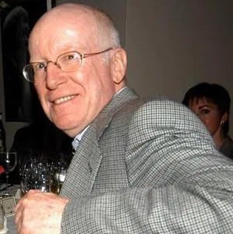
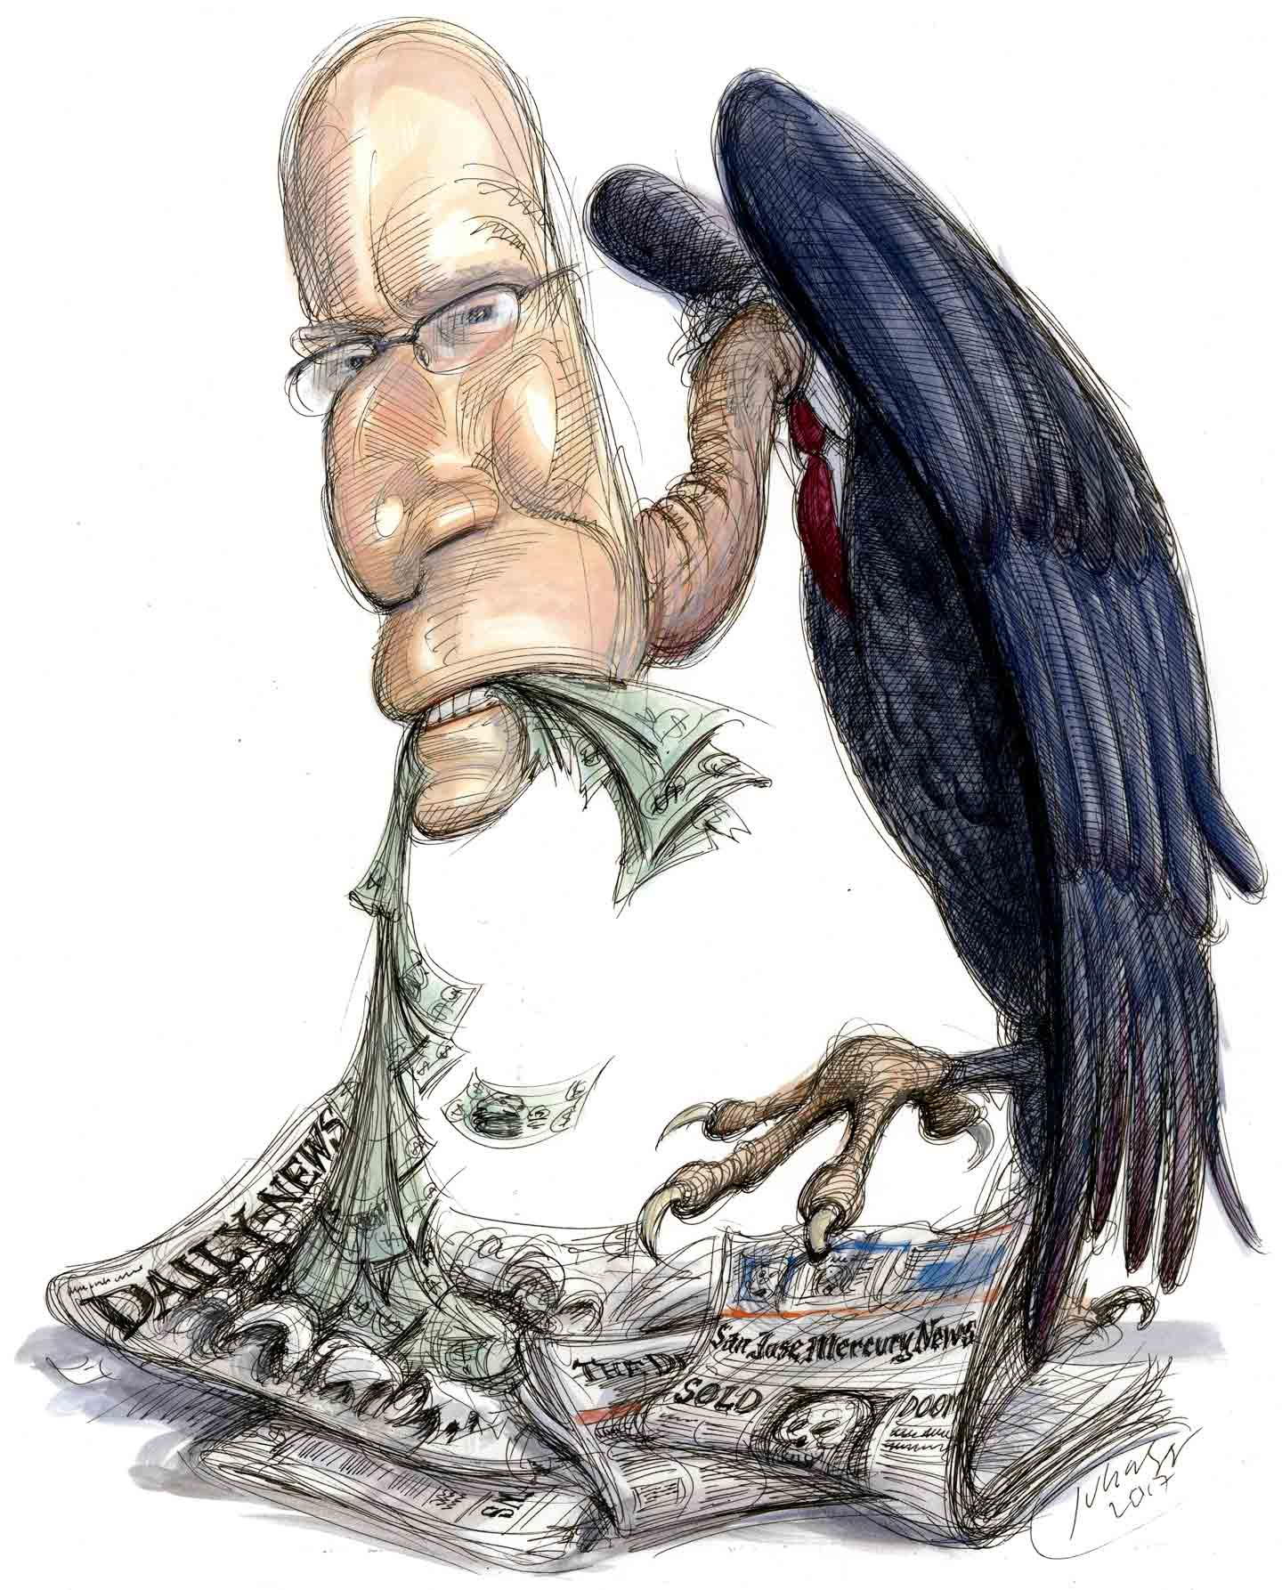
Randall Smith
Billionaire who owned Alden
It’s this picture:
Let’s go to a caricature:
Notes:
Alden has been called “…the grim reaper of American newspapers…” and “the hedge fund vampire that bleeds newspapers dry…” Alden is owned by billionaire, Randall Smith. Currently, there is only one available photograph of Smith online and it is unlicensed - which means if you post it publicly, you can be sued. It’s this picture:
But if we can’t show this picture, fuck Randal Smith; let’s go to a caricature:
Images:
https://www.thenation.com/article/archive/how-many-palm-beach-mansions-does-a-wall-street-tycoon-need/
https://nypost.com/2012/07/26/vulture-in-distress/

Slide 24
Between the years 2012 to 2018, papers on average lost 32% of their entire workforce
Alden newspapers laid off 72% of their staff
The Mercury newspaper from Pottstown, PA
One particular journalist, Evan Brant, was asked to cover 25 different beats
Notes:
Smith’s company aggressively buys newspapers and then fires staff and sells assets to make more money for himself while ending the careers of plenty of journalists. For example, between the years 2012 to 2018, papers on average lost 32% of their entire workforce. However, during that same time period, Alden newspapers laid off 72% of their staff and that was regardless of whether or not unions were involved.
So journalists were laid off or fired. Papers closed - as they have, without notice, in my own home town and many others. For those journalists lucky enough to still have a job, they now had to learn how to write, and blog, and compete for clicks online.
Extra digital demands placed on journalists is now common throughout the industry. They have to do their reporting, participate in social media, produce a wire service that's available 24 hours a day, they have to be responsible for video, you name it...It's a lot to ask.
To demonstrate just how absurd the demands on journalists became after the flood of layoffs, consider another example from Alden after they acquired The Mercury newspaper from Potsdown, PA. In 2012, the paper had 73 journalists; by 2020, they had 8. They also didn’t have an actual building in which to work because Alden sold that too. With 65 fewer journalists, different sections or ‘beats’ of the newspaper have to be divided amongst the remaining eight. One particular journalist, Evan Brant, was asked to cover 25 different beats. That is simply not possible for any singular journalist - not even Clark fucking Kent - to cover. Alden has made huge profits at the cost of hundreds of lives of journalists and their families and at an even greater cost to the public for lacking in good, reliable, investigative journalism.
Image: https://www.pottsmerc.com/news/the-mercury-moving-offices-from-pottstown-to-exton/article_84491bb3-71e3-5186-a2bd-1a7420de0c51.html

Slide 25
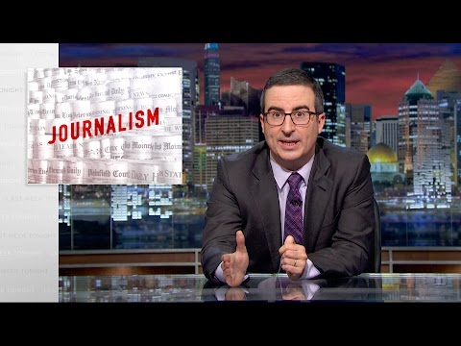
Sam Zell, who in 2007, purchased the Tribune Company which owns the LA Times, the Orlando Sentinel, and the Chicago Tribune.
Sam Zell, who in 2007, purchased the Tribune Company which owns the LA Times, the Orlando Sentinel, and the Chicago Tribune
https://www.youtube.com/watch?v=bq2_wSsDwkQ
Notes:
One of the worst fears in journalism has already occurred: news services are letting the public dictate what information should be covered. We were warned about this by Lou Grant on the Mary Tyler Moore show back in 1972. And now, it has arrived. Consider a recent billionaire, Sam Zell, who in 2007, purchased the Tribune Company which owns the LA Times, the Orlando Sentinel, and the Chicago Tribune. From a clip of John Oliver’s Last Week Tonight, here is what Zell once told a room full of his new journalist employees [https://www.youtube.com/watch?v=bq2_wSsDwkQ] (8:10 – 9:37) :
Sam Zell: My attitude on journalism is very simple. I want to make enough money so I can afford you. It's really that simple. Okay? You need to help me, by being a journalist that focuses on what our readers want. And generates more revenue.
Journalist: But what readers want are puppy dogs, and we also need to inform the community…
Sam Zell: I'm sorry, I can't...You're giving me the classic what I would call ‘journalistic arrogance’, of deciding that puppies don't count. Hopefully we get to the point where our revenue is so significant that we can do puppies and Iraq, okay? Fuck you.
Image: https://www.forbes.com/sites/christopherhelman/2020/11/17/billionaire-sam-zell-talks-trump-spacs-and-interest-rates-in-forbes-qa/?sh=14bbc8504cb0

Slide 26
The system is completely backwards.
Instead of news agencies, reporters, editors, etc., determining the coverage and presentation of information that the public should know about, the news agencies are letting the public determine what they want to see.
Notes:
Despite Zell’s uncouth brashness, that exchange was very clear in how new owners can control what ‘news’ gets covered, and what doesn’t. And if it’s all revenue-based: whatever gets the most hits, the most clicks, the most tweets, makes it to the ‘front page’ of the website because those stories are what will generate the most revenue. The system is completely backwards; instead of news agencies, reporters, editors, etc., determining the coverage and presentation of information that the public should know about, the news agencies are letting the public determine what they want to see.
Image: [[File:More than 70% of all internet traffic goes through sites owned or operated by Google or Facebook.png|More_than_70%_of_all_internet_traffic_goes_through_sites_owned_or_operated_by_Google_or_Facebook]]

Slide 27
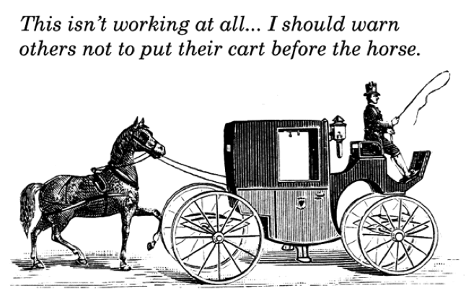
Notes:
Image: [[File:More than 70% of all internet traffic goes through sites owned or operated by Google or Facebook.png|More_than_70%_of_all_internet_traffic_goes_through_sites_owned_or_operated_by_Google_or_Facebook]]

Slide 28
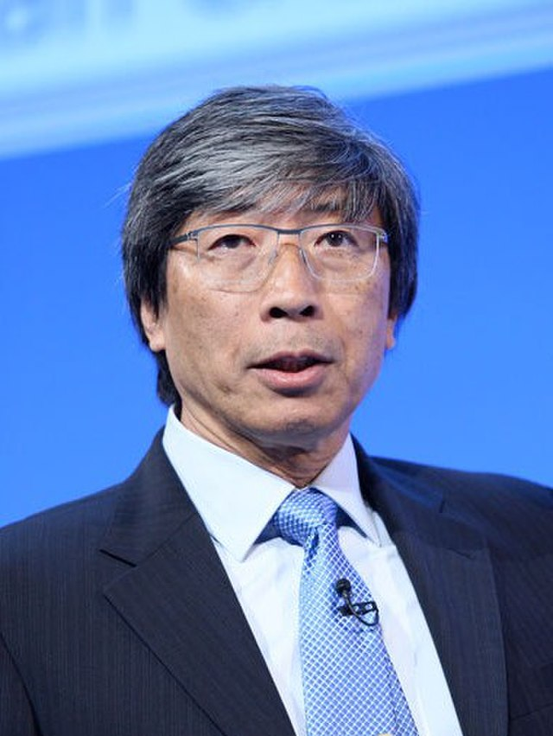
Dr. Patrick Soon-Shiong
‘We need newspapers,’ he said. ‘We need this intellectual integrity. We need writers and editors who are passionate about this work.’
Notes:
Fortunately, Zell no longer owns and operates Tribune Company. In 2018, it was purchased by billionaire, Dr. Patrick Soon-Shiong, who has been an investor in the company since 2016. Perhaps there is some hope yet for print journalism. When Soon-Shiong made the purchase, he told The LA Times he wanted to “save the integrity” of the publication. “We need newspapers,” he said. “We need this intellectual integrity. We need writers and editors who are passionate about this work.” But there is another problem with private ownership of news agencies.
Image: [[File:Dr Patrick Soon-Shiong (14212355607) cropped.jpg|Dr_Patrick_Soon-Shiong_(14212355607)_cropped]]

Slide 29
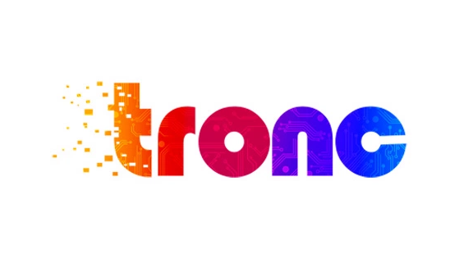
TRONC
Stands for Tribune Online Content
What happens when we lose local news
We will be ‘dumber’ or less-informed about what is going on in our communities, cities, and countries
We’re going to know less and less about each other, our neighbours, our communities, and the information that means the most to us locally
Notes:
Because so many news affiliates are run by people or agencies with political biases, the audiences are simply fed confirming information. In the US, if you politically lean right, you can watch Fox News to find out what a great job President Donald Trump is doing. If you politically lean left, then you can have your biases confirmed on either CNN or MSNBC. In fact, the news has gotten so attuned to audience bias, that news systems have been put in place which no longer require human input at all. For example, Tribune Publishing has been modified and rebranded as TRONC - which stands for Tribune Online Content.
We're going to harness the power of our journalism by having an optimization group. This Tronc team. Will work with all the local markets to harness our local journalism, feed it into a funnel, and then optimize it so that we reach the biggest global audience possible...Artificial intelligence is going to allow journalists to do their jobs more efficiently, finding the right photos, the videos, the things that you will package your stories with. With artificial intelligence, you can create a system that automatically is doing that.
Unfortunately, several of my journalist colleagues have confirmed that such systems - or similar ones to it - are already up and operating to determine the likelihood of positive audience response. If an editor cannot determine whether or not a story should be covered, the algorithms of the automated system will do it for her.
What happens when we lose local news.
We will be ‘dumber’ or less-informed about what is going on in our communities, cities, and countries.
We’re going to know less and less about each other, our neighbours, our communities, and the information that means the most to us locally.
Image: https://deadline.com/2016/06/tribune-publishing-tronc-words-corporate-brand-name-ever-1201767840/

Slide 30
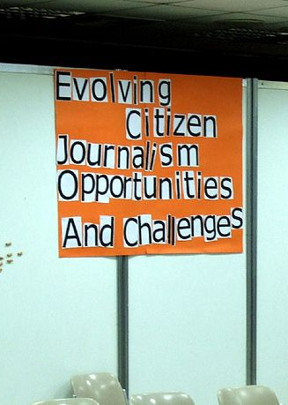
Who or what is to blame for the demise of journalism?
A cultural evolutionary process
Tax revenues
Paid subscriptions
We are living through a very bad time in journalism history
Notes:
So who or what is to blame for the demise of journalism? Is it simply a cultural evolutionary process whereby new forms of media and technology are preferred by the market and so it simply becomes a matter of supply and demand? For the most part, yes. People who want news and information and have been receiving it online for free, don’t want to subscribe to or pay for it elsewhere. Why would they? They have become accustomed to receiving their daily dose of news juice without charge and have lost the need or interest in supporting reliably-attained, investigative reporting. But this can change. If people care about responsible news journalism, they can support in many ways, from voting for politicians who would support their existence through tax revenues as we do in Canada and the UK, to paid subscriptions which goes directly to the paper itself, to allowing them to change their status to not-for-profits, to sugar daddies or sugar mommas who have enough cake and balls or Thatchers to take a loss for the sake of journalistic integrity. Until then, we are living through a very bad time in journalism history.
Image: [[File:Evolving citizen journalism.jpg|Evolving_citizen_journalism]]

Slide 31
The Rise of Social Media
By the end of the 20th century, around 4% of the world’s population was online
Today, in 2021, approximately 65% of the world is online
Notes:
The Rise of Social Media
At the same time the influence and integrity of standard news journalism was dying, the onslaught of information available online was growing exponentially. By the end of the 20th century, around 4% of the world’s population was online. Today, in 2021, approximately 65% of the world is online. We can view the World Wide Web as one of the greatest advancements and liberators in communication history. Aside from the development of sophisticated human languages, and the advent of the printing press, the Internet has provided information to more people throughout the world than any other medium in the history of our existence. Think about that. In the last several decades, it has become possible for practically anyone, anywhere in the world, to connect to people and information sources which immediately provides results.
Image: [[File:World Wide Web logo.png|World_Wide_Web_logo]]

Slide 32
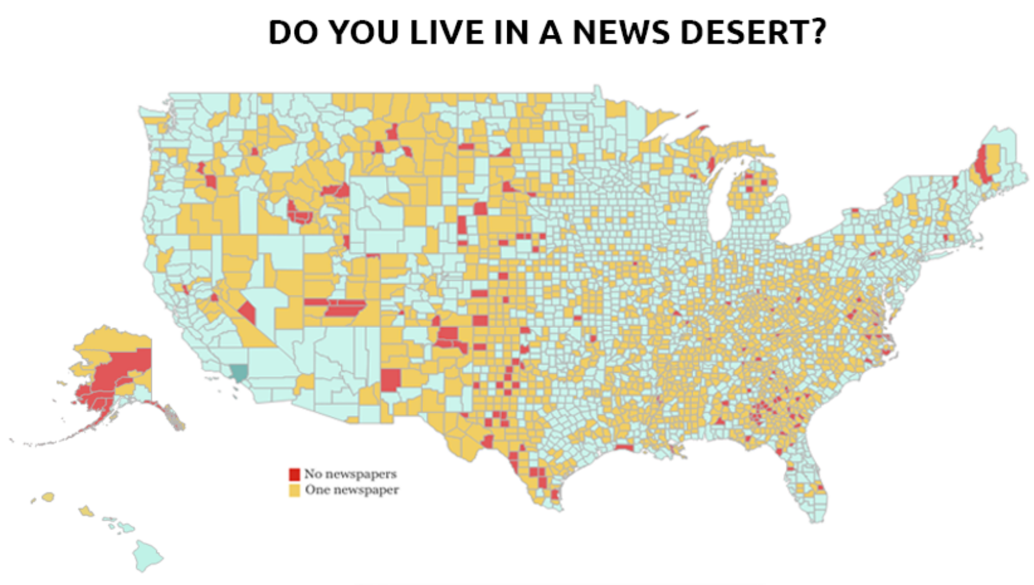
Notes:
This phenomenon has created ‘News Deserts’ i.e. places throughout the world with only one or no local newspapers. This makes it much easier for people in positions of power to commit crimes without being caught.
Image: https://www.brinknews.com/quick-take/news-deserts-are-a-major-loss-for-communities-across-the-us/

Slide 33
Anything that ‘looks’ like the news can pass for news
Dangerous
A dangerous path to misinformation and worse, disinformation
Notes:
It also means that anything that ‘looks’ like the news can pass for news. And that’s dangerous. Because it gives people with little to no authority or experience the capacity to say whatever the fuck they want. Filling the void of a journalistic wasteland with privately run and deeply opinionated websites is a dangerous path to misinformation and worse, disinformation. The rise of such sites has contributed significantly to the barrage of misinformation and conspiracy theories now flourishing around the world.
Image: [[File:Disinformation vs Misinformation.svg|Disinformation_vs_Misinformation]]

Slide 34
Plandemic
Judy Mikovits
Plandemic: Indoctornation
It "taps into people's uncertainty, anxiety and need for answers"
It "is packaged very professionally and uses common conventions people already associate with factual documentaries"
Notes:
Arguably the most famous of these in recent history would include the documentary: Plandemic.
The so-called ‘documentary’ that is Plandemic, is a hodge-podge account of falsehoods and misinformation regarding the origin and spread of Covid-19.
Plandemic (a portmanteau of "plan" + "pandemic")[α] refers to a pair of conspiracy theory videos, the first posted to several social media platforms, on May 4, 2020, and the longer one posted August 18, 2020. Both, produced by conspiracist Mikki Willis, promotes falsehoods and misinformation about the COVID-19 pandemic. They feature Judy Mikovits, a discredited former researcher. Mikovits has been described as an anti-vaccine activist, which she denies. The first video became viral, making it one of the most widespread pieces of COVID-19 misinformation. It was removed by multiple platforms, because of its misleading content and promotion of false medical information. Meanwhile, the second video, Plandemic: Indoctornation, did not get as much attention. The videos were criticized by scientists and health professionals as promoting misinformation and conspiracy theories. Willis's response varies, from being silent to being supportive of Plandemic.
By early May, 2020, reactions from the scientific community were being heard around the world. One science journalist found that the video was pure propaganda and "has been extremely successful at promoting misinformation for three reasons":
It "taps into people's uncertainty, anxiety and need for answers".
It "is packaged very professionally and uses common conventions people already associate with factual documentaries".
Image: [[File:Plandemic-Indoc.png|Plandemic-Indoc]]

Slide 35
It effectively exploits various methods of persuasion, including the use of a seemingly trustworthy and sympathetic narrator, appeals to emotion, the Gish gallop, and "sciencey" images.
Notes:
It effectively exploits various methods of persuasion, including the use of a seemingly trustworthy and sympathetic narrator, appeals to emotion, the Gish gallop, and "sciencey" images.
If you’re wondering what the ‘Gish gallop’ is, it involves the use of a fallacious form of debating in which one moves so rapidly from subject to subject with as many arguments as possible, that the respondents are overwhelmed.
Image:
[[File:A laboratory.jpg|A_laboratory]]

Slide 36
The Streisand Effect
“Censorship backfire”
The unriging of a bell
Mark Twain: “A lie can travel halfway around the world before the truth can get its boots on.”
Notes:
Others, such as Zarine Kharazian, assistant editor of the Atlantic Council's Digital Forensic Research Lab, believes the response to the removal of the video from Facebook and YouTube may have caused a “censorship backfire”, invoking the Streisand Effect. The Streisand effect is an example of psychological reactance, wherein once people are aware that some information is being kept from them, they are significantly more motivated to access and spread that information. Sometimes, in trying to rid the internet of misinformation, it actually creates greater interest. It’s sort of like the unriging of a bell or, as is often attributed to Mark Twain: “A lie can travel halfway around the world before the truth can get its boots on.”
Image: [[File:Streisand effect.svg|Streisand_effect]]

Slide 37
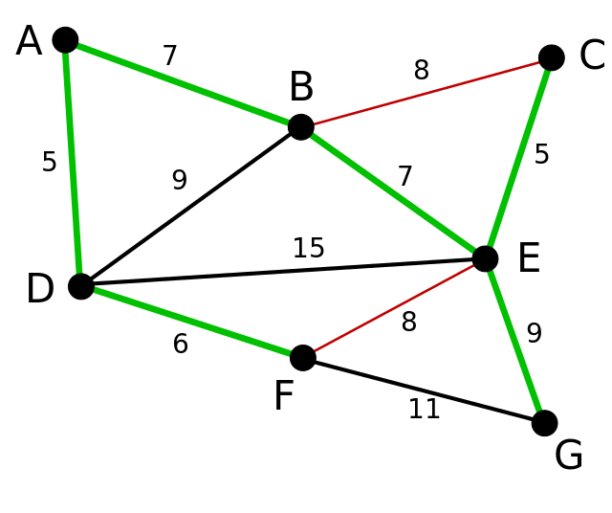
The Omniscient Algorithms
But what is an algorithm?
A precise step-by-step list of instructions that outline exactly how to complete a task
Toothbrushes
Toothpaste, or dental floss, or other products related to dental hygiene
Notes:
The Omniscient Algorithms
As the integrity of journalistic reporting was waning and social media sites were booming, another incredible phenomenon was occurring which aided the process of conspiracists: computerized algorithms.
But what is an algorithm?
In essence, algorithms are simply a series of instructions that are followed, step by step, to do something useful or solve a problem. You could consider a cake recipe an algorithm for making a cake, for example. In computing, algorithms provide computers with a successive guide to completing actions. They’re comprised of a precise step-by-step list of instructions that outline exactly how to complete a task. So, what is an algorithm? A good way to think of them is as mini instruction manuals telling computers how to complete a given task or manipulate given data.
You might have first experienced the effects of algorithms if you have ever ordered anything online. If you once made an Amazon purchase for a product - say, toothbrushes, you might eventually notice ads appearing on some of your browser pages suggesting various brands of toothpaste, or dental floss, or other products related to dental hygiene. You can thank algorithms for that. The computer programs use sophisticated learning software which generate algorithms to detect and then determine buying trends and behaviour in an effort to provide consumers with other available information and buying options. This all seems fairly harmless. For, what’s wrong with extending the potential for consumer purchases based on past buying trends, right? Well, what has happened is that similar algorithms can also be found on social media sites. If you happen to be interested in a particular conspiracy theory like the moon landing, or 9/11, or the Kennedy assassination, the algorithms will pick up on your browsing history and make suggestions for other similar sites with different conspiracy theorists. How is this possible?
Image: [[File:Kruskal Algorithm 7a.svg|Kruskal_Algorithm_7a]]

Slide 38
Patterns of behaviour
Generating revenue
Your information is worth money (...conspiracy?)
On the other side of the screen, it’s almost as if they had this avatar voodoo doll-like model of us
More accurate model
Reward or positive reinforcement
‘ They’re controlling us more than we’re controlling them. ’
- Sandy Parakilas
Notes:
Here’s how it works: algorithms with the capacity to recognize patterns of behaviour were incorporated into the internet for the purpose of generating revenue. The more information you provide on the Internet, the greater the algorithms’ capacities to make predictions related to your current chosen interests. In other words, the algorithms learn and evolve over time. Your information is worth money because it - along with billions of others - becomes data that can be used to influence more people. In recent years, Facebook has launched massive scale contagion experiments:
Over time, the algorithms can develop models that predict our behaviour.
On the other side of the screen, it’s almost as if they had this avatar voodoo doll-like model of us. All of the things we’ve ever done, all the clicks we’ve ever made, all the videos we’ve watched, all the likes, that all gets brought back into building a more and more accurate model. The model, once you have it, you can predict the kinds of things that person does.
Through engagement activities like positive intermittent reinforcement, our phones, much like slot machines, get us to behave in predictable ways because we’re always anticipating what might happen next - in other words, what reward or positive reinforcement awaits us? The former VP of Growth at Facebook, Chamath Palihapitiya, has stated that:
...we want to psychologically figure out how to manipulate you as fast as possible and then give you back that dopamine hit. We did that brilliantly at Facebook. Instagram has done it. WhatsApp has done it. You know, Snapchat has done it. Twitter has done it.
By exploiting human needs, wants, and desires in this fashion, the major social media platforms have been manipulating our online habits for years. As Tristan Harris, president of The Center for Humane Technology has said: “Social media isn’t a tool that’s just waiting to be used; it has its own goals, and it has its own means of pursuing them by using your psychology against you.”
According to Sandy Parakilas, former Operations and Product Manager at Uber and Facebook:
“The algorithm has a mind of its own, so even though a person writes it, it’s written in a way that you kind of build the machine, and then the machine changes itself. There’s only a handful of people at these companies, at Facebook and Twitter and other companies. There’s only a few people who understand how those systems work, and even they don’t necessarily fully understand what’s gonna happen with a particular piece of content. So, as humans, we’ve almost lost control over these systems. Because they’re controlling, you know, the information that we see, they’re controlling us more than we’re controlling them.”
Image:
[[File:Difference between Data-Driven Companies and Data Bounty Hunter Companies.png|Difference_between_Data-Driven_Companies_and_Data_Bounty_Hunter_Companies]]
Image: [[File:Money in hands.jpg|Money_in_hands]]

Slide 39
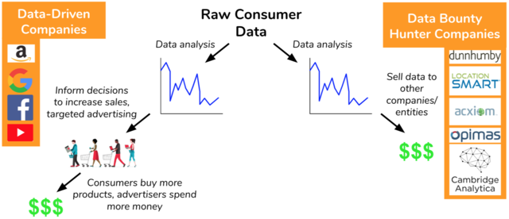

Slide 40
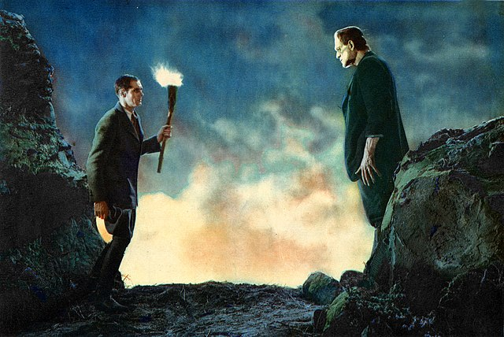
The ‘Frankenstein Effect’
Lysine contingency
The making of more conspiracy theorists
Feeding us information that continuously confirms our biases and connecting us with other like-minded individuals and groups
Power of machine learning has enabled the algorithms to nudge you
Notes:
And so we have entered a digital information age in which we are being controlled by our own doing. I refer to this elsewhere as the ‘Frankenstein Effect’. This occurs when any human technology produces unforeseen bad consequences against humans. But in particular, with this form of AI, we should have had a lysine contingency built in and ready to activate in case it evolved beyond a level of central control.
So how does this contribute to the making of more conspiracy theorists? By feeding us information that continuously confirms our biases and connecting us with other like-minded individuals and groups. And this type of digital manipulation happens not just to a select few, but to everyone. Justin Rosenstein, former engineer at both Google and Facebook and co-founder of Asana, says it best:
When you go to Google and type in “Climate change is,” you’re going to see different results depending on where you live. In certain cities, you’re gonna see it autocomplete with “climate change is a hoax.” In other cases, you’re going to see “climate change is causing the destruction of nature.” And that’s a function not of what the truth is about climate change, but about where you happen to be Googling from and the particular things Google knows about your interests.
The power of machine learning has enabled the algorithms to nudge you in specific directions according to what your profile’s interests have revealed about you.
Image: [[File:Frankenstein1931KarloffCrop.jpg|Frankenstein1931KarloffCrop]]

Slide 41
These self-learning algorithms have created the perfect environment for conspiracy theorists to meet and further network with like-minded individuals.
Notes:
Tristan Harris goes so far as to say:
Even two friends who are so close to each other, who have almost the exact same set of friends, they think, you know, “I’m going to news feeds on Facebook. I’ll see the exact same set of updates.” But it’s not like that at all. They see completely different worlds because they’re based on these computers calculating what’s perfect for each of them.
This is how the process of the Internet further influences the proliferation of misleading information online. These self-learning algorithms have created the perfect environment for conspiracy theorists to meet and further network with like-minded individuals.
Image: [[File:Paily, M.U. Graphics on Artificial intelligence and Education.jpg|Paily,_M.U._Graphics_on_Artificial_intelligence_and_Education]]

Slide 42
Everyone in your news feed sounds just like you
Trapped
Inside a silo
Well-insulated
Echo chamber of biased beliefs
Everyone in your news feed sounds just like you
Trapped
Inside a silo
Well-insulated
Echo chamber of biased beliefs
Notes:
It is not by coincidence that at anti-mask rallies, you will also see anti-vaxxers, flat-earthers, and more than a few Christians who believe in God’s love over supposed science. This has led all of us to believe that our digital lives online are roughly the same as everyone else’s. But it is quite the opposite:
The way to think about it is it’s 2.7 billion Truman Shows. Each person has their own reality, with their own… facts. Why do you think that, uh, Truman has never come close to discovering the true nature of his world until now? We accept the reality of the world with which we’re presented. It’s as simple as that. Over time, you have the false sense that everyone agrees with you, because everyone in your news feed sounds just like you. And that once you’re in that state, it turns out you’re easily manipulated, the same way you would be manipulated by a magician.
This also helps to contribute to a blinding and misunderstanding of how other people are seeing the world. If all we’re receiving in our news feeds is information that continuously confirms our biases, then we are trapped, as it were, inside a silo, and well-insulated from any outside influence that may penetrate our echo chamber of biased beliefs.
Image: [[File:Katsunai Silos in Otaru city, Hokkaido(7982530299).jpg|Katsunai_Silos_in_Otaru_city,_Hokkaido(7982530299)]]

Slide 43
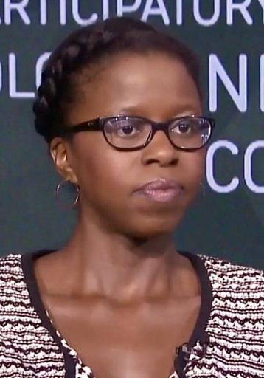
‘ You’re no longer able to reckon with or even consume information that contradicts with that worldview that you’ve created. ’
‘ We aren’t actually being objective, constructive individuals.’
- Rashida Richardson
Notes:
Rashida Richardson, Adjunct Professor (NYU School of Law) and Director of Policy Research at AI Now Institute maintains that:
Facebook is in charge of your news feed. We all simply are operating on a different set of facts. When that happens at scale, you’re no longer able to reckon with or even consume information that contradicts with that worldview that you’ve created. That means we aren’t actually being objective, constructive individuals.
Image: [[File:Rashida Richardson 2018.jpg|Rashida_Richardson_2018]]

Slide 44
‘ How can those people be so stupid? Look at all of this information that I’m constantly seeing. How are they not seeing that same information?’
‘ They’re not seeing that same information.’
“How can those people be so stupid? Look at all of this information that I’m constantly seeing. How are they not seeing that same information?”
“They’re not seeing that same information.”
Notes:
And it even goes a bit deeper. In regards to those who might oppose our views, Justin Rosenstein believes states:
And then you look over at the other side, and you start to think, “How can those people be so stupid? Look at all of this information that I’m constantly seeing. How are they not seeing that same information?” And the answer is, “They’re not seeing that same information.”
Image: [[File:Stupidly Is as Stupidly Does (3914146886).jpg|Stupidly_Is_as_Stupidly_Does_(3914146886)]]

Slide 45
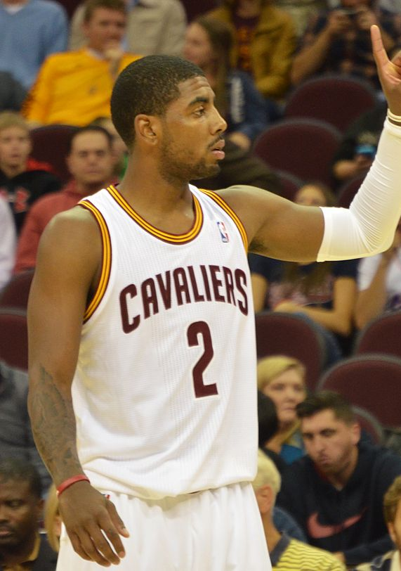
‘Flat-earther’
NBA basketball star, Kyrie Irving
YouTube videos
A rabbit hole of misinformation
Notes:
In case you’ve wondered, this is one more reason why, for example, there has been such a rise in people claiming to be ‘flat earthers’. And this is where things get really interesting. Arguably, the most famous ‘flat-earther’ in recent times was the great NBA basketball star, Kyrie Irving. Although no longer a flat-earther, Irving admitted that it was due to a cycling of YouTube videos that got him hooked into crawling further and further into a rabbit hole of misinformation.
Image: [[File:Kyrie Irving (10355627426).jpg|Kyrie_Irving_(10355627426)]]

Slide 46
Kyrie Irving
Blamed it on a YouTube rabbit hole
“The round-Earthers got to him.”
Notes:
Tristan Harris states that:
People think the algorithm is designed to give them what they really want, only it’s not. The algorithm is actually trying to find a few rabbit holes that are very powerful, trying to find which rabbit hole is the closest to your interest. And then if you start watching one of those videos, then it will recommend it over and over again. It’s not like anybody wants this to happen. It’s just that this is what the recommendation system is doing. So much so that Kyrie Irving, the famous basketball player, uh, said he believed the Earth was flat, and he apologized later because he blamed it on a YouTube rabbit hole...When he later came on to NPR to say, “I’m sorry for believing this; I didn’t want to mislead people,” a bunch of students in a classroom were interviewed saying, “The round-Earthers got to him.”
Image: https://commons.wikimedia.org/wiki/File:Orlando-Ferguson-flat-earth-map_edit.jpg

Slide 47
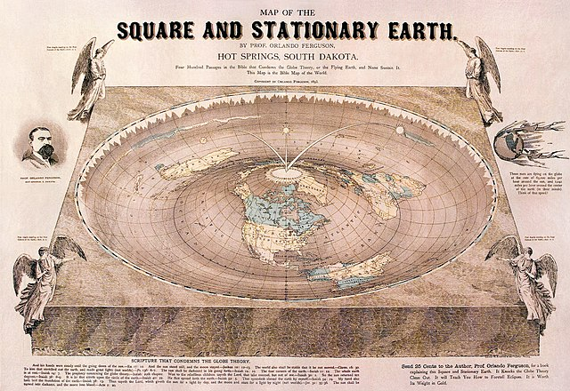

Slide 48
Conspiracy theorists can insulate themselves from dissenting opinions and cognitive dissonance.
Memetic equilibrium
We’ve created a system that biases towards false information.
Conspiracy theorists can insulate themselves from dissenting opinions and cognitive dissonance
Memetic equilibrium
We’ve created a system that biases towards false information.
False information makes the companies more money than the truth.
Truth is boring.
A disinformation-for-profit business model
Notes:
This is how conspiracy theorists can insulate themselves from dissenting opinions and cognitive dissonance. Instead of realizing that members of their own in-group can evolve to a point of seeing things differently, they must preserve their memetic equilibrium by using the ‘conversion’ as further proof that none of them are safe from the influences of the out-group ‘round-earthers’. Guillaume Chaslot, YouTube former engineer, CEO at Intuitive AI, and Founder of AIgo Transparency, stated the central cause of the proliferation of the flat-Earth conspiracy theory:
The flat-Earth conspiracy theory was recommended hundreds of millions of times by the algorithm. It’s easy to think that it’s just a few stupid people who get convinced, but the algorithm is getting smarter and smarter every day. So, today, they are convincing the people that the Earth is flat, but tomorrow, they will be convincing you of something else that’s false.
Sandy Parakilas believes that some of the larger online social media platforms are allowing for the dissemination of misinformation simply because it makes them more money:
We’ve created a system that biases towards false information...
Image: [[File:CognitiveDissonanceDiagram.jpg|CognitiveDissonanceDiagram]]

Slide 49
False information makes the companies more money than the truth.
Truth is boring.
A disinformation-for-profit business model.
Notes:
Not because we want to, but because false information makes the companies more money than the truth. The truth is boring. It’s a disinformation-for-profit business model. You make money the more you allow unregulated messages to reach anyone for the best price.The truth may be boring; but when it loses out to entertainment and feelings trump facts, we are living in very dangerous times. When we can longer discern accurately and quickly what information is true and what is false, we lose our sense of security in the world.
Image: [[File:CognitiveDissonanceDiagram.jpg|CognitiveDissonanceDiagram]]

Slide 50
So what are we going to do about it?
Are we really digitally-manipulated to this extent?
Are there no independent reliable news sources to which we can turn to find out actual facts regarding important issues?
Notes:
So What Are We Going to Do About It?
I believe the first question we should consider is: are we really digitally-manipulated to this extent? Are there no independent reliable news sources to which we can turn to find out actual facts regarding important issues?
Image: [[File:CognitiveDissonanceDiagram.jpg|CognitiveDissonanceDiagram]]

Slide 51
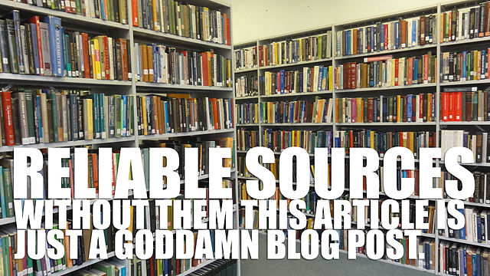
Reliable Sources of Information
Snopes, Pressbook: Web Literacy, Politifact, Factcheck.org Washington Post Fact Checker, Truth be Told, NPR Fact-Check, Lie Detector (Univision, Spanish language), Hoax Slayer, Climate Feedback, SciCheck, Quote Investigator, FactsCan (Canada), TrudeauMetre (Canada), El Polígrafo (Mexico), The Hound (Mexico), Guardian Reality Check (UK), BBC Reality Check (UK), Full Fact (UK).
Notes:
Of course there are. As bleak as this picture seems to be painted, we can forearm ourselves with some of the most reliable sources of information available online. These include sites such as: Snopes, Pressbook: Web Literacy, Politifact, Factcheck.org Washington Post Fact Checker, Truth be Told, NPR Fact-Check, Lie Detector (Univision, Spanish language), Hoax Slayer, Climate Feedback, SciCheck, Quote Investigator, FactsCan (Canada), TrudeauMetre (Canada), El Polígrafo (Mexico), The Hound (Mexico), Guardian Reality Check (UK), BBC Reality Check (UK), Full Fact (UK). Now, it might be argued that the algorithms of the Internet are pushing or nudging us in this direction, but I believe it is still possible to attain more reliable information from a variety of sources.
Image: [[File:Reliable Sources or bust.jpg|Reliable_Sources_or_bust]]

Slide 52
Conclusion
Inverse proportional relationship between the rise of the Internet and the decline of responsible journalism
Notes:
In our research, we have discovered an inverse proportional relationship between the rise of the Internet and the decline of responsible journalism.

Slide 53
Q&A session

Slide 54
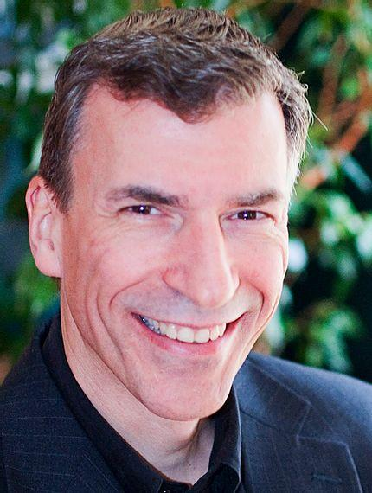
Thank you

