Slide 1
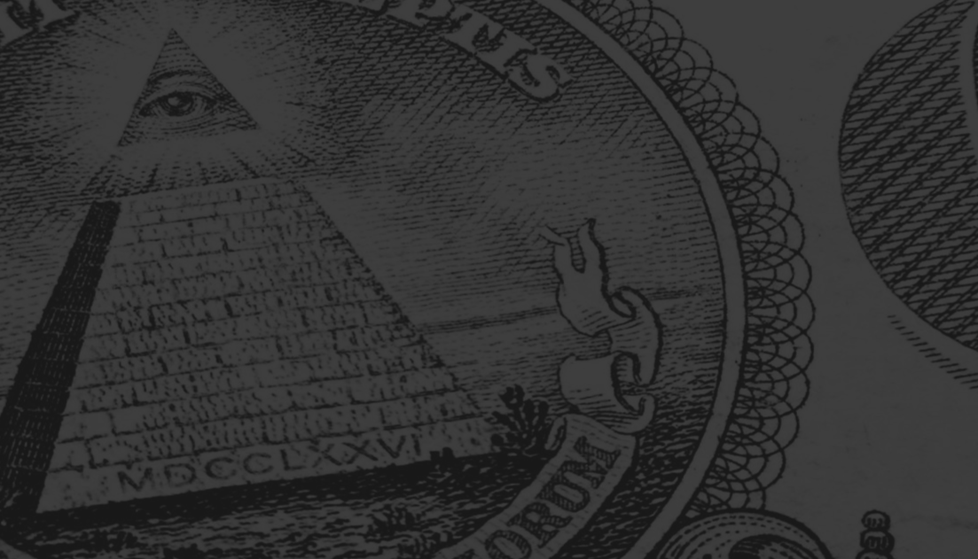
How to Talk to a Conspiracy Theorist
Lecture 05:
The Future of Conspiracy Theories
---
DR CHRISTOPHER DICARLO

Slide 2
In collaboration with Pixel Dreams
pixeldreams.com
Branding & Marketing agency in Toronto
Think Tank Raise I+C (intelligence and consciousness)

Slide 3
The Future of Conspiracy Theories
It’s going to get worse before it gets better
Speculate
Complex societies
Donald Trump
Notes:
It’s going to get worse before it gets better.
We can only speculate about how conspiracy theories will play out in the future. One of the things we can say with some certainty is that, as long as there are complex societies, conspiracy theories will be with us for quite some time to come. Unfortunately, since 2016, the world has witnessed the first US Presidential conspiracy theorist: Donald Trump.
Image:

Slide 4
Characteristics like charisma, or charm, or bullshit, will become the predominant forces in spreading misinformation based purely in conspiracy theories.
Notes:
The future of conspiracy theories is a future filled with a variety of people in positions of power who, not through expertise but rather characteristics like charisma, or charm, or bullshit, will become the predominant forces in spreading misinformation based purely in conspiracy theories.
Image: [[File:Donald Trump (43627493710).jpg|Donald_Trump_(43627493710)]]

Slide 5
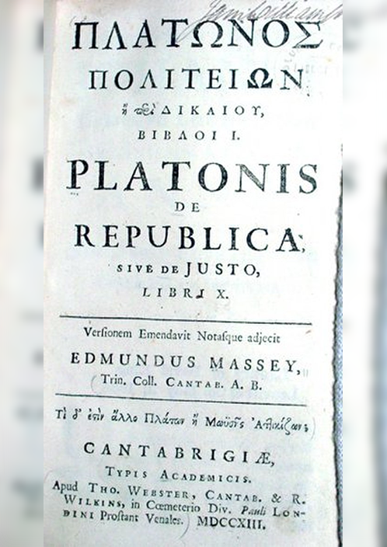
Socrates and Plato
Demagoguery
The Republic
When voters care more about the cult of personality than what’s best for the citizens, democracies can lead to ruin
Notes:
One of the most powerful tools in recent history for allowing for the proliferation of conspiracy theories is the endorsement of them by people in positions of power who simultaneously create doubt regarding the truthfulness of mainstream media. Socrates and Plato warned against this type of demagoguery in the sixth chapter of The Republic i.e. when voters care more about the cult of personality than what’s best for the citizens, democracies can lead to ruin.
Image: [[File:Plato Republic 1713.jpg|Plato_Republic_1713]]
[[File:Plato Republic 1713.jpg|Plato_Republic_1713]]

Slide 6
Help the spread of conspiracy theories
Cast doubt on legitimate sources of news and information
‘Fake’
All news sources are open to questioning and reliability except those cited by the president himself i.e. Fox News
Notes:
Historically, one of the best ways to help the spread of conspiracy theories is to initially cast doubt on legitimate sources of news and information. From the moment Donald Trump began running for President of the US, and all the way through his presidency, he proudly boasted about denigrating news sources as ‘fake’. Once you have a base of people believing that legitimate news sources are fake, all news sources are open to questioning and reliability except those cited by the president himself i.e. Fox News.
Image: [[File:New Fox News Channel logo.svg|New_Fox_News_Channel_logo]]

Slide 7
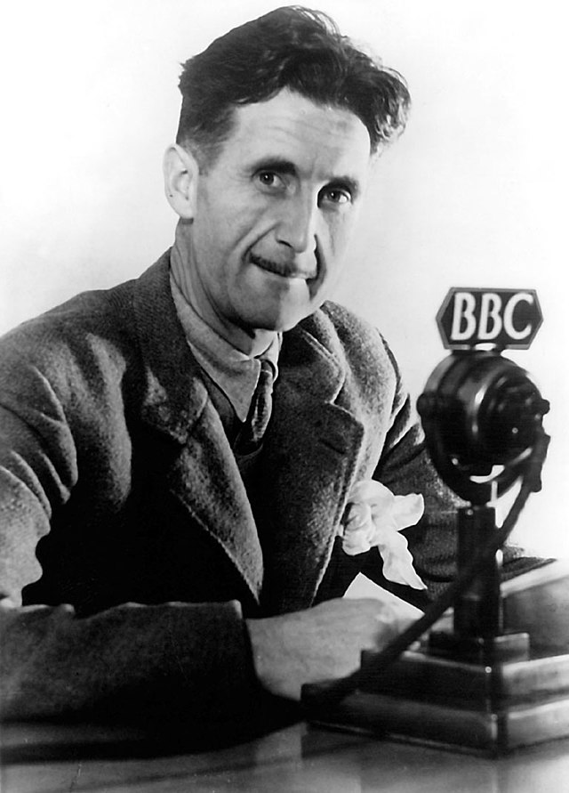
Orwellian
Trump: a dyed-in-the-wool conspiracy theorist
The ‘birther’ movement
Notes:
It seems rather Orwellian, that Trump managed to cast enough public doubt on reliable news and information to generate a basic distrust by his base over the 4th estate. He even encouraged his fans to ‘boo’ and jeer reporters at his rallies and events. And don’t forget, Trump, himself, is a dyed-in-the-wool conspiracy theorist. He was a major proponent of the ‘birther’ movement which cast doubt on the legitimacy of Barack Obama’s country of birth. At one point, he also subscribed to the idea that vaccines cause autism.
Image: [[File:George-orwell-BBC.jpg|George-orwell-BBC]]

Slide 8
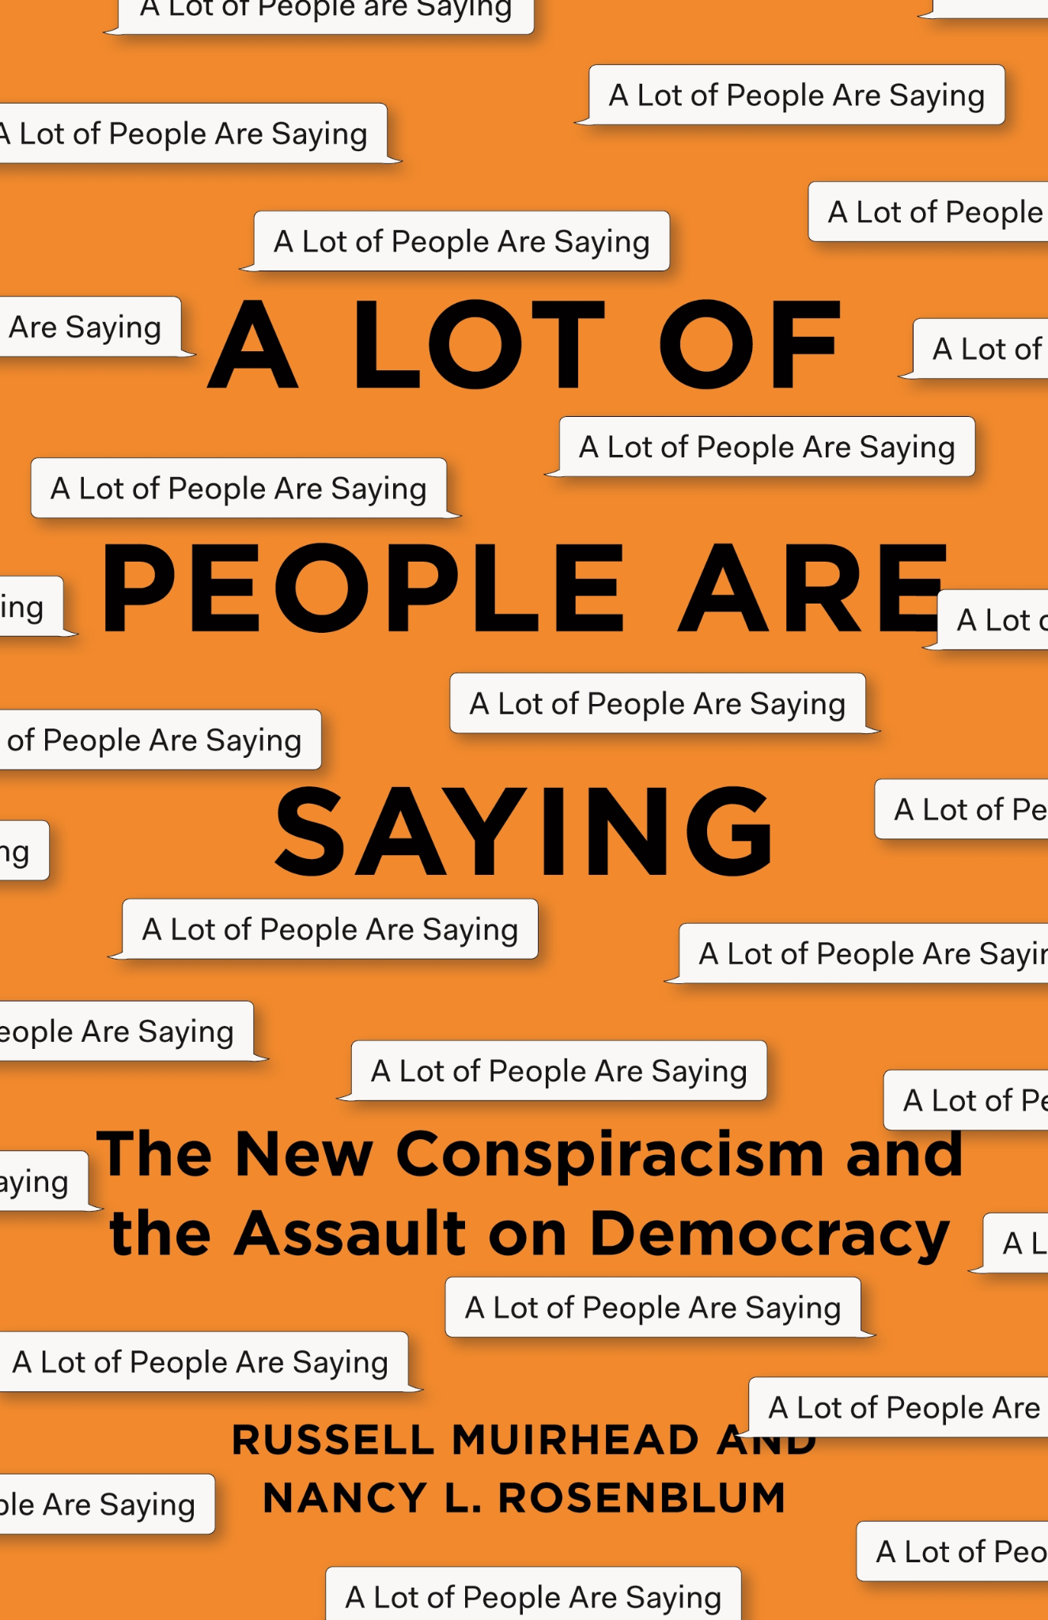
Russell Muirhead: Dartmouth College
Conspiracy theories
Propagated by people on the margins
A weapon of the powerless
Holding the powerful to account
The new stuff is coming directly from the powerful
Notes:
Russell Muirhead, a political scientist at Dartmouth College, New Hampshire, is concerned about the direction conspiracy theories are taking.
“Classically, conspiracy theories are propagated by people on the margins – they’re almost a weapon of the powerless, for holding the powerful to account,” he says. “But right now the new stuff is coming directly from the powerful, which is really quite extraordinary.”^{[1]}
^{[1]} https://www.bbc.com/future/article/20200522-what-we-can-learn-from-conspiracy-theories
Image: https://press.princeton.edu/books/hardcover/9780691188836/a-lot-of-people-are-saying

Slide 9
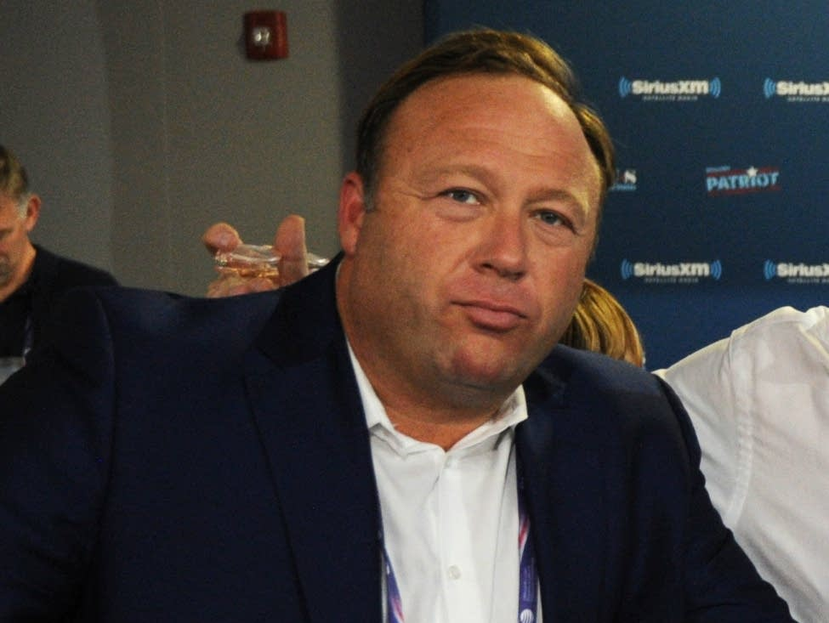
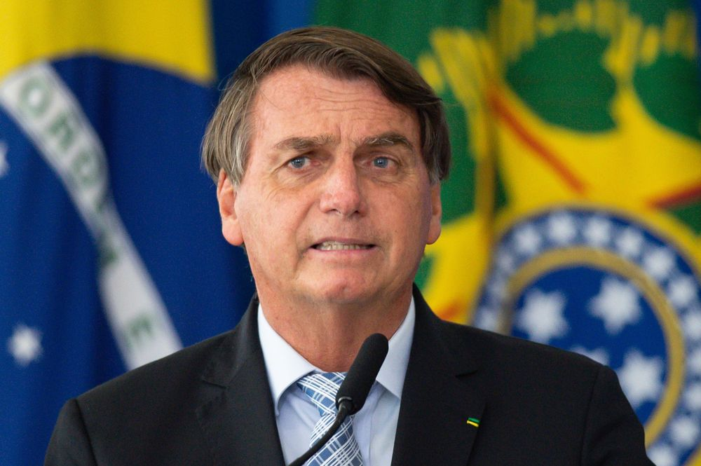
Alex Jones
Narendra Modi of India
Jair Bolsonaro of Brazil
Notes:
It’s not just Alex Jones who spins such wild and unbelievable tales; it’s world leaders like Narendra Modi of India and Jair Bolsanaro of Brazil. If conspiracy theories serve their purposes i.e. keep them in power, then they will happily use them.
Images: [[File:Alex Jones Portrait (cropped).jpg|Alex_Jones_Portrait_(cropped)]]
[[File:25 01 2020 Cerimônia de Troca de Atos com o Primeiro-Ministro da Índia (49438725768).jpg|25_01_2020_Cerimônia_de_Troca_de_Atos_com_o_Primeiro-Ministro_da_Índia_(49438725768)]]

Slide 10
A new type of conspiracy theory is evolving.
Qanon
Notes:
Aside from appeals to authoritarian endorsements, I believe that a new type of conspiracy theory is evolving and emerging, which doesn't really require any evidence or justification. For example, when we seriously look at Qanon, we find some absolutely bizarre claims:
Image: [[File:QAnon - Q Conspiracy - Deep State Trump.jpg|QAnon_-_Q_Conspiracy_-_Deep_State_Trump]]

Slide 11
Followers believe a high-ranking, anonymous government official called “Q” is providing top-secret information in internet posts about a cannibalistic, satanic cabal of “Deep State” actors engaged in a child trafficking ring that Trump has been chosen to dismantle. Some also believe the conspirators are extracting chemicals from the children’s blood to extend their lives.
Notes:
The far-right Qanon conspiracy theory has made waves in this election after US President Donald Trump’s acknowledgement of its adherents in August [2020] and an increase in Republican and independent congressional candidates embracing the movement, which many consider a mad hoax or even a cult. Followers believe a high-ranking, anonymous government official called “Q” is providing top-secret information in internet posts about a cannibalistic, satanic cabal of “Deep State” actors engaged in a child trafficking ring that Trump has been chosen to dismantle. Some also believe the conspirators are extracting chemicals from the children’s blood to extend their lives.^{[1]}
^{[1]} https://www.aljazeera.com/news/2020/10/8/what-is-qanon-the-conspiracy-theory-spreading-throughout-the-us
Image: [[File:Qanon SUV, Burbank, California, USA.jpg|Qanon_SUV,_Burbank,_California,_USA]]

Slide 12
Barack Obama, Hillary Clinton, Nancy Pelosi, and Chuck Schumer
A set of beliefs with no real anchor to any real semblance of truth
In many conspiracy theories, you will often find kernels of truth
Notes:
Some of the members of this ‘Deep State’ cabal include: Barack Obama, Hilary Clinton, Nancy Pelosi, and Chuck Schumer.
At this point, what we see emerging is a set of beliefs with no real anchor to any real semblance of truth. This is genuinely frightening because conspiracy theories were always considered somewhat ‘out there’ in regards to the truth - and in many conspiracy theories, you will often find kernels of truth.
Image: [[File:Barack Obama signs Lilly Ledbetter Fair Pay Act of 2009 1-29-09.jpg|Barack_Obama_signs_Lilly_Ledbetter_Fair_Pay_Act_of_2009_1-29-09]]

Slide 13
‘Spectral discourse’
A model of dialogue which allows people to establish - roughly - where they lie in terms of the extreme ends of issues
These two extremes allow us to do is better situate ourselves in terms of our position relative to a specific issue
Notes:
But lately, they have diverged away from any basis in reality, whatsoever. The future of conspiracy theories may be simply to just make shit up:
In the book A Lot of People Are Saying, which Muirhead co-authored with the political scientist Nancy Rosenblum from Harvard University, he introduces a second new trend in the conspiracy world: conspiracy without the theory. “Not only were there no children being held captive at the pizza restaurant, there wasn’t even a basement,” says Muirhead. “What surprised us was the way this narrative was a complete fabrication, from beginning to end.” He explains that normally conspiracy theories would start with a kernel of truth – an event in the real world that’s easy to see and hard to understand, like an assassination or an attack – and build on it. But the latest generation of conspiracies skip this first step and seem to be successful regardless of how blindingly obvious it is that they’re false.^{[1]}
In several books and all of my courses, I teach students how to think in terms of what I call ‘spectral discourse’. This is a model of dialogue which allows people to establish - roughly - where they lie in terms of the extreme ends of issues. For example, with gun control, we might imagine the far left side disallowing any guns or weapons whatsoever with major jail time for those who have them; and on the far right of this spectrum, we might imagine the allowance and use of all and any guns anywhere, and anytime. What these two extremes allow us to do is better situate ourselves in terms of our position relative to a specific issue.
^{[1]} Ibid.
Image: [[File:Spectrum.svg|Spectrum]]

Slide 14
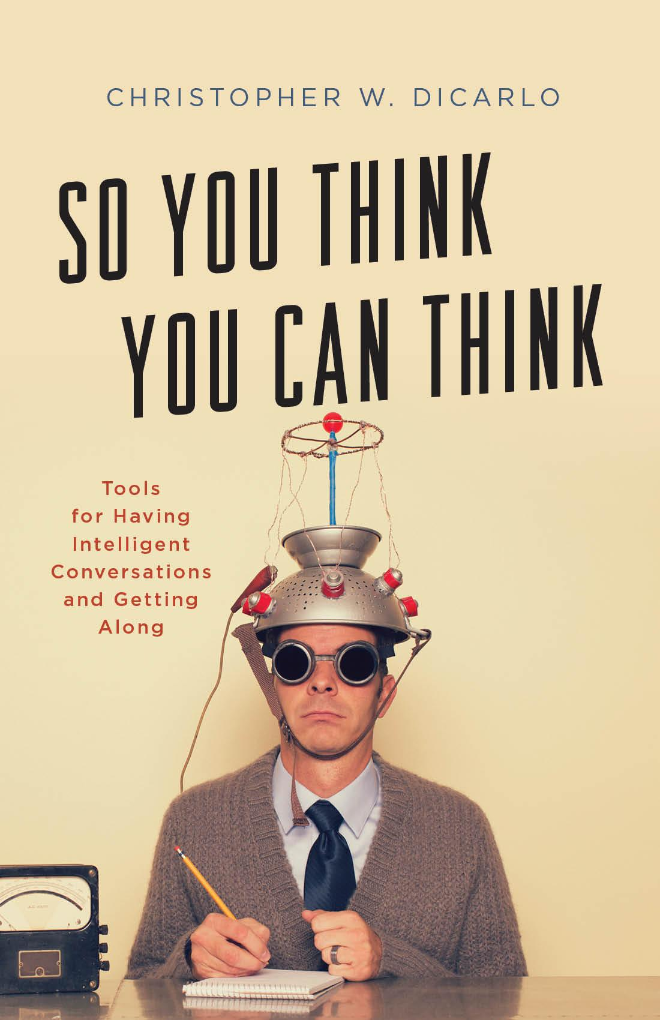
An epistemic ‘sweet spot’
The antidotes to conspiracy theories are Critical Thinking and Media Literacy
Recognizing personal biases, taking epistemic responsibility, and acting fairly require cooperation and practice
Notes:
With conspiracy theories, it would be folly to believe that all of them are true while equally so, it would be unwise to think that no conspiracy theories have been or will be true. And, as we have seen in past lectures, we need to be constantly aware of the fact that, every now and then, a conspiracy theory turns out to be true.
Adam Enders, an assistant professor at the University of Louisville who researches how conspiracy theories affect politics, believes that:
We’re all on a conspiracy-thinking continuum. The really high end is problematic: Fringe groups weaponizing conspiracy theories to ramp up their bases for whatever purposes they have. But really low on the spectrum might be bad, as well: People who uncritically accept everything and believe that, you know, politicians are always telling the truth. Once we think about conspiracy thinking on a continuum, there’s more nuance.^{[1]}
So there appears to be an epistemic ‘sweet spot’ as it were, where we want to doubt the ridiculous but not be so gullible that we believe anything and everything we’re told. Clearly, the antidotes to conspiracy theories are Critical Thinking and Media Literacy. But this assumes that people are capable of learning the tools within the Critical Thinking skill set and applying them fairly. That’s a big ask; but not an impossible one. Recognizing personal biases, taking epistemic responsibility, and acting fairly require cooperation and practice.
^{[1]} Ibid.
Image: Rowman and Littlefield.

Slide 15
A trend
March 25, 2021
“Disinformation Nation: Social Media's Role in Promoting Extremism and Misinformation”
Notes:
Combine these with in-group loyalty on cultural grounds, and the likelihood for stopping such theories may seem hopeless. Others, such as Enders, believe combating such theories should proceed in stages:
Correcting conspiracy beliefs is really tricky. You have prevention, which is just trying to mitigate the spread of them in the first place. But private companies [like social media platforms] can basically do whatever they want, and they have no real incentive to do that. It’s hard for them, and some of those posts generate a lot of clicks. But also, First Amendment concerns are all tied up into that, and your YouTubes and Facebooks and Twitters are going to be hesitant to do that for a number of reasons. There’s also pre-bunking, which is trying to get ahead of a conspiracy theory and say, “A lot of people are talking about this now, but it has problems X, Y and Z with it. You’ll encounter this at some point, and it’s bogus.” And then on the back end, we have treatment: “OK, you’ve been exposed to this and were motivated to believe it. How can we make you not believe that anymore?” For the most part, that comes in the form of giving people corrective information that has factual content from trusted sources. An easy fix to what feels like an influx of partisan conspiracy theories is for politicians to just not repeat them, and instead check them out in a technical kind of way. Easy, right? But they’re not going to do that, because they now know how potent and useful it is.^{[1]}
So it would appear that a trend is developing in how conspiracy theories may be used by politicians and other people in power. This makes it all the more paramount that strategies for combating misinformation be put into place to offer help to those who have not gone too far down a rabbit hole. On March 25, 2021 at a hearing titled: “Disinformation Nation: Social Media's Role in Promoting Extremism and Misinformation,”
^{[1]} Ibid.
Image: https://inforrm.org/2017/01/20/united-states-congress-to-weaken-section-230-of-the-communications-decency-act-ed-klaris-alexia-bedat/

Slide 16
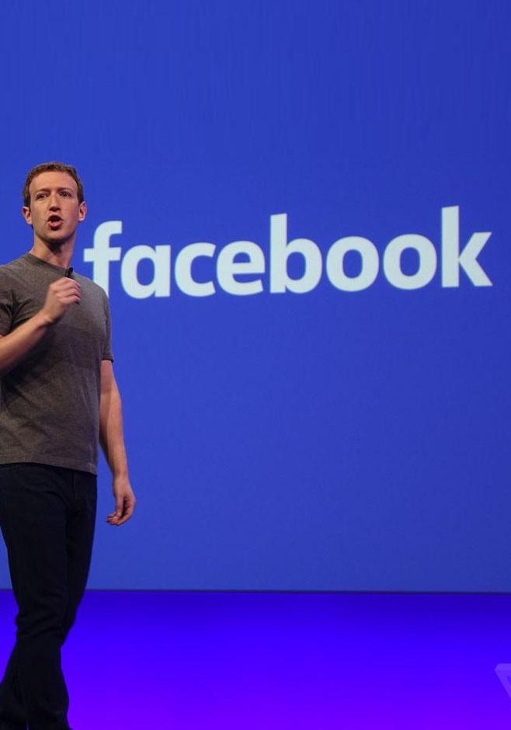
Facebook’s Mark Zuckerberg, Google’s Sundar Pichai and Twitter’s Jack Dorsey
‘Stop the Steal’ conspiracy theory
Notes:
The chief executives of Facebook, Google and Twitter were in the hot seat once again, as lawmakers grilled them…over their companies' alleged role in the proliferation of disinformation and misinformation online…The deadly riot on Jan. 6 at the U.S. Capitol -- and the apparent role social media played leading up to the event -- loomed large over the virtual hearing commenced by two House subcommittees under the Committee on Energy and Commerce.[1]
Facebook’s Mark Zuckerberg, Google’s Sundar Pichai and Twitter’s Jack Dorsey, faced questions related to the ‘Stop the Steal’ conspiracy theory which has been circulating widely among Trump supporters – especially Qanoners.
[1] https://www.msn.com/en-ca/news/newspolitics/facebook-google-and-twitter-ceos-face-lawmakers-over-online-disinformation/ar-BB1eXoIk
Image: [[File:Mark Zuckerberg f8 Keynote (2696181147).jpg|Mark_Zuckerberg_f8_Keynote_(2696181147)]]

Slide 17
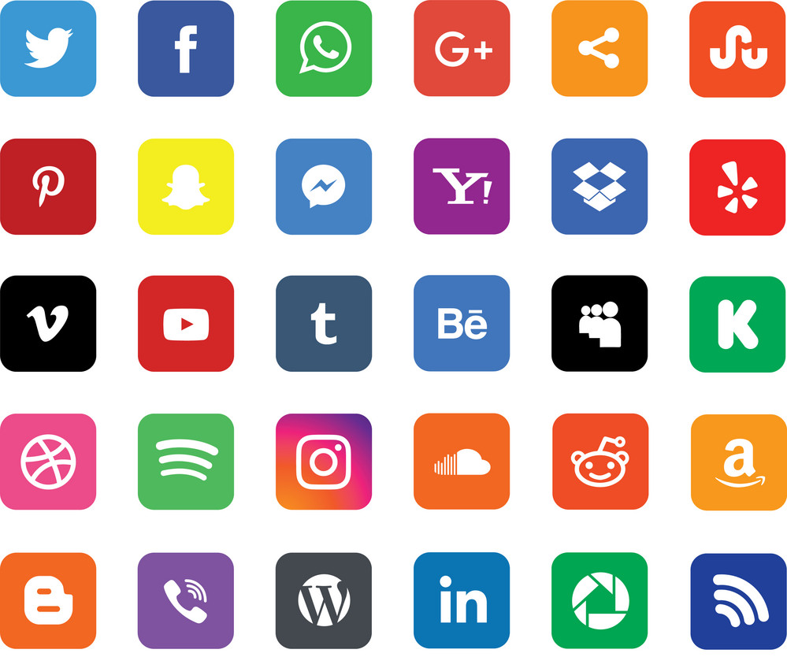
Section 230 of the Communications Decency Act
Platforms, themselves cannot be sued or held legally accountable
Section 230 protects freedom of thought
Facebook had started taking down misinformation about vaccines as early as December 202
Notes:
Rep. Mike Doyle, (D-Pa) noted that a new study suggested that 65% of anti-vaccine information was actually spread throughout these three social platforms by just 12 individuals. When asked if Facebook, Google, and Twitter would take down such ‘super spreaders’ of disinformation,
Zuckerberg said his team would need to look at the exact examples. Pichai said they have clear policies and remove content, though some content is allowed “if it’s people’s personal experiences.” Dorsey said, “Yes, we remove everything against our policy.”[1]
Much of the hearing focused on reform to Section 230 of the Communications Decency Act. The law essentially provides internet companies legal safety from the various forms of content users post on their sites. This means that if anyone puts up a post on any of these platforms which may be considered legally libelous, the platforms, themselves cannot be sued or held legally accountable as you could with a news organization. But it can also be argued that Section 230 protects freedom of thought and the right to express one’s opinions, ideas, etc. Mark Zuckerberg argued for transparency and accountability. We should note that Facebook had started taking down misinformation about vaccines as early as December 2020 and prior to that:
[1] Ibid.
Image: [[File:Automotive Social Media.jpg|Automotive_Social_Media]]

Slide 18
Warning labels on about 50 million pieces of content, with 95% of people who saw the label not clicking past to view the content
Twitter is investing in to address misinformation on its platform including Birdwatch and Bluesky
Notes:
Between March and October [2020], Facebook and Instagram removed 12 million pieces of misinformation related to Covid-19. In April alone, it put warning labels on about 50 million pieces of content, with 95% of people who saw the label not clicking past to view the content. Between March and October, it put warning labels on 167 million pieces of content.[1]’
Google’s Sundar Pichai discussed a balance between freedom and accountability, while Twitter’s Dorsey emphasized a trusting relationship with users:
Twitter is investing in to address misinformation on its platform including Birdwatch and Bluesky. Birdwatch, launched in beta in January, uses a “community-based approach to misinformation,” Dorsey said. Essentially, it allows users to identify misinformation in tweets and write notes that provide context. Bluesky, another anti-misinformation project funded by Twitter, has the goal of developing open and decentralized standards for social media. “Bluesky will eventually allow Twitter and other companies to contribute to and access open recommendation algorithms that promote healthy conversation and ultimately provide individuals greater choice,” Dorsey said.[2]
[1] https://www.dailymail.co.uk/sciencetech/article-9014475/Facebook-start-removing-false-claims-new-coronavirus-vaccines.html?ito=push-notification&ci=57077&si=17097303
[2] https://www.msn.com/en-ca/news/newspolitics/facebook-google-and-twitter-ceos-face-lawmakers-over-online-disinformation/ar-BB1eXoIk
Image: [[File:Automotive Social Media.jpg|Automotive_Social_Media]]

Slide 19
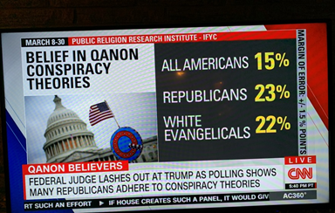
Notes:
So we are starting to see trends developing amongst the major social media platforms to take seriously the threat of conspiracy theories circulating widely among the public. Unfortunately, the bell of conspiracy theories has rung loud and long, and quieting it, is not easy. Even though the January 6, 2021 attempted insurrection at the State Capitol in Washington failed and disproved many of Qanon supporters’ beliefs, cognitive dissonance has moved in with a vengeance and has actually emboldened supporters to fight harder.
As of June, 2021, these are the latest statistics for Qanon support in the US:
Image:

Slide 20
Unringing the Bell: How to Stop the Spread of Conspiracy Theories
Clarify the language
A ‘story’
Not a ‘theory’
The term ‘theory’ is confusing
An evidence-based and extremely well-established body of scientific information e.g. theory of relativity, theory of evolution, etc
A hunch, or a wild guess with very little supporting evidence
Notes:
Currently, there are 19 Qanon candidates running for Congress in 2022.[1]
Unringing the Bell: How to Stop the Spread of Conspiracy Theories
Katharina Nocun and Pia Lamberty released: Fake Facts. How Conspiracy Theories Shape Our Thinking in April 2020. But instead of calling them conspiracy theories, they call them “conspiracy myths” or “ideologies” because:
Theories are a scientific concept. We assume that proponents will immediately withdraw or rethink a theory once it is proven wrong. But this is not what conspiracy ideologists do. A conspiracy myth is a narrative of a secret agreement among individuals or groups perceived as powerful. The alleged conspirators are endowed with certain abilities and authority. But such narratives may also target socially disadvantaged and marginalised groups, such as the anti-Semitic pogroms of the Black Plague in the Middle Ages. Another key component is that the conspirators are accused of having evil intent and seeking to deliberately harm others.^{[2]}
We’re trying to clarifying the language of what a conspiracy theory actually is. It is a ‘story’ and not a ‘theory’ because the term ‘theory’ is confusing: it can mean simultaneously: an evidence-based and extremely well-established body of scientific information e.g. theory of relativity, theory of evolution, etc.….or…it can mean a hunch, or a wild guess with very little supporting evidence.
[1] https://www.mediamatters.org/qanon-conspiracy-theory/here-are-qanon-supporters-running-congress-2022
^{[2]} https://www.goethe.de/en/kul/ges/21938441.html
Image: [[File:Parts of a Bell.jpg|Parts_of_a_Bell]]

Slide 21
Conspiracy Story: What conspiracists believe to be true, often without sufficient evidence or proof
Conspiracy Myth: A conspiracy story which has be falsified
Conspiracy: A conspiracy story which turned out to be true
Note: We may simply be stuck with the term ‘conspiracy theory’ because it has become too embedded into the vocabulary of common parlance to change
Notes:
We believe that when talking about knowledge – especially, knowledge about important issues and topics, the term ‘theory’ should be reserved only for information attained according to the very highest standards for knowledge.
Conspiracy Story: What conspiracists believe to be true, often without sufficient evidence or proof.
Conspiracy Myth: A conspiracy story which has be falsified.
Conspiracy: A conspiracy story which turned out to be true.
NOTE: We may simply be stuck with the term ‘conspiracy theory’ because it has become too embedded into the vocabulary of common parlance to change.
Image: [[File:Conspiracy Theories Fallacy Icon.png|Conspiracy_Theories_Fallacy_Icon]]

Slide 22
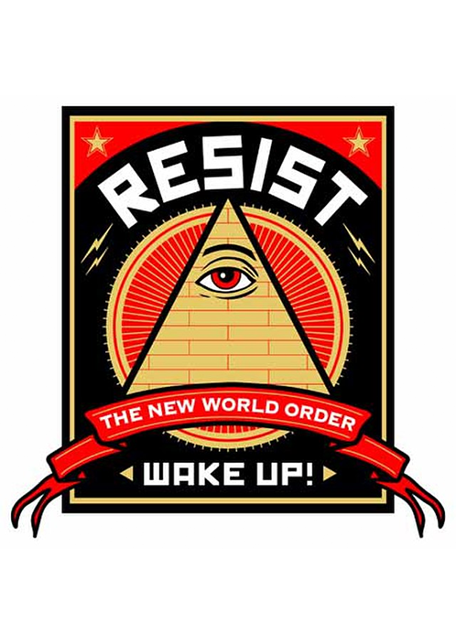
Determine what information is real or true, from that which is fabricated or fake
How do we combat this new mutation of conspiracy theories?
Notes:
The attempt to determine what information is real or true, from that which is fabricated or fake, is one of the central goals of limiting the spread of conspiracies.
There are real conspiracies, of course. In a democracy, it is important to keep close watch on what the secret services and governments are doing, what is happening in politics and the economy. The deciding factor is whether I can back up my claim to the truth with facts, or if I am just subscribing to an ideology, a closed world view. There is a difference between discussing hypotheses and adhering to a faith model.^{[1]}
So how do we combat this new mutation of conspiracy theories?
“We can’t just take on the conspiracy charges one by one by one,” says Muirhead. In his view, part of the problem is that people have gradually lost trust in experts, governments and powerful institutions. To fix the system, he suggests that we need to re-legitimise democracy – reform our governments and retrain our institutions. “In the United States that was done in the early decades of the 20th Century. It rehabilitated the government for new generations, and led to all sorts of progressive reforms, culminating in female suffrage.”^{[2]}
Karen Douglas, a social psychologist at the University of Kent believes that far more research is needed: “I think it is really, really important to understand where conspiracy theories come from and how they spread, because there’s strong evidence that believing them has significant consequences.”^{[1]} To date, there is little evidence to indicate why some conspiracy theories stick around - like the Moon Landing, Illuminati, JFK assassination, etc. - and why others die out fairly quickly.
Some psychologists have compared conspiracy theories to religious beliefs, in the way that they help us to feel more in control, by taking unpredictable or random events and making them seem somehow predestined or shaped by human hands. Others have gone so far as to suggest that this is why they stick: in their content, storylines and purposes, they come uncannily close to the beliefs perpetuated by many organized religions. Some people believe in conspiracy theories to such an extent that they will even put their lives on the line, in their attempts to prove themselves right.^{[2]}
^{[1]} Ibid.
^{[2]} Ibid.
^{[1]} Ibid.
^{[2]} Ibid.
Image: [[File:Anti-New world Order.jpg|Anti-New_world_Order]]

Slide 23
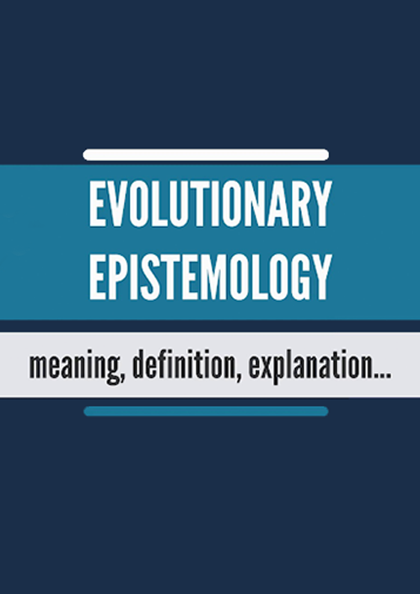
Evolutionary Epistemology
The ways in which ideas, beliefs, opinions survive within a given culture
Sometimes factual-based ideas maintain e.g. E = mc²
Sometimes great popularity ensures the survival and longevity of an idea e.g. the Mandela Effect
Notes:
Evolutionary Epistemology
This field of study examines the ways in which ideas, beliefs, opinions, etc., survive within a given culture. For example, over time, various beliefs compete to survive based on a number of factors e.g. sometimes factual-based ideas maintain e.g. E = mc²; at other times, great popularity ensures the survival and longevity of an idea e.g. the Mandela Effect.
Image: https://www.youtube.com/watch?v=oxLzI96JZaA

Slide 24
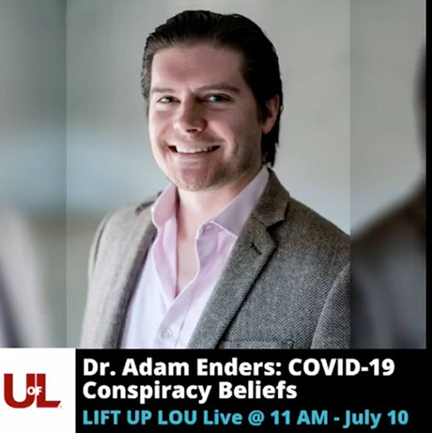
Adam Enders
University of Louisville
“I know you feel this way. Let me remind you that you feel this way. And then let me connect that to important things that are happening, like this upcoming vote, or this policy.”
Notes:
Prior to the Covid-19 pandemic, Adam Enders, an assistant professor at the University of Louisville who researches how conspiracy theories affect politics, had already noted that conspiracy thinking was becoming increasingly weaponized for political purposes.
“Entrepreneurial politicians have realized that they can tap into these conspiratorial, populist sentiments that can be activated: ‘I know you feel this way. Let me remind you that you feel this way. And then let me connect that to important things that are happening, like this upcoming vote, or this policy,’”^{[1]}
^{[1]} https://www.politico.com/news/magazine/2020/06/17/conspiracy-theories-pandemic-trump-2020-election-coronavirus-326530
Image: https://www.facebook.com/uoflpoliticalscience/posts/-dont-miss-this-great-talk-with-dr-adam-enders-thanks-to-lift-up-lou-for-making-/10158524060943688/

Slide 25
In the misinformation pandemic, conspiracy theories occupy an increasingly commonplace part of mainstream political discourse, political leaders weaponize them for their partisan benefit, and neutral, trusted sources of information lose sway.
Notes:
In reference to political leanings, however:
Research into conspiracy theories has found no innate correlation between conspiracy thinking and left-right political orientation. “But conspiratorial thinking can be pulled in one direction or another; it can be harnessed,” Enders says. “And that’s exactly what we’re seeing. Strategic politicians can cue conspiratorial thinking.” In the misinformation pandemic, conspiracy theories occupy an increasingly commonplace part of mainstream political discourse, political leaders weaponize them for their partisan benefit, and neutral, trusted sources of information lose sway. Like a virus, once a conspiracy theory starts spreading, it is difficult to contain. “What’s a trusted source for somebody who is literally defined by thinking that everyone and everything is a lie and against them and a conspiracy?” Enders asks. Where once political leaders provided fact-based messaging grounded in a sense of responsibility and aimed at informing the public, the incentive to act responsibly has withered.^{[1]}
^{[1]} Ibid.
Image:

Slide 26
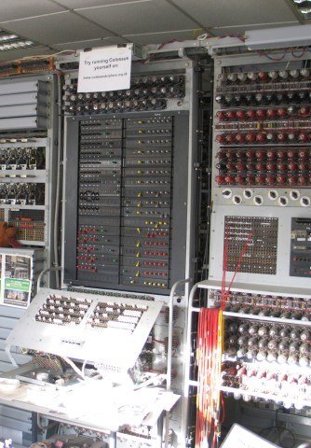
Is it possible to develop a system of information which can quickly and efficiently prove the falsehood of a conspiracy myth and replace it with reliable, dependable, information?
The Fair Machine
The Future of Combatting Conspiracy Theories will require AI
The concept of fairness
Notes:
Is it possible to develop a system of information which can quickly and efficiently prove the falsehood of a conspiracy myth and replace it with reliable, dependable, information? Proposal: The Fair Machine.^{[1]}
The Future of Combatting Conspiracy Theories will require AI
One might say that politics at each and every level revolves around the concept of fairness.
^{[1]} See: https://www.youtube.com/watch?v=pZii5NGi1to
Image: [[File:Colossus Computer, Bletchley Park - geograph.org.uk - 1590854.jpg|Colossus_Computer,_Bletchley_Park_-_geograph.org.uk_-_1590854]]

Slide 27
To treat people fairly, we presuppose that the information we act upon has been gathered from reliable, fair, and balanced sources. But what sources are considered ‘fair’?
An information system would need to be comprised of material and information gathered and distributed in as least a biased manner as possible.
A veil of ignorance
Notes:
The majority of humans tend to value highly the concept of fairness. But what is it to be fair? As members of society, how should we define, value, and act on the concept of fairness? Fairness does seem to be in many ways, one of the highest virtues in any given society because it is valued on so many levels by so many people. At what point would unfairness ever be considered virtuous? When we look at humanity as well as other species, we see that there is a fairness detector built into our perception and value of the actions of others. And so the concept of fairness seems to be ubiquitous among all cultures and throughout the animal kingdom as well.
In order to treat people fairly, we presuppose that the information we act upon has been gathered from reliable, fair, and balanced sources. But what sources are considered ‘fair’? What criteria need to be satisfied for us to consider that the information is indeed conducive to fairness? In other words, what kind of information source do we need in order to garner fairness? Could we devise and build a Fairness Machine? And if so, how would we do this?
First, to develop such a machine, we would need to clarify the concept of fairness. What is fairness? What would a fair society look like? How would it function? An information system would need to be comprised of material and information gathered and distributed in as least a biased manner as possible. So how do we do this? Something like a veil of ignorance must be built into the process to assure that the reduction of bias is secured in order to safeguard against collusion or slanting due to political interests and personal agendas.
Image: [[File:Computer Fosdic 1960 Census.jpg|Computer_Fosdic_1960_Census]]

Slide 28
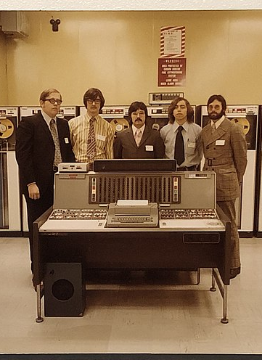
Safeguard against corruption of such a machine?
A least-biased information system (LBIS)
A base level of information which could provide politicians, administrators, etc., with a fair starting point in the consideration of bills, social policies,
Notes:
How do we safeguard against corruption of such a machine? A least-biased information system (LBIS) could become a starting point for providing the most epistemically-responsibly-attained information and evidence to inform those making policy decisions regarding the management of human and natural resources. It would become a base level of information which could provide politicians, administrators, etc., with a fair starting point in the consideration of bills, social policies, etc.
Image: [[File:IBM 7030 Stretch computer photo at National Cryptologic Museum.agr.jpg|IBM_7030_Stretch_computer_photo_at_National_Cryptologic_Museum.agr]]

Slide 29
The purpose of such a machine is the reduction of bias, vested interest, personal agendas, etc., in an effort to produce information which can be used to generate fair social policies.
Notes:
The idea is to create a machine that will produce information in an effort to arrive at resolutions to social issues in the least biased manner. And this is because more than any other virtue of human conception, fairness seems to garner, at least in principle, the greatest consensus of appreciation. We may not all agree with the results or consequences of a decision, policy, etc., but if they were arrived at in a perceived fair manner, we tend to have an easier time accepting them. The purpose of such a machine is the reduction of bias, vested interest, personal agendas, etc., in an effort to produce information which can be used to generate fair social policies. This is a project which begins with philosophers, political scientists, sociologists, economists, psychologists, etc., in discussing the concept of fairness in order to arrive at the most cogent definition we can attain and then radiates outward into the social and physical sciences.
Image:

Slide 30
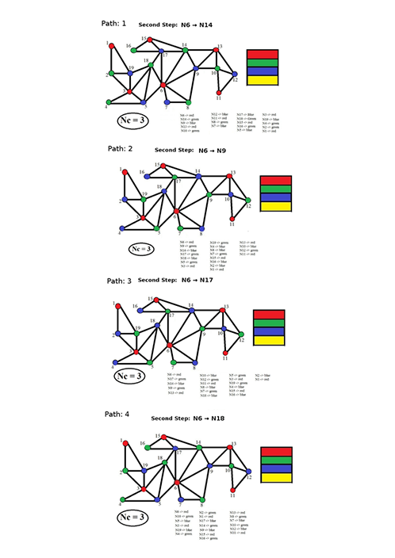
We have to limit humans in the fact-acquisition process
A machine which has no particular political leanings, no private or personal agendas, nothing to gain or lose, and one that acts on algorithmic principles which will generate ideas for further discussion in the least-biased manner possible
Notes:
If we truly value fairness, then it follows that we have to limit humans in the fact-acquisition process. At this point in our evolutionary history, we are simply too stupid, frail, and egomaniacal to be trusted with this type of procedure. Therefore, we need a machine which has no particular political leanings, no private or personal agendas, nothing to gain or lose, and one that acts on algorithmic principles which will generate ideas for further discussion in the least-biased manner possible. So we need to develop an information system or model which allows us to consider the fairest manner in dealing with the responsible management of human and natural resources.
Image: [[File:The trailing path algorithm. .png|The_trailing_path_algorithm._]]

Slide 31
This may be our best hope for the future of battling misinformation and conspiracy theories.
Notes:
We will not know whether or not such a machine is possible until we try. But I believe in the interest of fairness, we have an obligation to try. This may be our best hope for the future of battling misinformation and conspiracy theories.
Image: [[File:To Hope is to Embrace Uncertainty by Teo Georgiev for Fine Acts.png|To_Hope_is_to_Embrace_Uncertainty_by_Teo_Georgiev_for_Fine_Acts]]

Slide 32
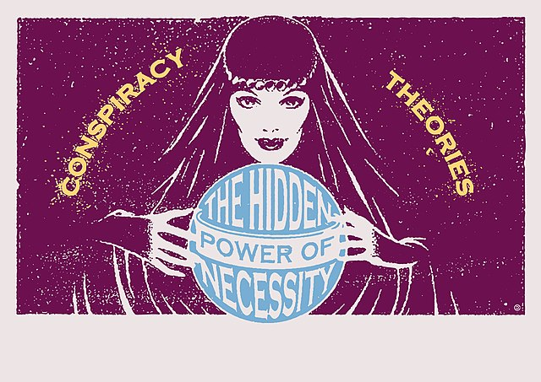
Next week’s lecture
The Conspiracy Theorist Spectrum Checklist

Slide 33
Q&A session
Pre-order How to Talk to Conspiracy Theorist at PDVERSE.com/conspiracy

Slide 34
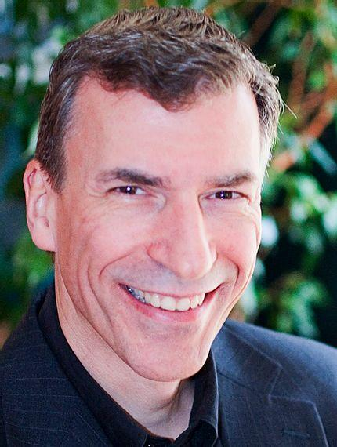
In collaboration with Pixel Dreams
pixeldreams.com
Thank you
Pre-order How to Talk to Conspiracy Theorist at PDVERSE.com/conspiracy
Christopher 'Doc' DiCarlo
Philosopher. Educator. Author.

