Slide 1
How to Talk to a Conspiracy Theorist
Lecture 07:
When to Stop Talking to a Conspiracy Theorist
---
DR CHRISTOPHER DICARLO

Slide 2
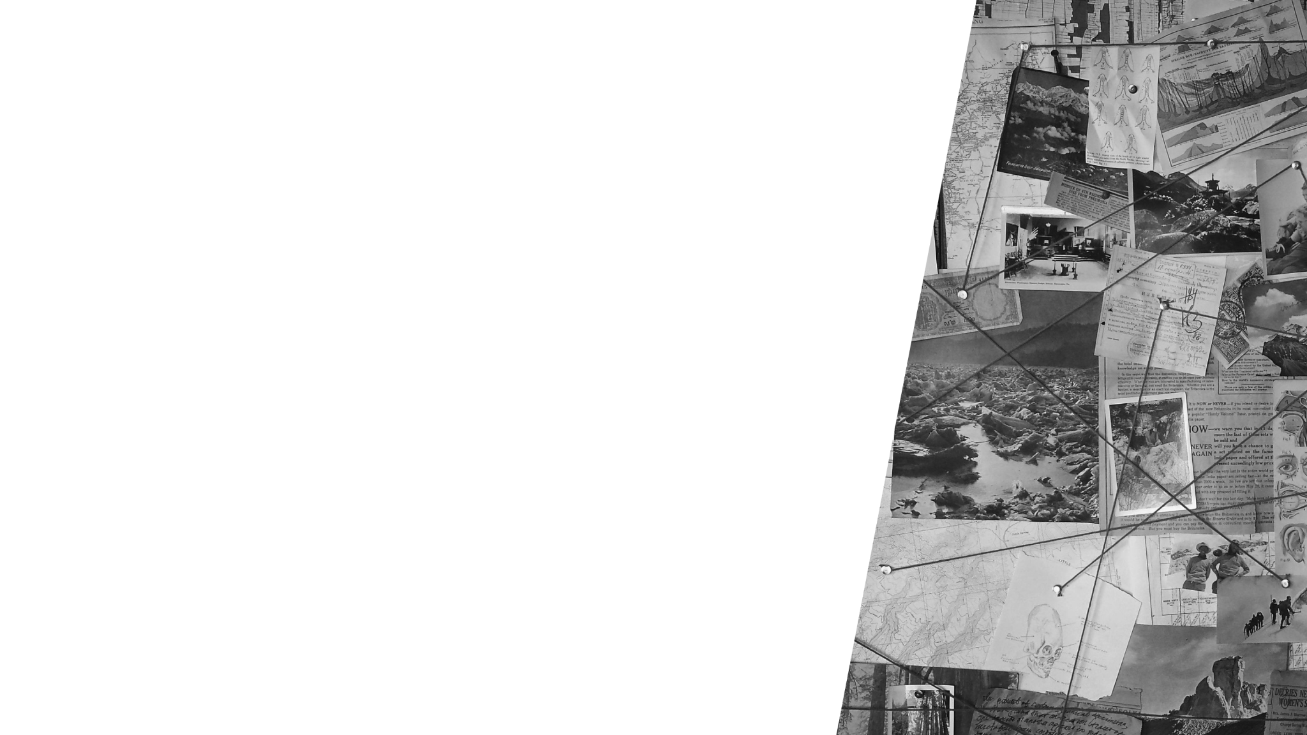
In collaboration with Pixel Dreams
pixeldreams.com
Branding & Marketing Agency in Toronto
Think Tank Raise I+C (intelligence and consciousness)

Slide 3
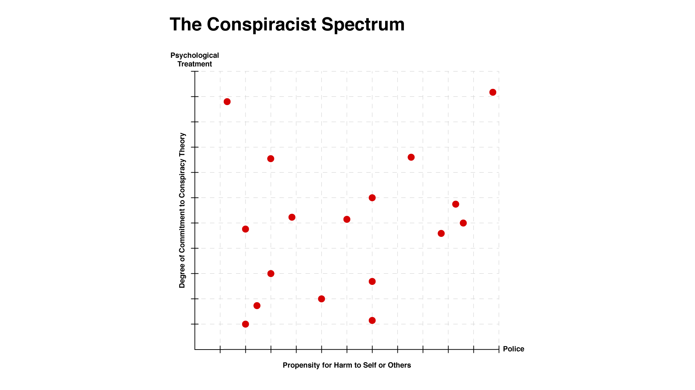
Notes:
Image: PDT.

Slide 4
Conspiracists vary in degree according to the seriousness with which they believe their conspiracy stories.
It is imperative that we know how to categorize our conspiracists if we wish to help them.

Slide 5
What happens when the conspiracists simply can't be reached?
Is it time to shut up and move on?
It depends...
Notes:
Image: [[File:Reaching out, Derry - Londonderry - geograph.org.uk - 142035.jpg|Reaching_out,_Derry_-_Londonderry_-_geograph.org.uk_-_142035]]

Slide 6
Notes:
Image: PDT.

Slide 7
Ethical problems
No magic formula
Avoiding the ‘Backfire Effect’
‘Doubling-down’
Notes:
Image: [[File:Wikimoji-Fast Down.svg|Wikimoji-Fast_Down]]

Slide 8
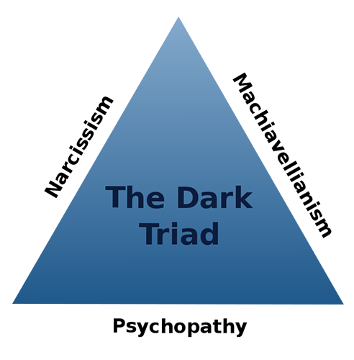
A seemingless endless loop of non-progression with your conspiracist
Narcissists
Not every narcissist is a psychopath; but every psychopath is a narcissist
Notes:
Image: [[File:The Dark Triad.svg|The_Dark_Triad]]

Slide 9
Determine the degree to which such mental health predispositions might lead to harmful behaviour.
Notes:
Image: [[File:Green-Thermometer.svg|Green-Thermometer]]

Slide 10
What type of narcissist is your conspiracist?
Grandiose and Vulnerable Narcissism
Grandiose narcissism
Narcissistic Personality Disorder (NPD)
Notes:
Image: [[File:Word Cloud NPD.png|Word_Cloud_NPD]]

Slide 11
A pervasive pattern of grandiosity in fantasy or behavior, a need for admiration, and a lack of empathy, beginning in early adulthood and present in a variety of contexts, as indicated by five (or more) of the following behavioral patterns:
Notes:
Tristan Harris goes so far as to say:
Even two friends who are so close to each other, who have almost the exact same set of friends, they think, you know, “I’m going to news feeds on Facebook. I’ll see the exact same set of updates.” But it’s not like that at all. They see completely different worlds because they’re based on these computers calculating what’s perfect for each of them.
This is how the process of the Internet further influences the proliferation of misleading information online. These self-learning algorithms have created the perfect environment for conspiracy theorists to meet and further network with like-minded individuals.
Image: [[File:Paily, M.U. Graphics on Artificial intelligence and Education.jpg|Paily,_M.U._Graphics_on_Artificial_intelligence_and_Education]]

Slide 12
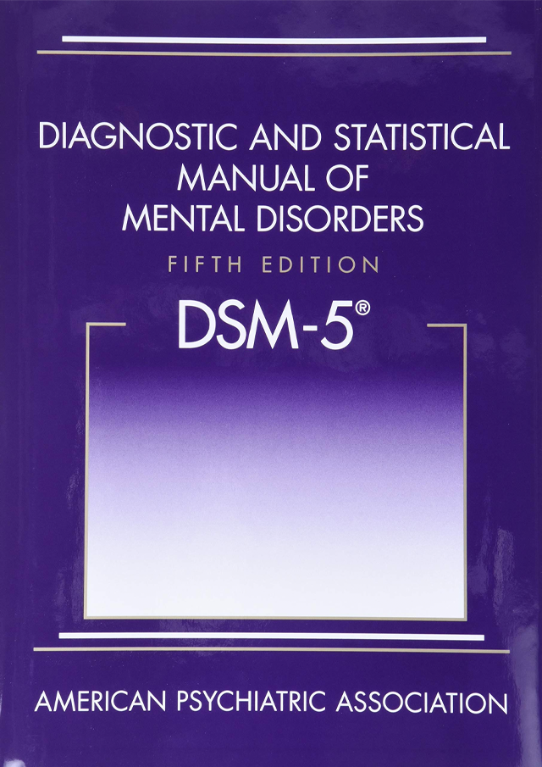
Grandiose sense of self-importance
Preoccupied with fantasies of unlimited success, power, brilliance, beauty, or ideal love
He or she is “special” and unique and can only be understood by, or should associate with, other special or high-status people
Notes:
Image: [[File:Dsm-5-released-big-changes-dsm5.jpg|Dsm-5-released-big-changes-dsm5]]

Slide 13
Requires excessive admiration
A sense of entitlement
Interpersonally exploitative
Lacks empathy
Envious
Arrogant
Requires excessive admiration
A sense of entitlement
Interpersonally exploitative
Lacks empathy
Envious
Arrogant
Notes:
Image: [[File:Signs of NPD.png|Signs_of_NPD]]

Slide 14
Notes:
Image: [[File:Donald J. Trump with Goya products on the Resolute Desk in the White House.jpg|Donald_J._Trump_with_Goya_products_on_the_Resolute_Desk_in_the_White_House]]

Slide 15
Dr. John Zinner
“The mental condition he suffers most from is formally known as a severe instance of narcissistic personality disorder”
“...the failure in childhood and beyond to develop an inner sense of worth or self-esteem”
“...makes one’s worth entirely dependent upon admiration from others.”
Notes:
Image: https://www.dailymail.co.uk/news/article-7758459/Trio-elite-psychiatrists-claim-Trump-showing-signs-delusion-amid-impeachment-inquiry.html

Slide 16
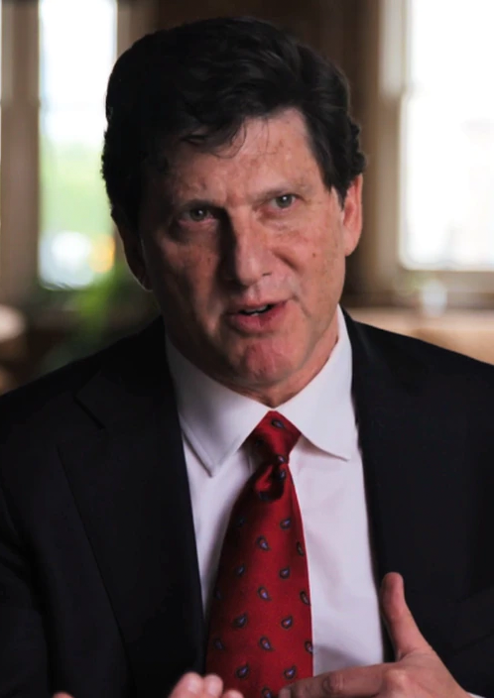
Malignant narcissism
Dr. John Gartner
“Trump suffers from malignant narcissism, a diagnosis [that is] far more toxic and dangerous than mere narcissistic personality disorder because it combines narcissism with three other severely pathological components: paranoia, sociopathy, and sadism. When combined, this perfect storm of psychopathology defines the ‘quintessence of evil,’ according to Fromm, the closest thing psychiatry has to describing a true human monster.”
Notes:
Image: https://www.psychologytoday.com/us/therapists/john-d-gartner-baltimore-md/60650

Slide 17
Narcissism (he knows “more about everything than anyone” and “has empathy for no one but himself”); paranoia (“his demonization of the press, minorities, immigrants, and anyone who disagrees with him, are all signs of paranoia”); sociopathy (“a diagnosis that describes people who constantly lie, violate norms and laws, exploits other people, and show no remorse”); and sadism (“He takes gleeful pleasure in harming and humiliating other people. He is undoubtedly the most prolific cyberbully in history.”)
Notes:
Image: [[File:Inaugural parade Donald Trump and Melania Trump 01-20-17.jpg|Inaugural_parade_Donald_Trump_and_Melania_Trump_01-20-17]]

Slide 18
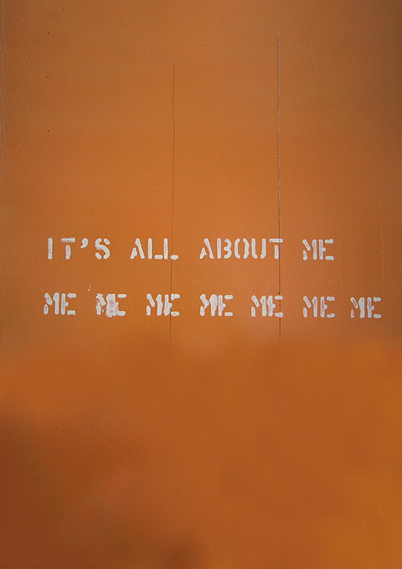
Vulnerable narcissism
6 common characteristics:
An introverted personality
A neurotic personality
Thrive on attention and accolade
Prone to feelings of shame
Blame others for your mistakes
Take but rarely give
Notes:
Image: [[File:London2007 img 5450.jpg|London2007_img_5450]]

Slide 19
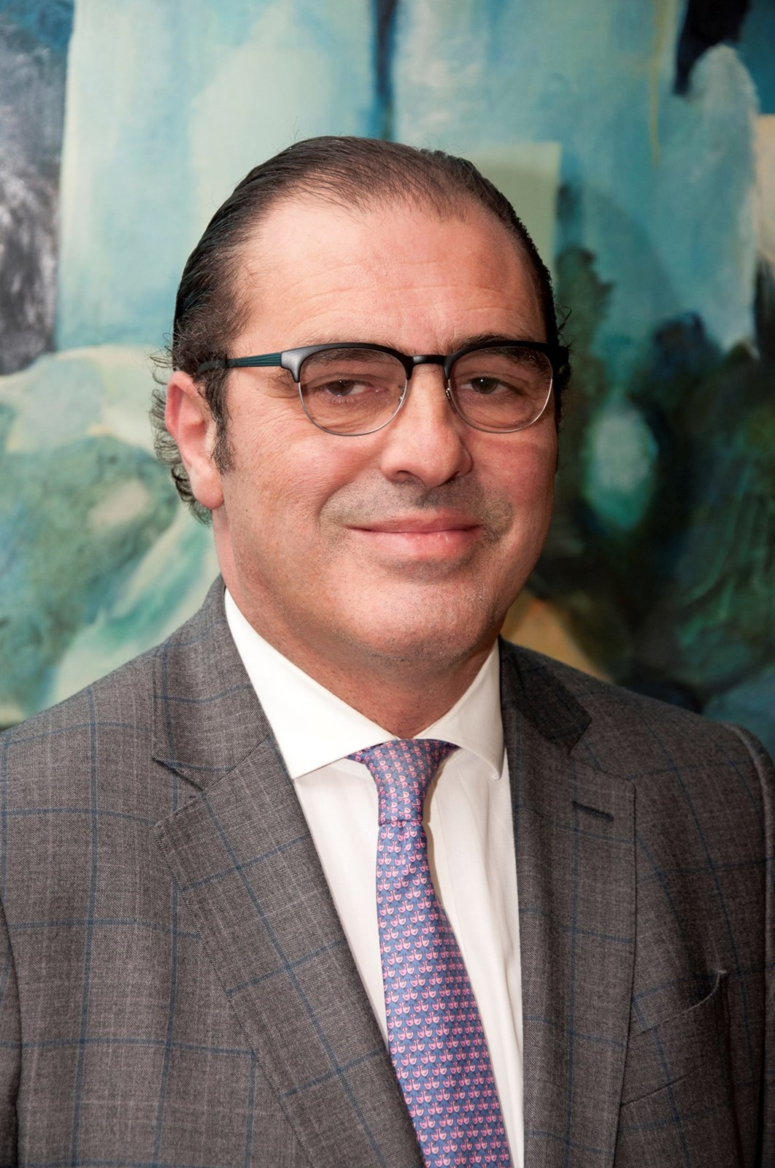
Jose Romero-Urcelay
Forensic psychiatrist, Director of therapies at the Dangerous and Severe Personality Disorders unit at Broadmoor, West London Mental Health Trust:
Pathological narcissists are drawn to careers in finance, law and politics...Those with personality disorders are exploitative, and likely to cause significant distress to others
Notes:
Image: https://jose-romero-urcelay.muchloved.com/v

Slide 20
The narcissist’s insatiable quest for attention…leads him or her to seek out a steady source of admiration. Where that is in short supply, the narcissist prefers to inspire fear or hatred than suffer the nightmare of being ignored. And unable to empathize, they are indifferent to the consequences of hurting people.
Consider when it’s worth our while to continue having discussions with a narcissistic conspiracist, or to simply move on.
Dr. Les Carter and Dr. Todd Grande
Notes:
Image: [[File:LOE3.jpg|LOE3]]

Slide 21
Video: How To Argue (But Not Fight) With A Narcissist (Dr. Les Carter)
Overall message: When dealing with a conspiracist who is narcissistic, the consensus appears to be as follows:
Don’t try to win an argument
Be calm and secure in what you believe
Don’t let them pull you into their game
Be clear and assertive
End the conversation i.e. shut up
Move on
Notes:
Image: https://www.pinterest.ca/pin/180284791322486890/

Slide 22
Interesting note 1: Online messaging refers to narcissists as ‘narcs’
Interesting note 2: A common theme from online messaging of those who are in relationships with narcissists is that they often attempt to ‘gaslight’ their partners i.e. make it seem like they’re the ones who don’t see things properly
Notes:
Image: [[File:Gaslight 1944 trailer(4).jpg|Gaslight_1944_trailer(4)]]

Slide 23
Interesting note 3: Most online messaging attributes narcissism to male partners
Interesting note 4:They convince through manipulation and intimidation
Narcissistic personality disorder demographics:
Approximately 0.5% of the United States population, or one 1 in 200 people, has the disorder
Narcissistic Abuse Affects Over 158 Million People in the U.S.
Notes:
Image: [[File:Abercrombie & Fitch Model 10.jpg|Abercrombie_&_Fitch_Model_10]]

Slide 24
Interesting note 5: Most professional advisers online have what seems to be a disdain for such people. But to what extent are such people in control of their behaviour? The advice is largely on how to deal with them in a passive-aggressive manner. Are there other ways? Have we exhausted all avenues before we are forced to keep quiet?
Notes:
Image: [[File:Marionettes (1934).jpg|Marionettes_(1934)]]

Slide 25
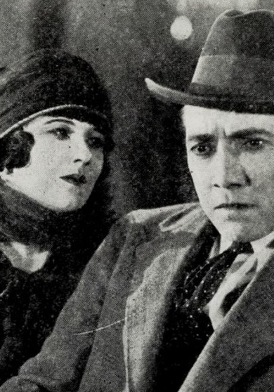
Deeper philosophical questions
If we discover at some point in the future that people like narcissistic conspiracists who possess specific types of biological biases tend to behave in ways that are generally harmful to others, what should we do?
Notes:
Image: [[File:Capital Punishment (1925) - 2.jpg|Capital_Punishment_(1925)_-_2]]

Slide 26
Do we simply accept that such people will always exist and will generate harm? It would be cruel and inhumane to morally blame someone for their genotype
Do we try to identify them early and guide them in less-harmful directions? “Hey, you don’t care too much about others, so...we’re going to have you work at the DMV.”
Notes:
Image: [[File:Schenectady County Department of Motor Vehicles.jpg|Schenectady_County_Department_of_Motor_Vehicles]]

Slide 27
Do we terminate them?
Would the world not generally be a better place with fewer humans who possess specific genes expressing for conspiracist traits such as narcissism, sociopathy, psychopathy, etc?
Notes:
Image: [[File:Capital Punishment (1925) - 3.jpg|Capital_Punishment_(1925)_-_3]]

Slide 28
Can they be reformed?
Do we ‘reform’ them at the biological i.e. genetic-neural level?
Or do we simply try to use behavioural conditioning which, to many psychologists, doesn’t work?
What if we could use a form of CRISPR Cas-9 gene therapy to ‘cut out’ the nasty bits and replace them with sunshiny moral bits?
Do we isolate them?
Put them on an island of misfit moralities?
Notes:
Image: [[File:Clockwork Orange Trailer poster.png|Clockwork_Orange_Trailer_poster]]

Slide 29
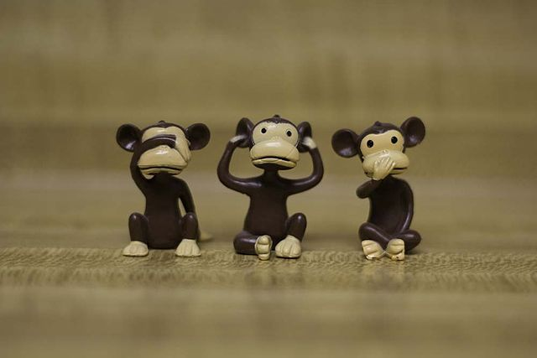
If your conspiracist is at the more dangerous end of the spectrum, the time for conversation has probably been over for a while.
Now you are faced with a much more daunting task: how to deal with someone who simply won’t listen and who has a potentially destructive personality.
Notes:
We will not know whether or not such a machine is possible until we try. But I believe in the interest of fairness, we have an obligation to try. This may be our best hope for the future of battling misinformation and conspiracy theories.
Image: [[File:To Hope is to Embrace Uncertainty by Teo Georgiev for Fine Acts.png|To_Hope_is_to_Embrace_Uncertainty_by_Teo_Georgiev_for_Fine_Acts]]

Slide 30
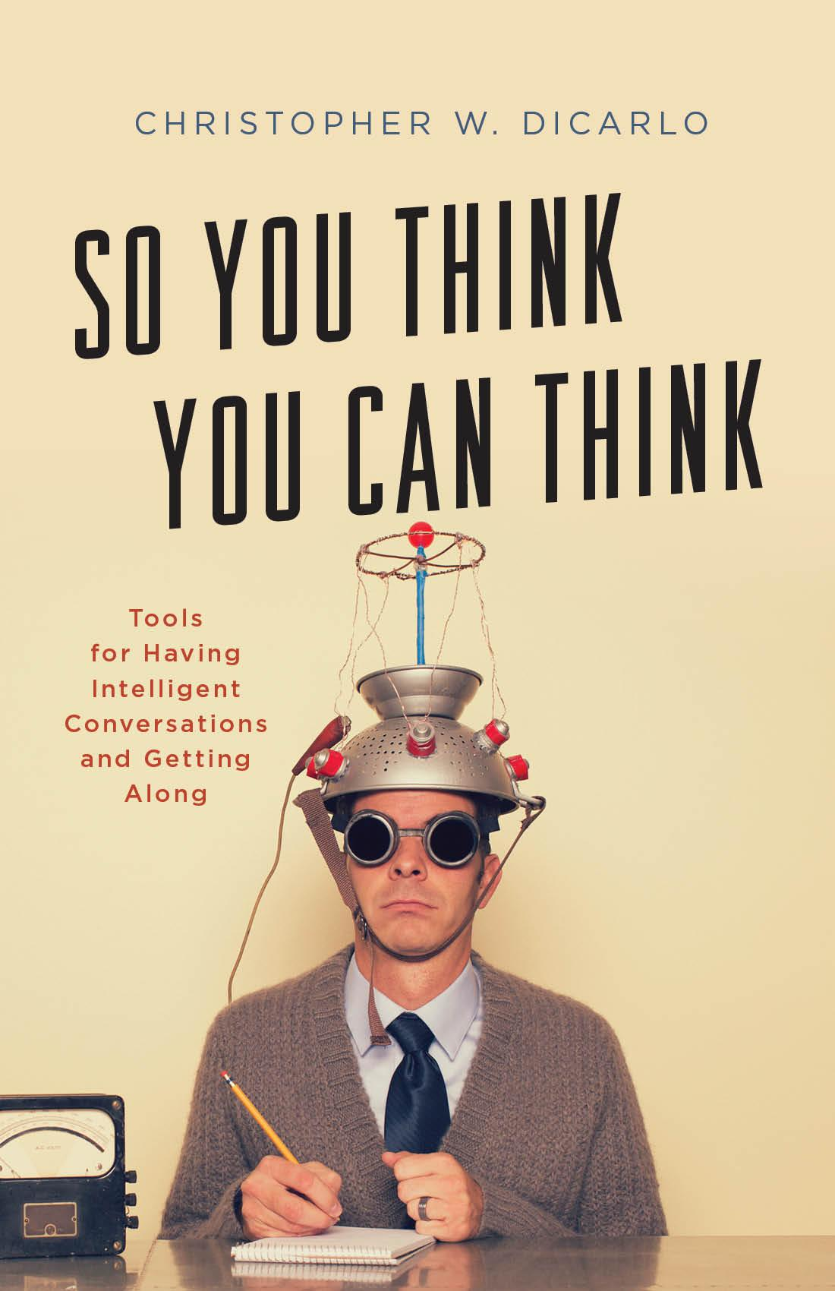
Conclusion
It will be sound Critical Thinking skills, education, and good policy decisions which will aid us in battling misinformation and conspiracy theories in the future.
Let us be cautiously optimistic that there are enough good minds out there to make this a reality.

Slide 31
Q&A session
Pre-order How to Talk to Conspiracy Theorist at PDVERSE.com/conspiracy

Slide 32
In collaboration with Pixel Dreams
pixeldreams.com
Thank you
Pre-order How to Talk to Conspiracy Theorist at PDVERSE.com/conspiracy
Christopher 'Doc' DiCarlo
Philosopher. Educator. Author.

